Slide 1
Methods
Developing Bias-Adjusted Downscaled Climate Projections for the Panj-Amu River Basin
Presented by: Meridel Phillips (SciSpace, LLC)
Alex Ruane, Manishka De Mel and Jennifer Evans
NASA GISS and Columbia University
June 2022

Slide 2
Our Approach
Combine the most useful pieces of information from different datasets to create a consolidated dataset that is suitable and allows an exploration of key uncertainties.
Understand present climate
- focus on fine-scale patterns
Future projections connected to the present reality
- captures climate changes but maintains overall pattern of fine-scale climate features important to ecosystems
Capture range of future projections
- focus on climate changes
Underlying climate projections from CORDEX-Core South Asia
8 combinations of global (GCM) and regional (RCM) climate models from CMIP5
Spatial resolution of 0.22 degrees (~22 km x 22 km)

Slide 3
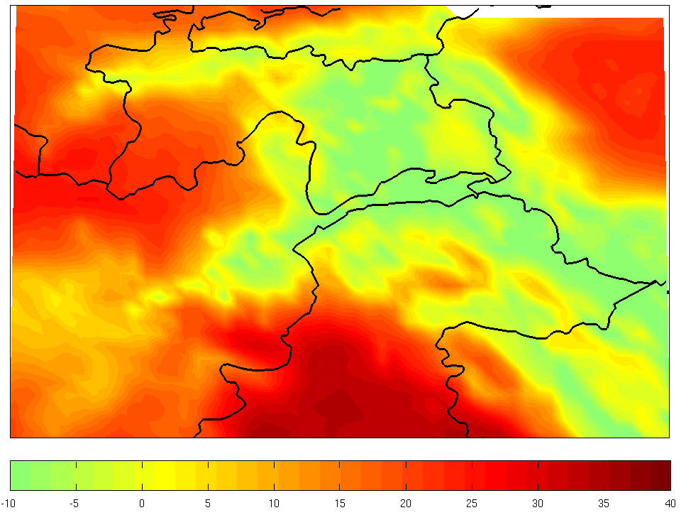
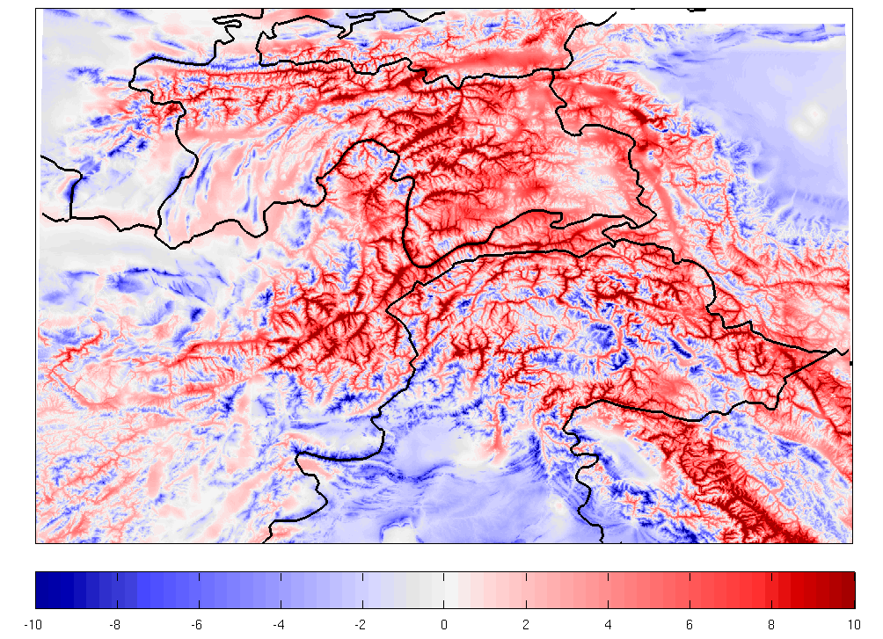
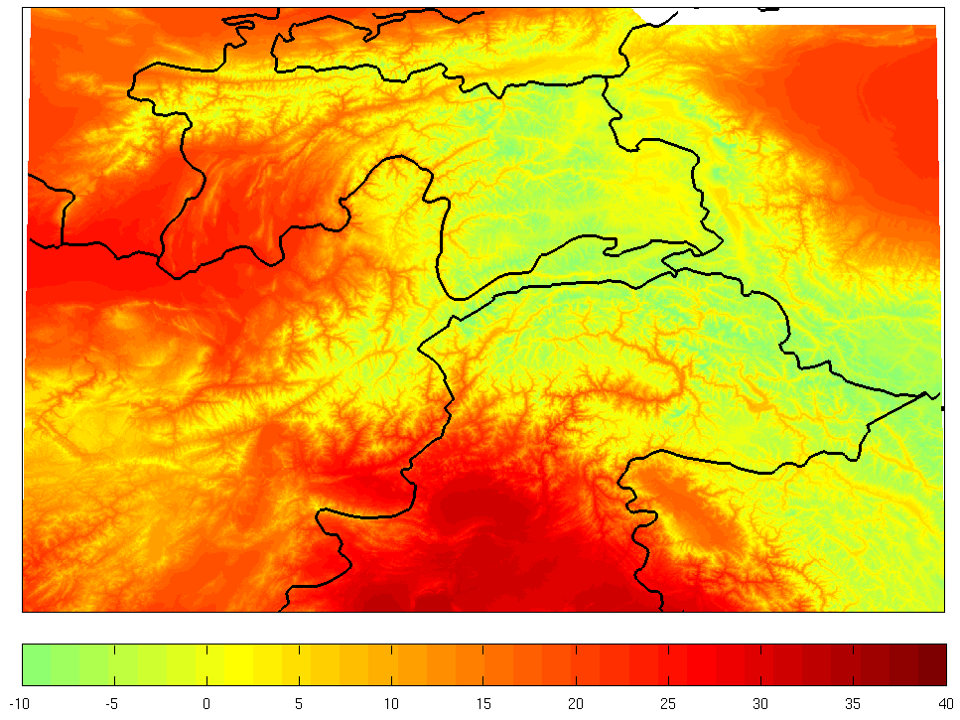
Temperature Overview
Target dataset for bias adjustment: CHELSA climatology* on 1km spatial resolution (1979-2013)
Sample Month (May) of Mean Temperature in MPI-ESM-LR REMO2015
Raw CORDEX-Core
Correction Value
Bias-Adjusted CORDEX-Core
CORDEX-Core Temperature (C)
CHELSA Temperature – CORDEX-Core Temperature
Bias-Adjusted CORDEX-Core Temperature (C)
*Karger, D.N., Conrad, O., Böhner, J., Kawohl, T., Kreft, H., Soria-Auza, R.W., Zimmermann, N.E., Linder, H.P. and Kessler, M., 2017. Climatologies at high resolution for the earth’s land surface areas. Scientific data, 4, p.170122.

Slide 4
Temperature Bias-Adjustment
Re-gridding: CORDEX-Core model outputs linearly interpolated onto a 30 arcsec grid to match CHELSA
Future Outputs
(RCP2.6, RCP8.5; to year 2099)
Historical Outputs
Bias-adjustment Calculation:
Monthly correction value calculated for Maximum, Minimum, and Average temperature
Historical Comparison
CORDEX-Core climatology (lower resolution) and CHELSA climatology (higher resolution)
for 1979-2013
Calculate Bias:
CORDEX-Core outputs subtracted on a monthly scale from the CHELSA climatology for the same period
Bias-adjustment Application:
Monthly adjustment added to each corresponding month in CORDEX-Core for the full 1979-2099 period
Final Product:
High-resolution monthly time series for each GCM-RCM combination at 30 arcsec grid

Slide 5
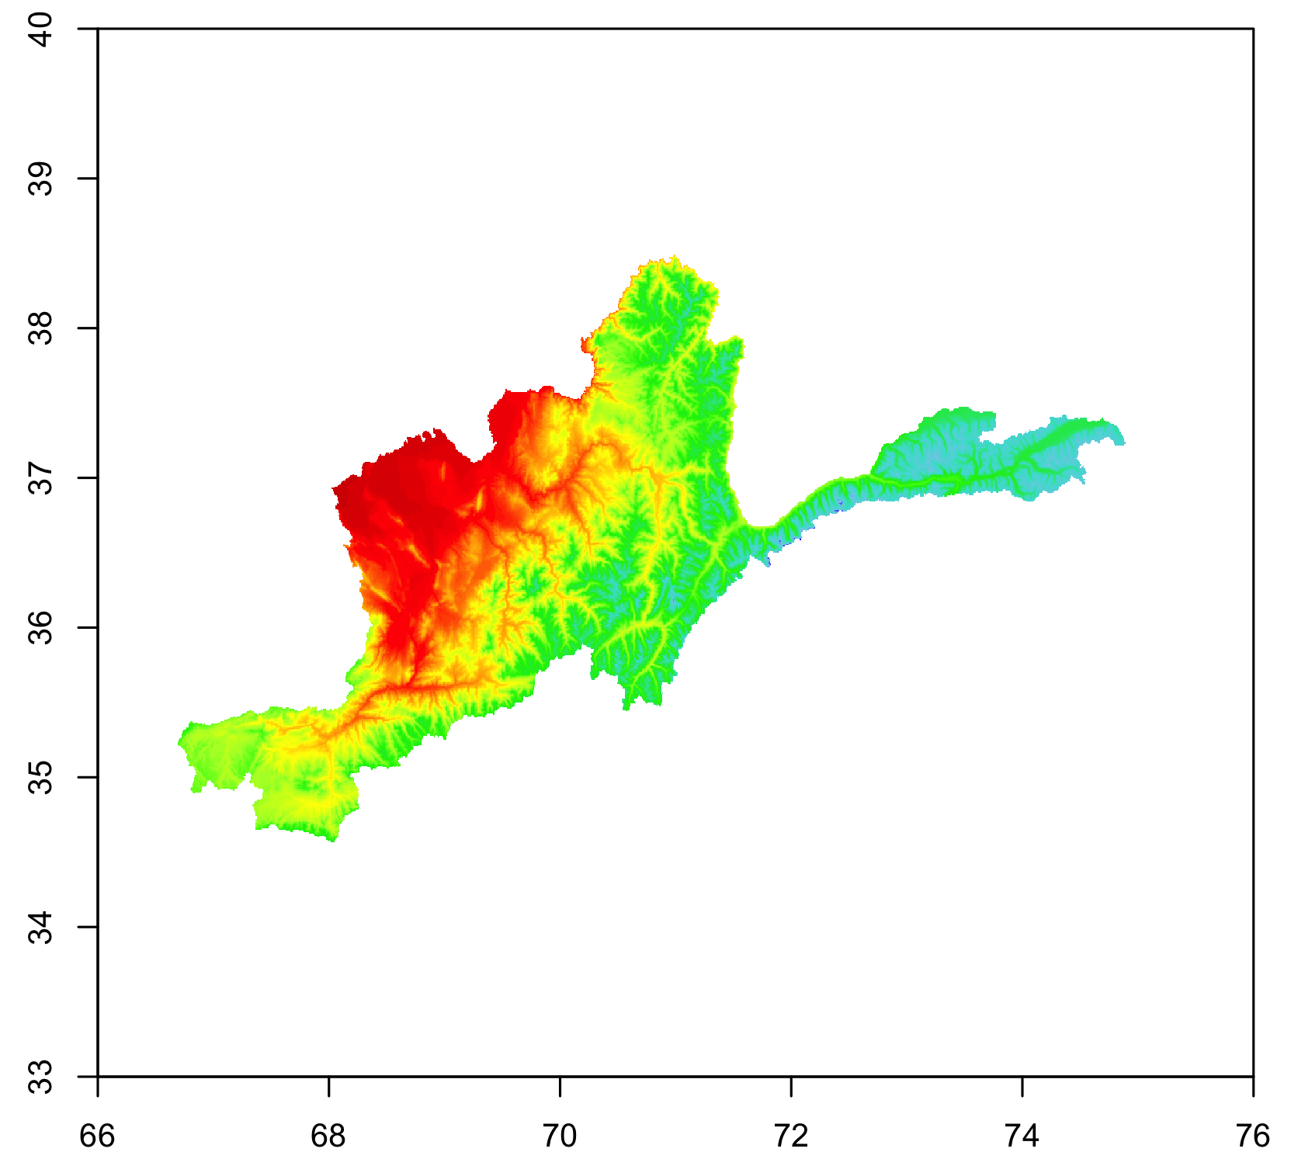
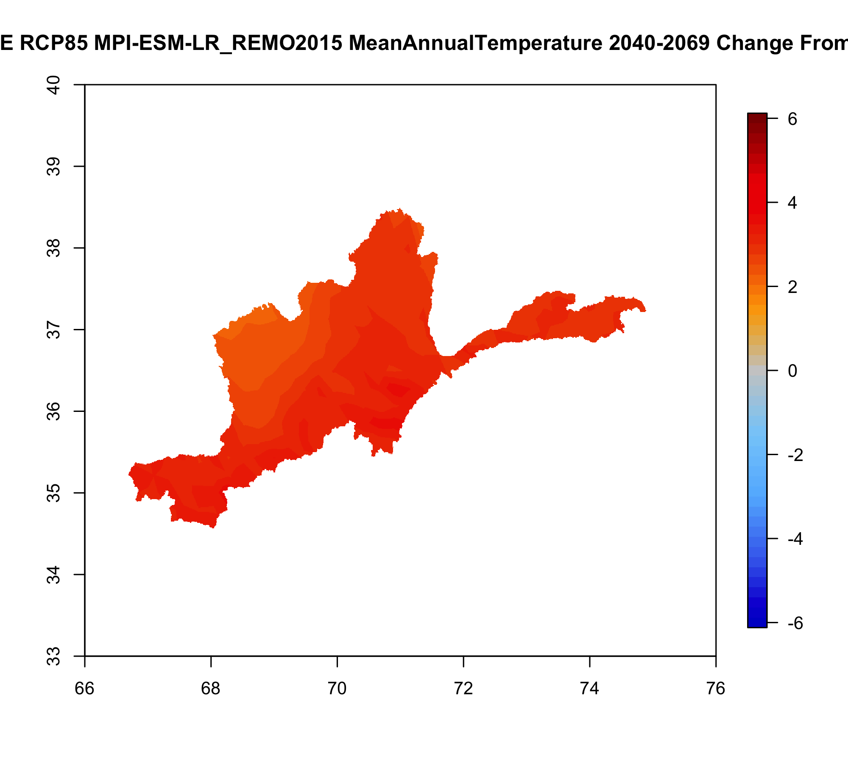
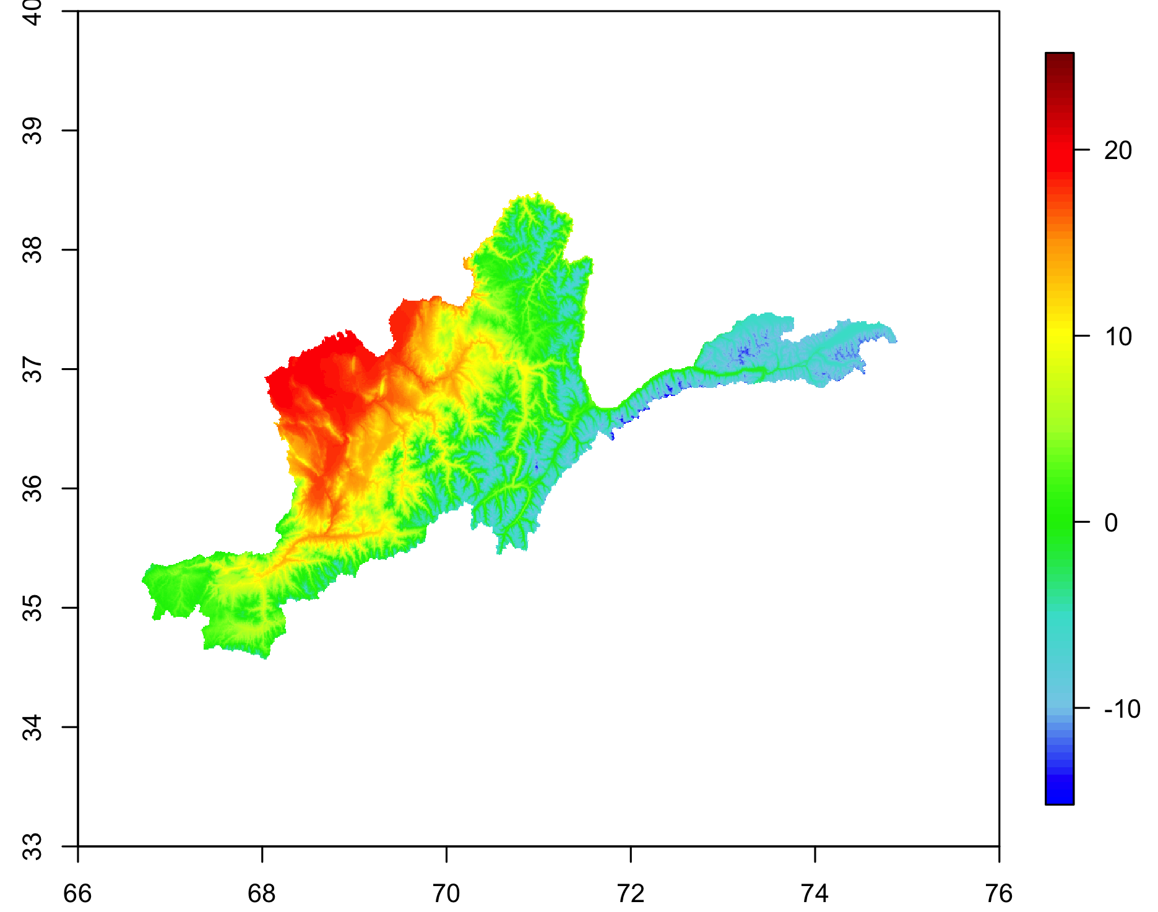
Temperature Outputs
Preservation of CORDEX-Core projected temperature changes with high-resolution spatial detail
MPI-ESM-LR REMO2015
Mean Annual Temperature
1980-2009 (Baseline)
MPI-ESM-LR REMO2015
Mean Annual Temperature
2040-2069 (Mid-Century) RCP8.5
MPI-ESM-LR REMO2015
Change in Mean Annual Temperature Between Baseline and Mid-Century
℃
℃

Slide 6
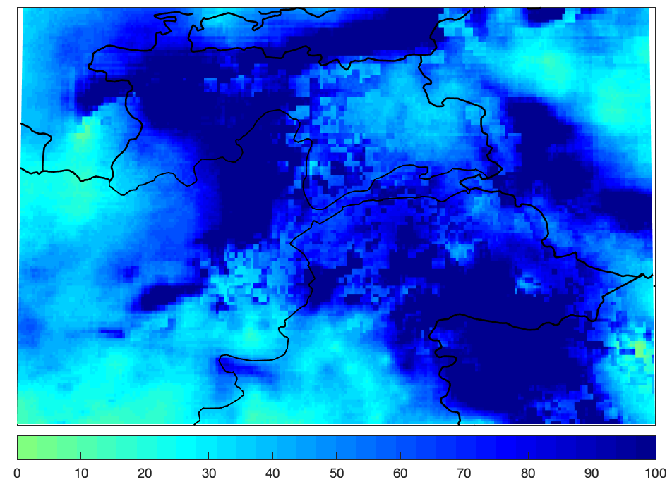
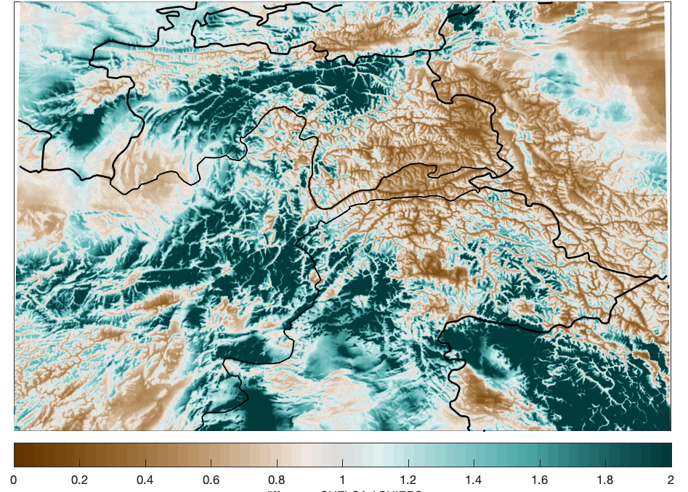
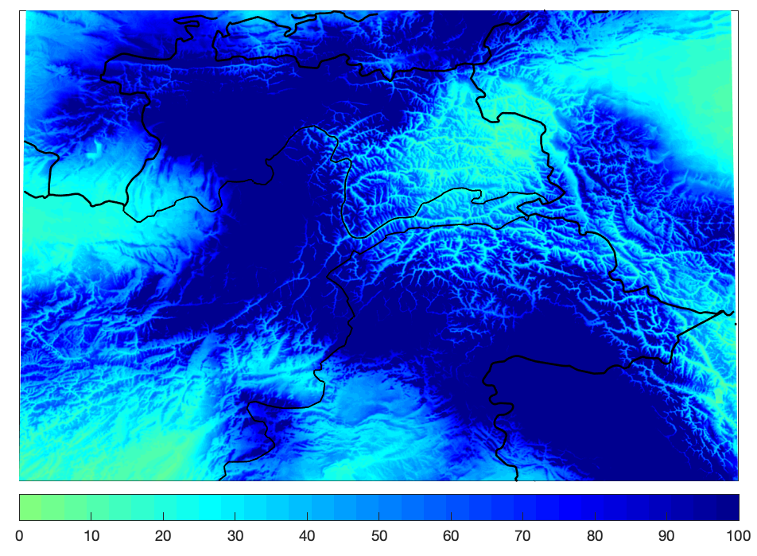
Creating a Precipitation Target Dataset
Target dataset for bias adjustment: CHELSA climatology on 1km spatial resolution (1979-2013) combined with CHIRPS satellite and model product* on 0.05-deg spatial resolution (1981-2019)
Sample Month (May) of Total Precipitation in CHIRPS
Raw CHIRPS
Correction Ratio
Bias-Adjusted CHIRPS (“CHIRPS+”)
CHIRPS Precipitation (mm)
CHELSA Precipitation /
CHIRPS Precipitation
CHIRPS+ Precipitation (mm)
*Funk, C., Peterson, P., Landsfeld, M., Pedreros, D., Verdin, J., Shukla, S., Husak, G., Rowland, J., Harrison, L., Hoell, A. and Michaelsen, J., 2015. The climate hazards infrared precipitation with stations—a new environmental record for monitoring extremes. Scientific data, 2(1), pp.1- 21.

Slide 7
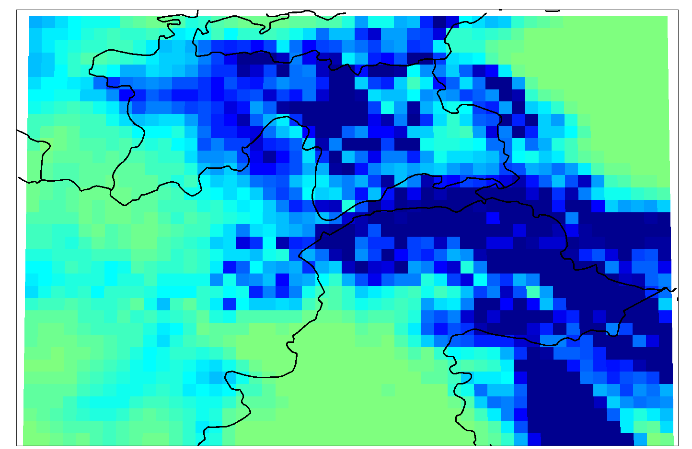
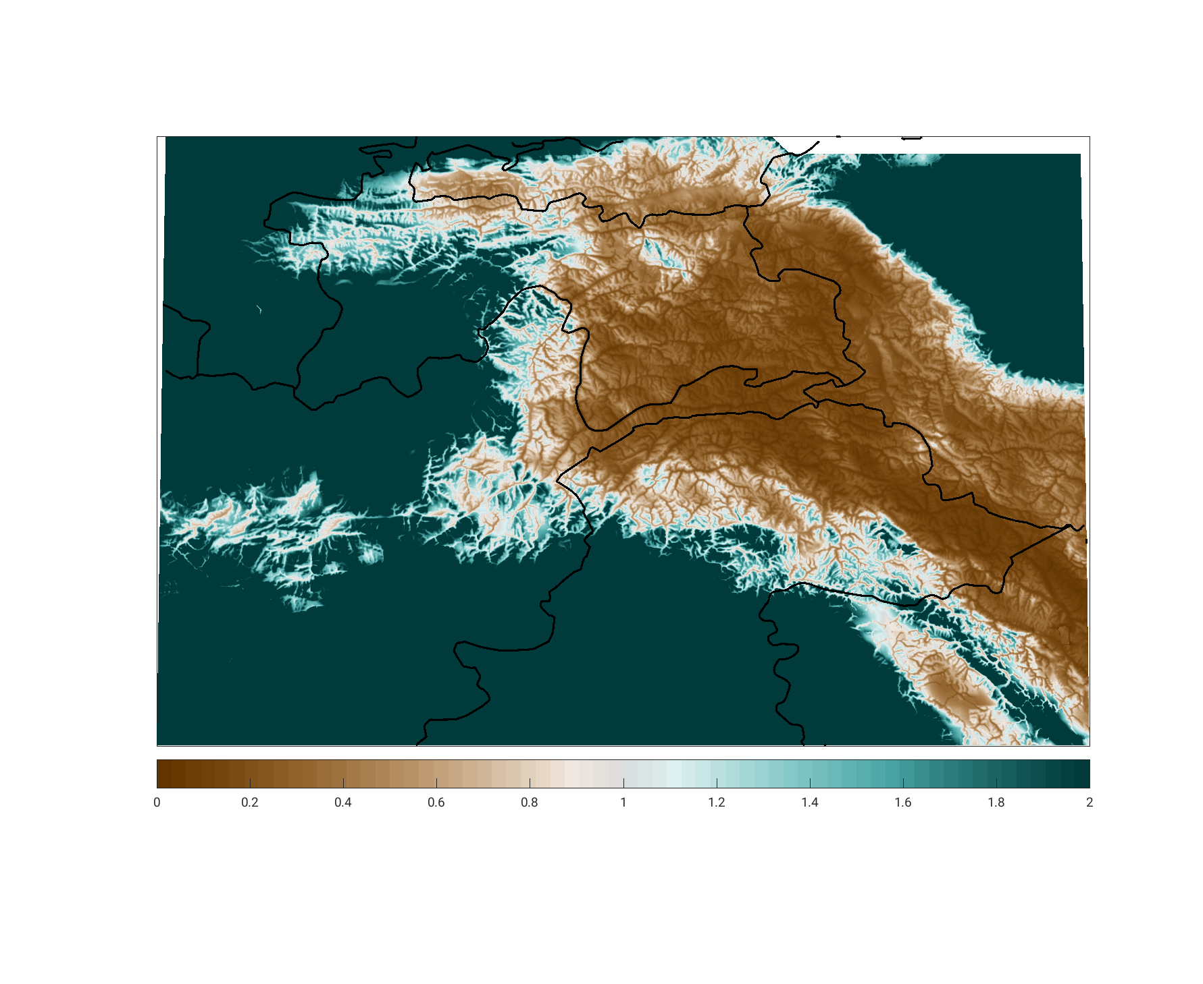
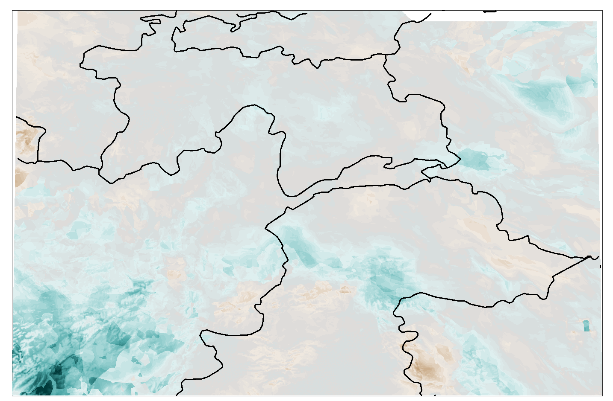
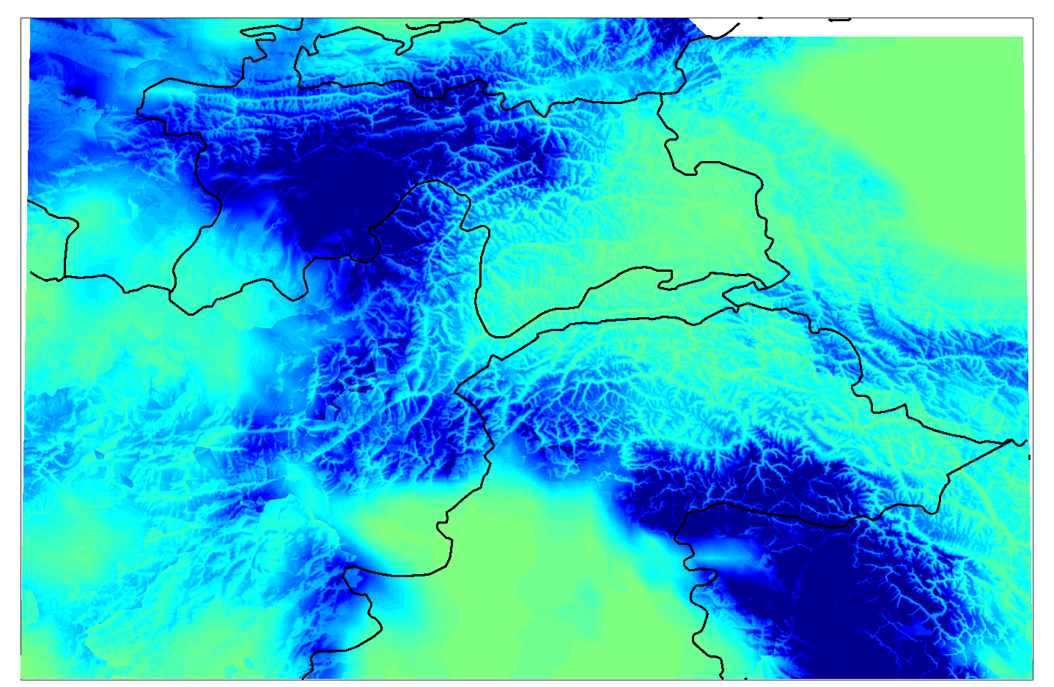
Precipitation Overview
Target dataset for bias adjustment: CHIRPS+ on 1km spatial resolution (1981-2019)
Split into four quantiles per month for better preservation of precipitation distribution
Additional step of decadal correction to preserve original CORDEX-Core climate changes
Sample Month (May) of Total Precipitation in MPI-ESM-LR REMO2015
Correction Ratio
for Sample Quantile
Bias-Adjusted CORDEX-Core
Raw CORDEX-Core
Decadal Correction Factor
CORDEX-Core Precipitation (mm)
CHIRPS+ Precipitation /
CORDEX-Core Precipitation
Factor
Bias-Adjusted CORDEX-Core Precipitation (mm)

Slide 8
Precipitation Bias-Adjustment
Observational data sources:
CHELSA precipitation – monthly climatology
Climate Hazards group InfraRed Precipitation with Station data (CHIRPS) – daily time series
Regridding climate model outputs:
CORDEX-Core model outputs linearly interpolated onto a 30 arcsec grid to match CHELSA
Temporal Scaling:
CHIRPS aggregated to monthly means
CHIRPS+ Dataset:
This 30 arcsec CHIRPS dataset serves as the target for CORDEX-Core precipitation bias adjustment
Historical
Future
Re-gridding:
CHIRPS data linearly interpolated onto a 30 arcsec grid to match CHELSA
Decadal Correction:
Each future month and decade is adjusted according to CORDEX-Core original changes
Quartile Bias Calculation:
Ratio calculated for each month depending on four portions of monthly precipitation distribution
Observational bias-adjustment:
Monthly ratio applied to impose CHELSA monthly climatology on CHIRPS monthly precipitation
Bias-adjustment:
Each historical and future month is adjusted according to quartile bias ratio
Final Product:
High-resolution monthly time series for each GCM-RCM combination at 30 arcsec grid

Slide 9
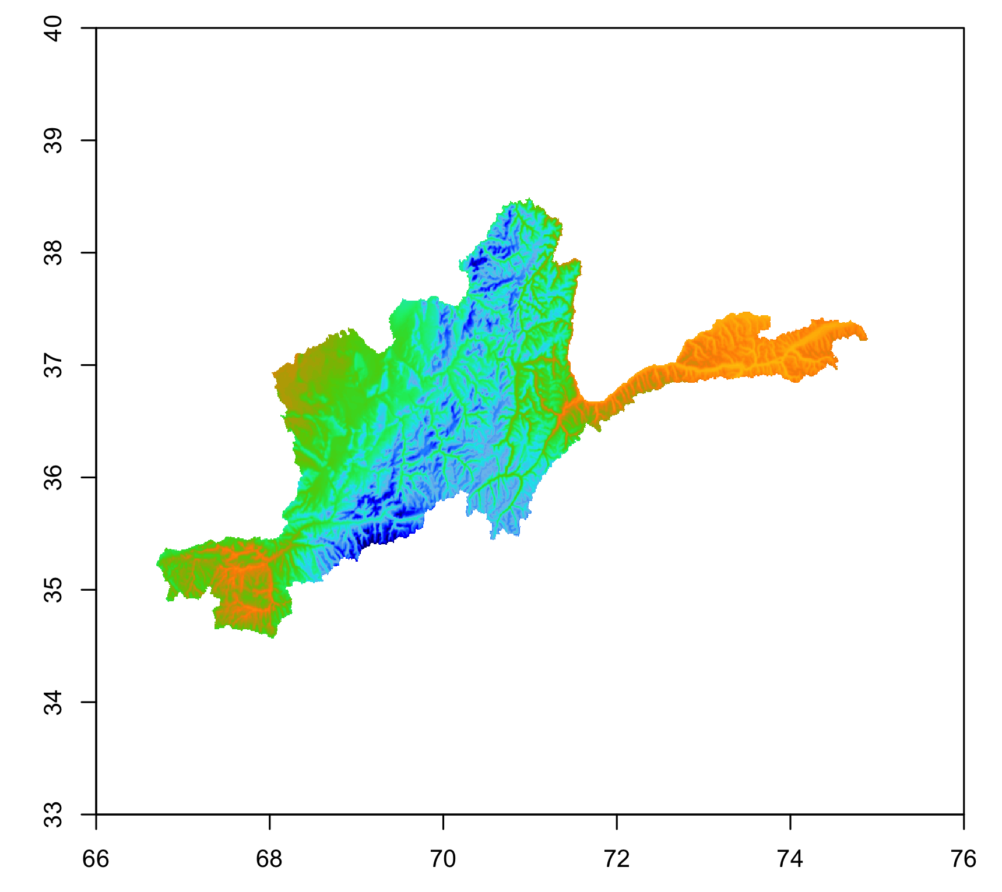
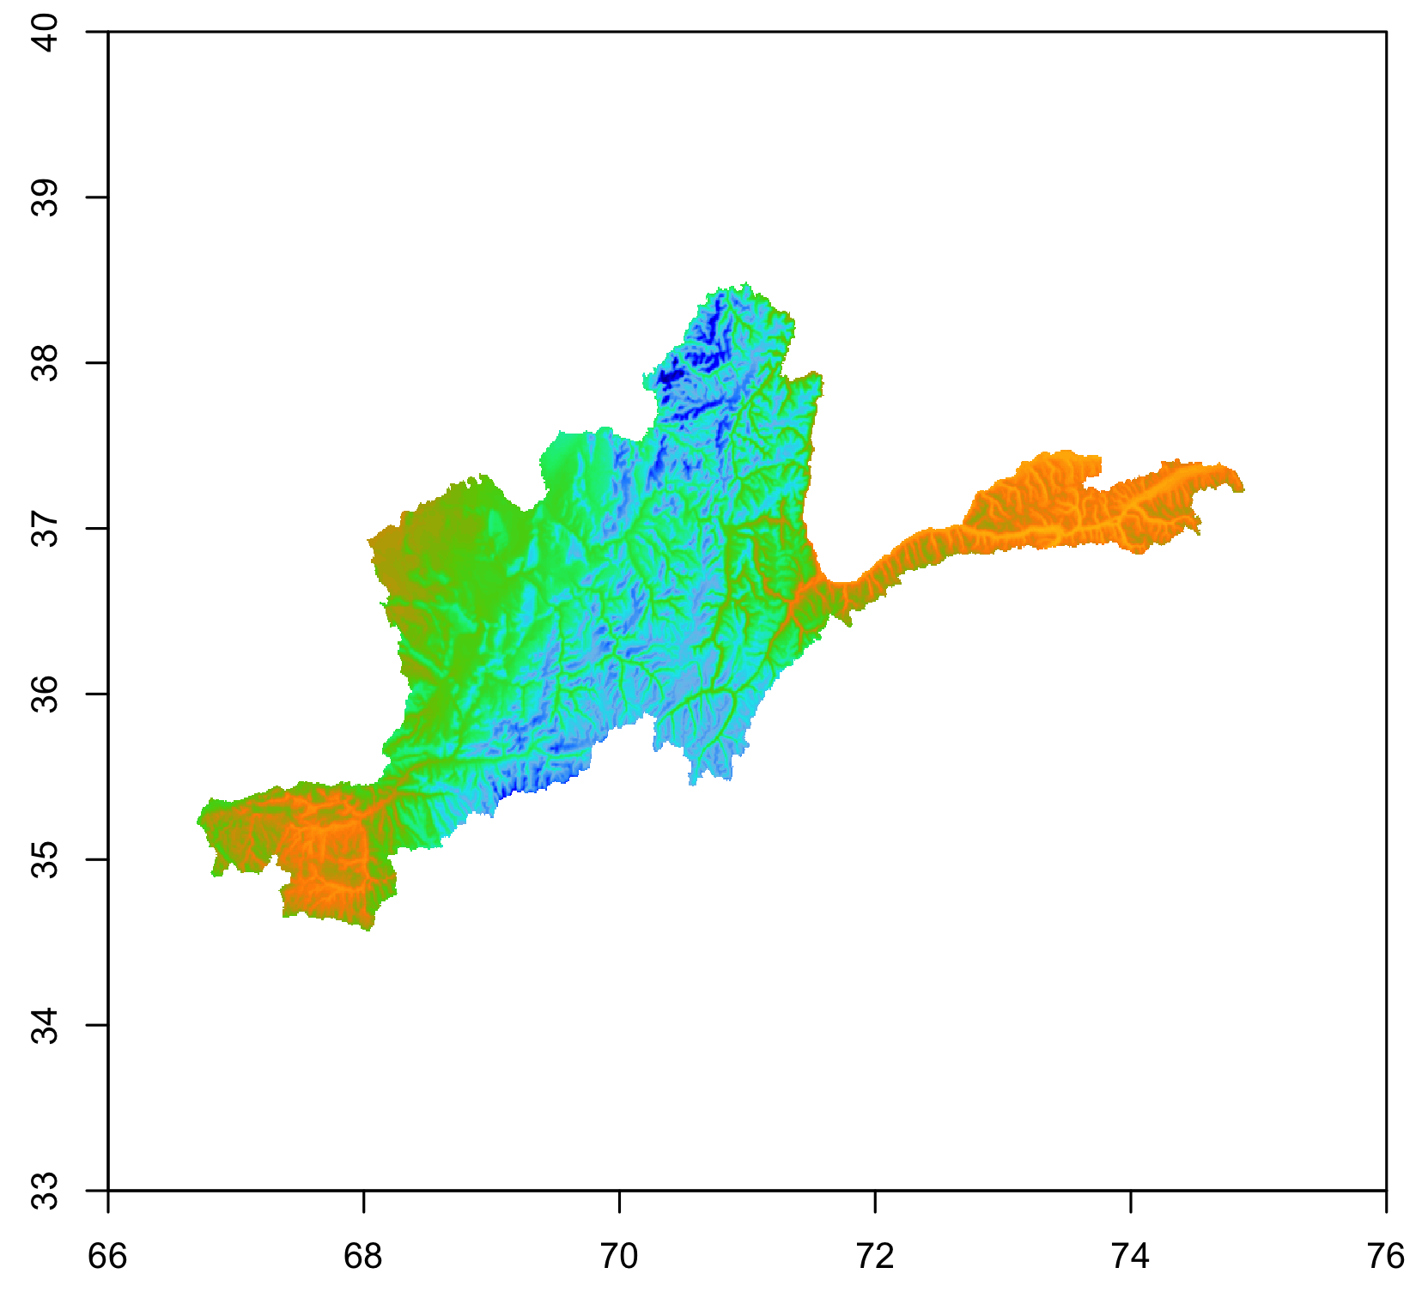
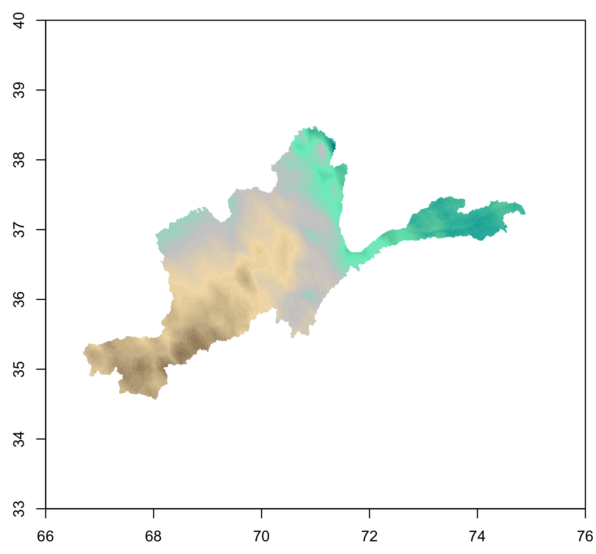
Precipitation Outputs
Preservation of CORDEX-Core projected precipitation changes across distribution of precipitation values with high-resolution spatial detail
MPI-ESM-LR REMO2015
Total Annual Precipitation
1980-2009 (Baseline)
MPI-ESM-LR REMO2015
Total Annual Precipitation
2040-2069 (Mid-Century) RCP8.5
MPI-ESM-LR REMO2015 Change in
Total Annual Precipitation Between Baseline and Mid-Century
mm/yr
%

Slide 10
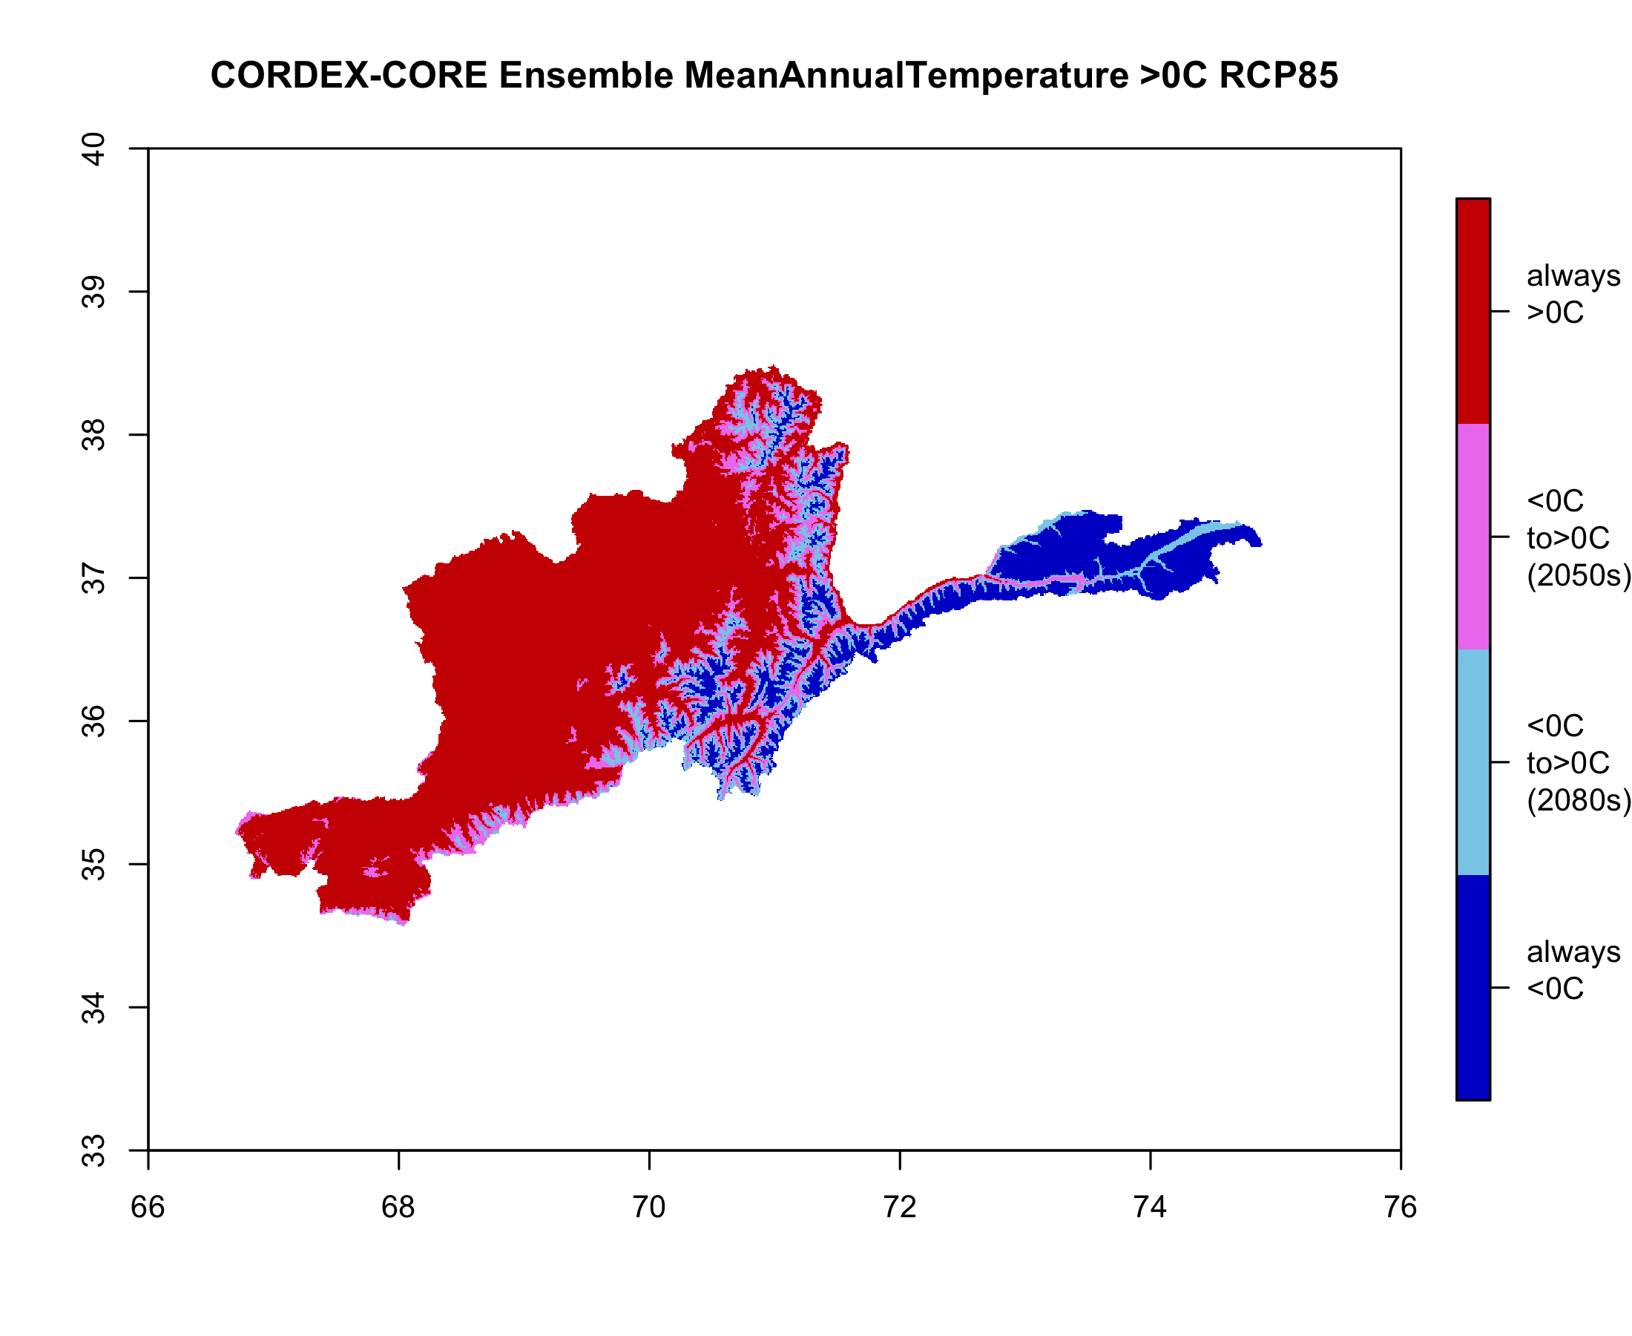
Potential Applications
Species and ecosystem modeling
Bioclimatic variables developed from monthly bias-adjusted temperature and precipitation
Hydrological or crop modeling
Daily variables at hydrological sites using bias-adjusted temperature and precipitation or direct (non-bias-adjusted) solar radiation, wind speed and humidity
Hazard metrics
Calculate metrics for various hazards using monthly bias-adjusted (1km resolution) or daily non-bias-adjusted (22km resolution) CORDEX-Core data
Caveats and limitations
Climate models contain uncertainties and should be treated as ensemble of projected futures
Use in conjunction with scenario-planning methods to manage the risks inherent in future climate
CORDEX-Core Ensemble Mean Change in Permafrost Line (Mean Annual Temperature > 0C)
always above 0C
rises above 0C in 2050s
rises above 0C in 2080s
always below 0C

Slide 11
Conclusions
Bias-adjusted temperature and precipitation products combine high-resolution observational data with global and regional climate model projections
Final product for each GCM-RCM for all climate variables is a 1-km, monthly climate projection from 1979 to 2099 under two future scenarios
Original changes in CORDEX-Core are preserved while raw output is downscaled to show topographical detail
Bias-adjusted outputs can be used in many applications although should be treated as ensemble of possible outcomes with inherent uncertainty

