Slide 1
Climatic Hazards
Project on
Climate Projections for the Panj-Amu River Basin
Presented by: Alex Ruane
Manishka De Mel, Meridel Phillips and Jennifer Evans
NASA GISS and Columbia University
June 2022

Slide 2
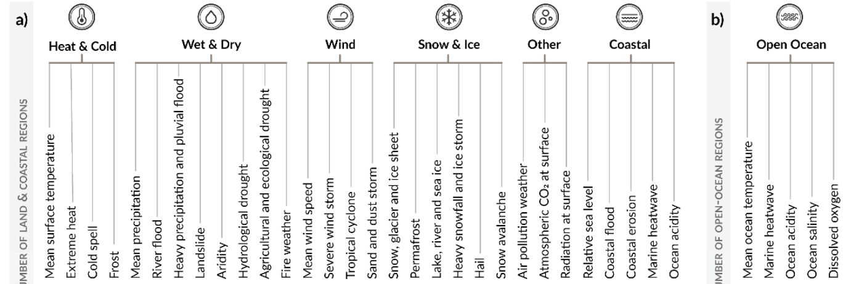
Climatic Impact-Drivers and Hazards
Climatic Impact-Drivers
RELEVANT FOR LAND REGIONS
RELEVANT FOR OCEAN REGIONS
RELEVANT FOR LAND REGIONS
RELEVANT FOR OCEAN REGIONS
Adopted from IPCC WGI (2021) Figure SPM.9; see also WGI Chapter 12
Ranasinghe et al. (2021)

Slide 3
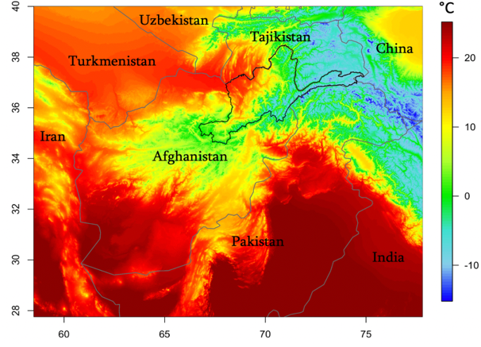
Climatic Hazards
Near-surface permafrost boundary line
Growing season length
Extreme heat
Extreme precipitation
Snow water equivalent
Soil moisture drought
1980-2009 Mean Temperature
Focus on Panj-Amu River Basin, Afghanistan

Slide 4
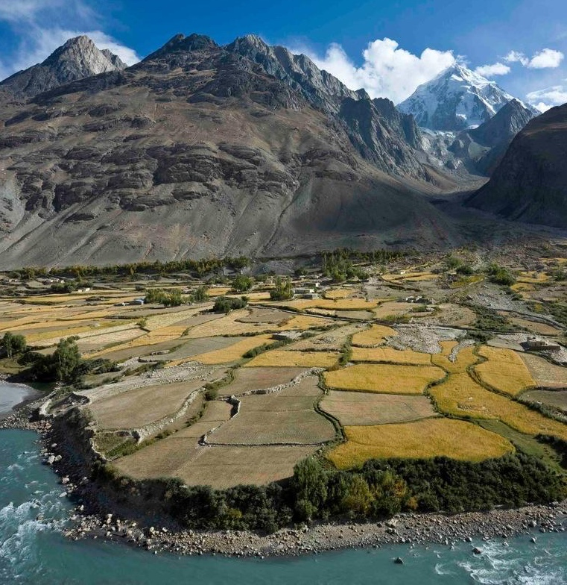
Overall Risk and Implications
Climate change has implications for several key sectors in Afghanistan, with focus here on ecosystems, wildlife, water resources, agriculture and communities.
Overall risk depends on mix of hazards, local vulnerability and exposure.
Some changes like mean temperature trends create long term-pressures, while heatwaves and extreme precipitation are projected to cause more immediate and acute impacts.
Climate change can alter the distribution of extreme events.
Credit: John Winnie Jr., WCS-Afghanistan

Slide 5
Overall Risk and Implications
Some risks are heightened when tolerance thresholds are crossed and system tipping points are surpassed.
Unique risks and adaptation potential linked to different threshold levels and the timing of events across seasons
Climate change is also a threat multiplier and can have knock-on effects, exacerbating existing issues such as food security and ecosystem degradation.
Compounding of extreme events, feedbacks, and other interactions can amplify physical impacts and need to be considered in planning and decision-making.

Slide 6
Extreme Heat
Definition: Days per year where maximum temperatures exceed 25ºC or 30ºC (two thresholds).
Why Extreme Heat matters
Extreme heat is often felt immediately given exceedance of biophysical or engineered tolerances.
Heat waves can directly threaten individual and community health, especially the very young and the elderly who have lower tolerances to high temperatures and humidity.
Ecosystems and agricultural crops have tolerance levels whereby productivity is decreased or plants begin to fail.
Extreme heat can can trigger physical hazards due to rapid snow melt.
Method
The thresholds of 25ºC and 30ºC were selected to understand how climate change influences these hazards.

Slide 7
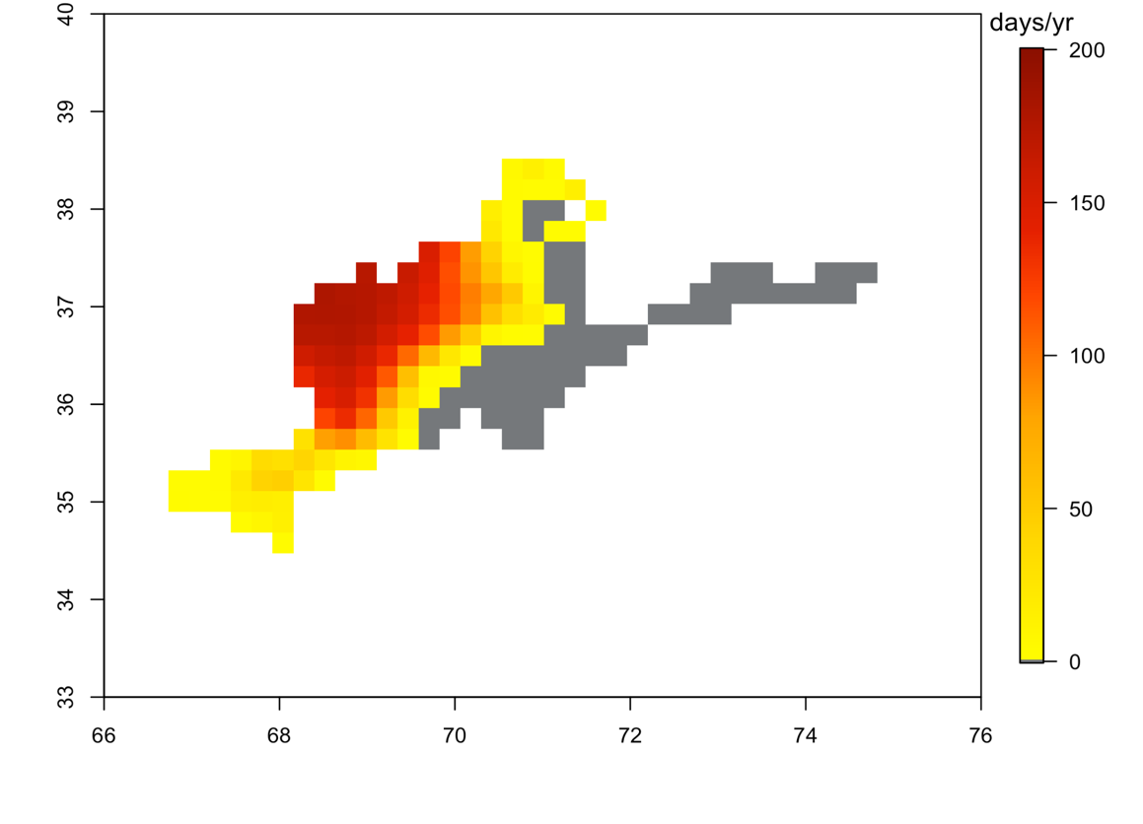
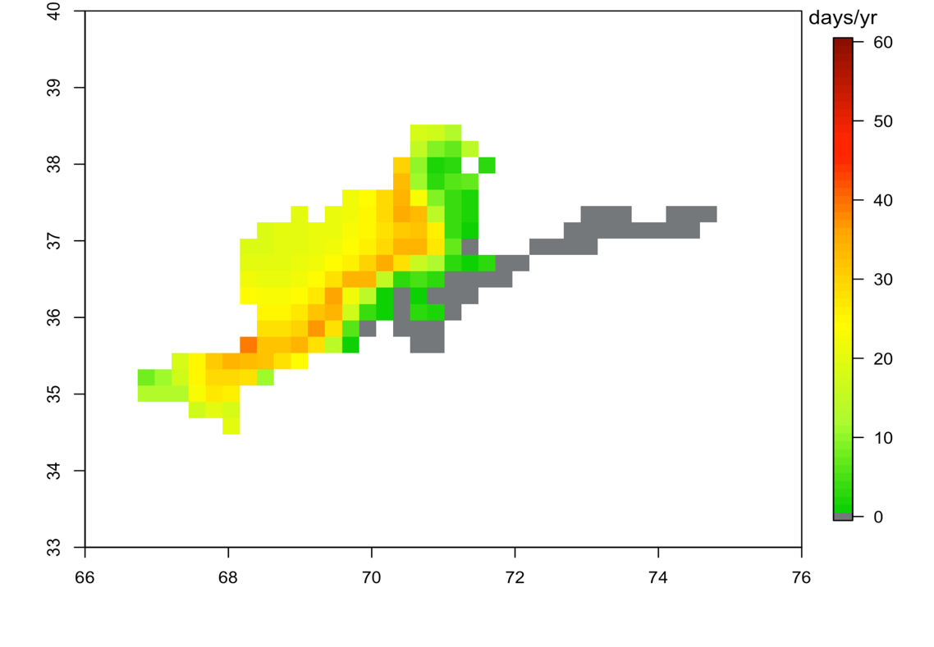
Extreme Heat #Days per year where Tmax > 25 °C
1980-2009 Ensemble Mean Frequency
In the baseline, much of the high-elevation northeastern parts of the region never exceed 25ºC. These were selected as two crucial thresholds to understand.
The number of extreme heat days above 25 °C is projected to increase by mid-century in the western and central portions of the Panj-Amu River Basin.
There will be expansion of warmer areas and seasons, and with those an increase in extreme heat days.
Projected extension of extreme heat conditions toward higher elevations.
Parts of north, central and southwestern regions see between 0-50 days above temp threshold.
In the Northwestern region 100-250 days exceed 25 °C.
RCP8.5 2050s Ensemble Mean Change in Frequency

Slide 8
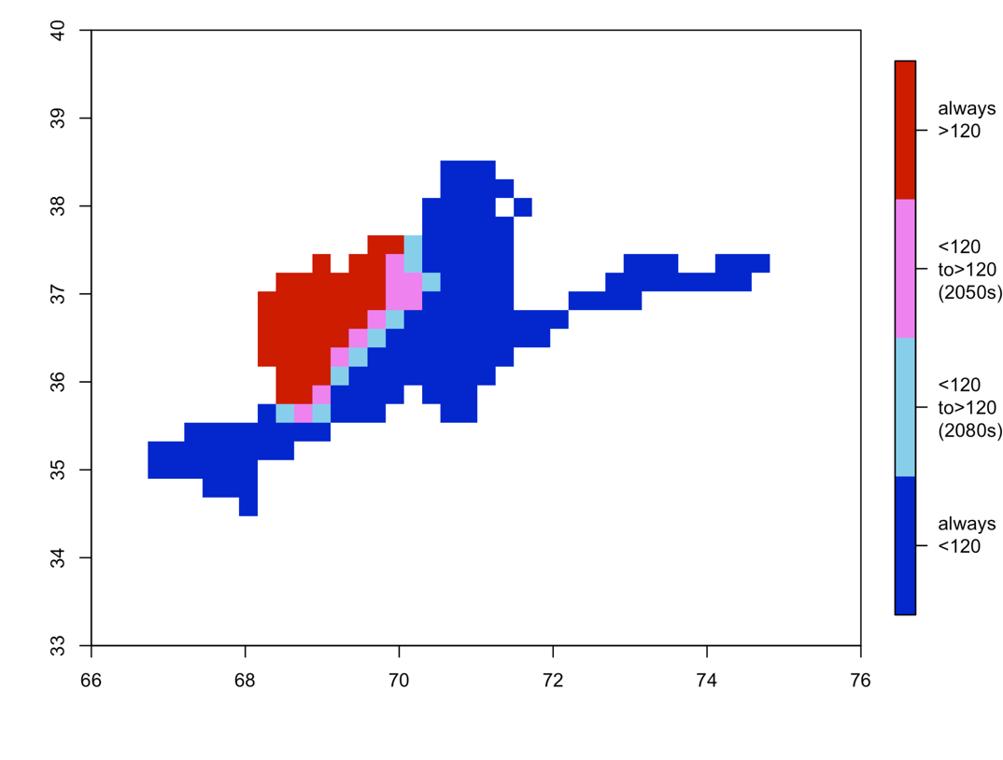
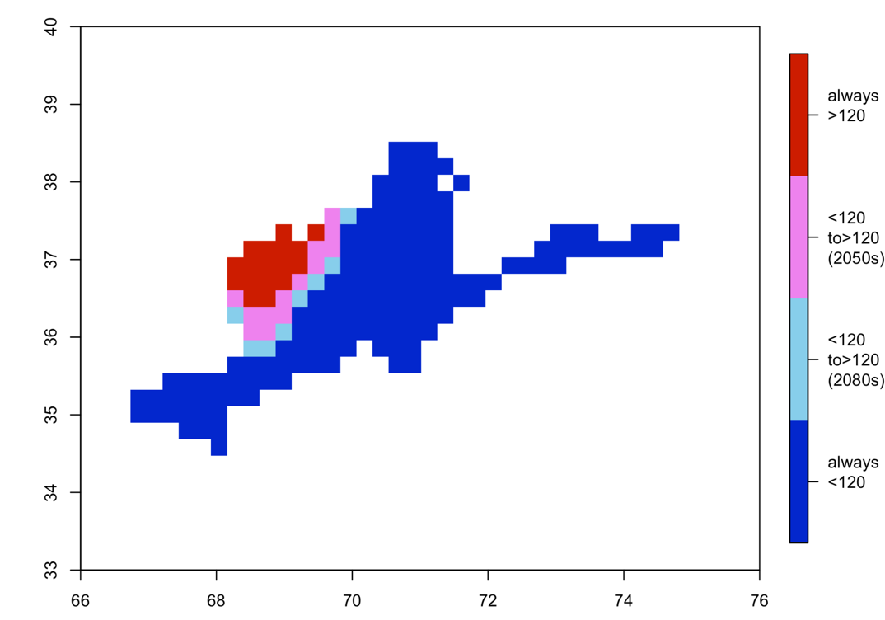
Extreme Heat Threshold Comparison
Decade where extreme heat threshold occurs ~1/3 of the time
Areas with more than 120 days exceeding 25 °C move slightly east in the 2050s and further into the center of the Panj-Amu River Basin by the 2080s.
Similarly, changes for the 30°C threshold are also most pronounced in the northwest.
Some areas experience up to 40 more days per year above 30 °C.
Prevalent extreme heat days expand for both thresholds, with 25 °C pattern followed by 30 °C
Changes in frequency of extreme heat days per year over 30 °C shows a similar pattern as 25 °C of larger changes along the mountain edges where extreme heat goes from sporadic to more regular.
25 °C
30 °C

Slide 9
Extreme Precipitation
Definition: Days per year where precipitation exceeds 20, 30, or 50 mm (three thresholds).
Why Extreme Precipitation matters:
Useful indicators of potential pluvial flooding and waterlogging and can also be linked to other climate hazards, such as flash river floods, landslides or avalanches.
Can can cause injury, death, and economic impacts.
Destabilize hillslopes leading to mudflow and landslide hazards, particularly in mountainous regions.
Can directly damage crops with acute impacts on crop production, rangelands and food security.
Method
A range of precipitation thresholds for single-day events, from 20 mm to 50 mm were assessed, to provide a broad analysis of the risk of these hazards and in recognition that coarser model resolution reduces the magnitude of extreme event statistics that can be larger at localized scales.

Slide 10
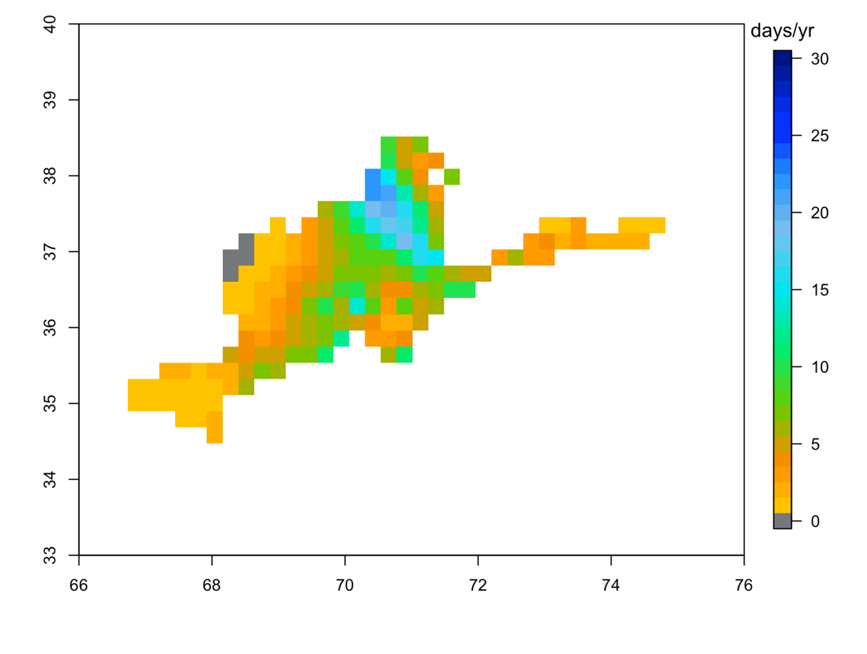
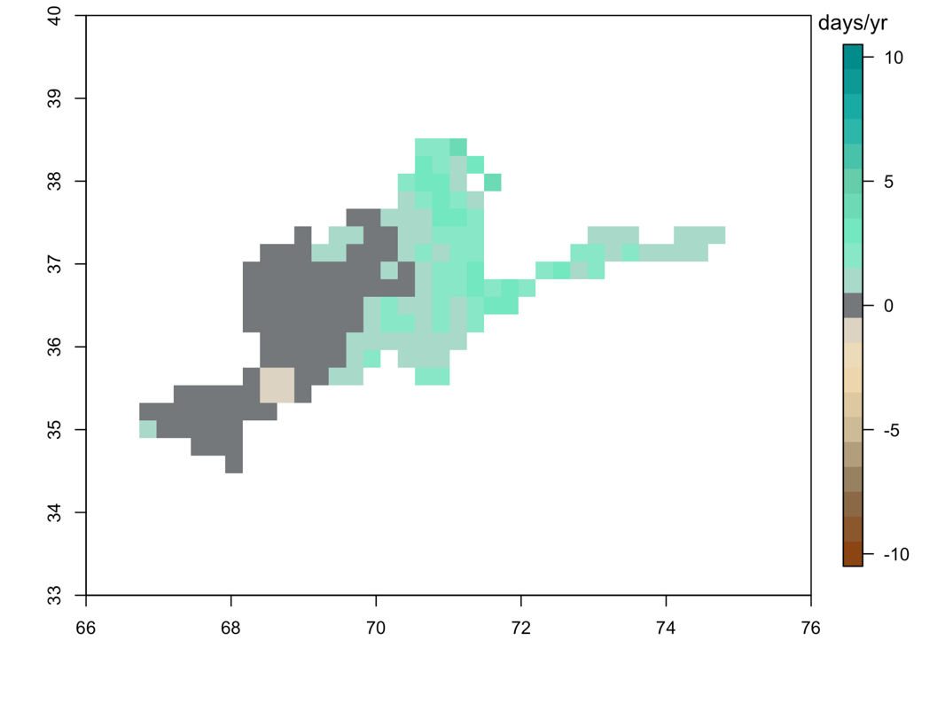
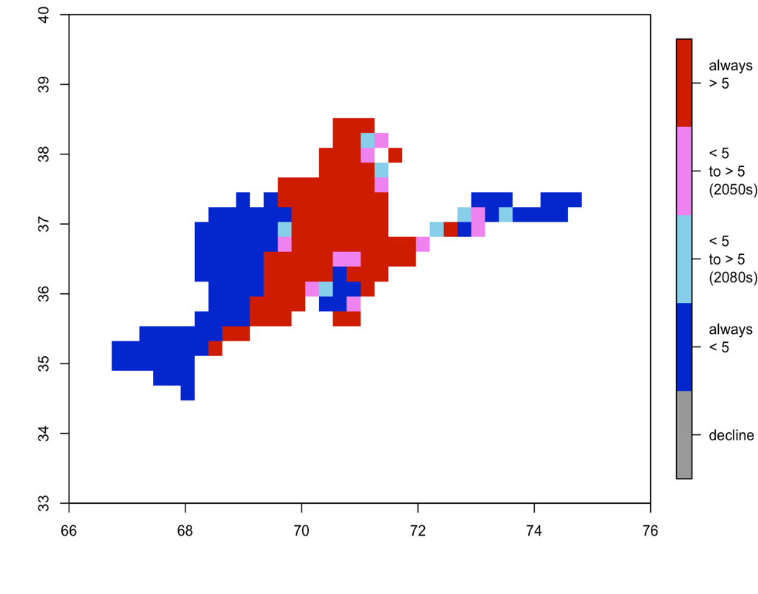
Extreme Precipitation – 20 mm/day
20mm/day precipitation events are seen especially in the center of the Panj-Amu River Basin and the largest number, nearly 30 days per year, is seen in the mountains just south of Tajikistan.
The frequency of 20 mm/day events per year increases slightly by the RCP8.5 mid-century scenario, only by 1-3 days per year in most areas, with the potential for a decrease by ~1 day per year in the mid-southern central region.
Small increases for these heavy precipitation events in mountainous terrain can still indicate an increased risk of rainfall-induced hazards, such as mudflows, erosion, flash floods, and landslides.
A slight expansion in the areas with more than 5 days is seen over the 21st Century under this high emissions scenario, and largely in the same regions that also see higher counts in the baseline.
First decade when 5 days/Year with Precipitation > 20mm
1980-2009 Ensemble Mean
RCPs 8.5 2050s Change in Frequency

Slide 11
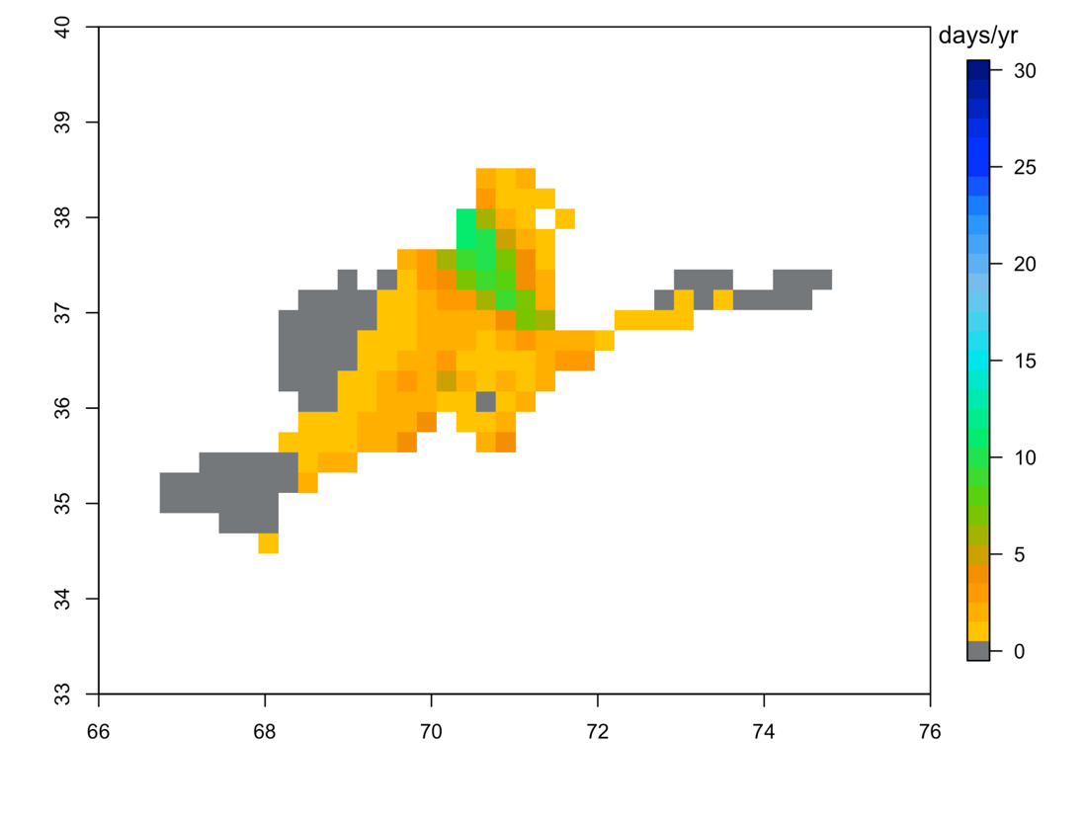
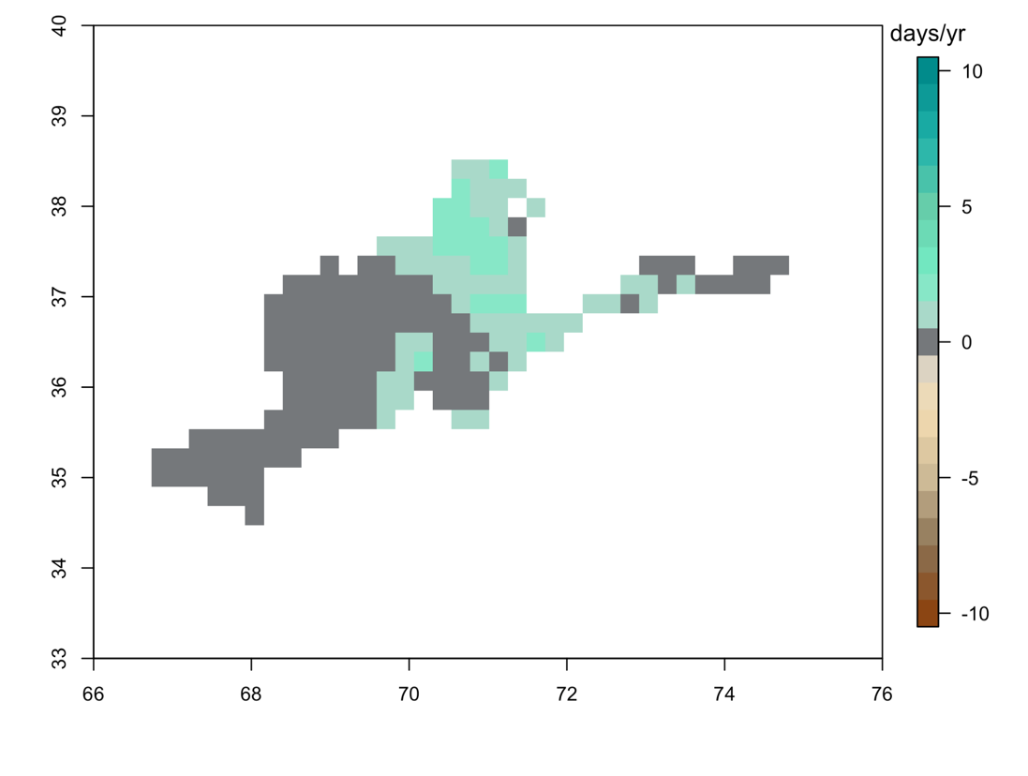
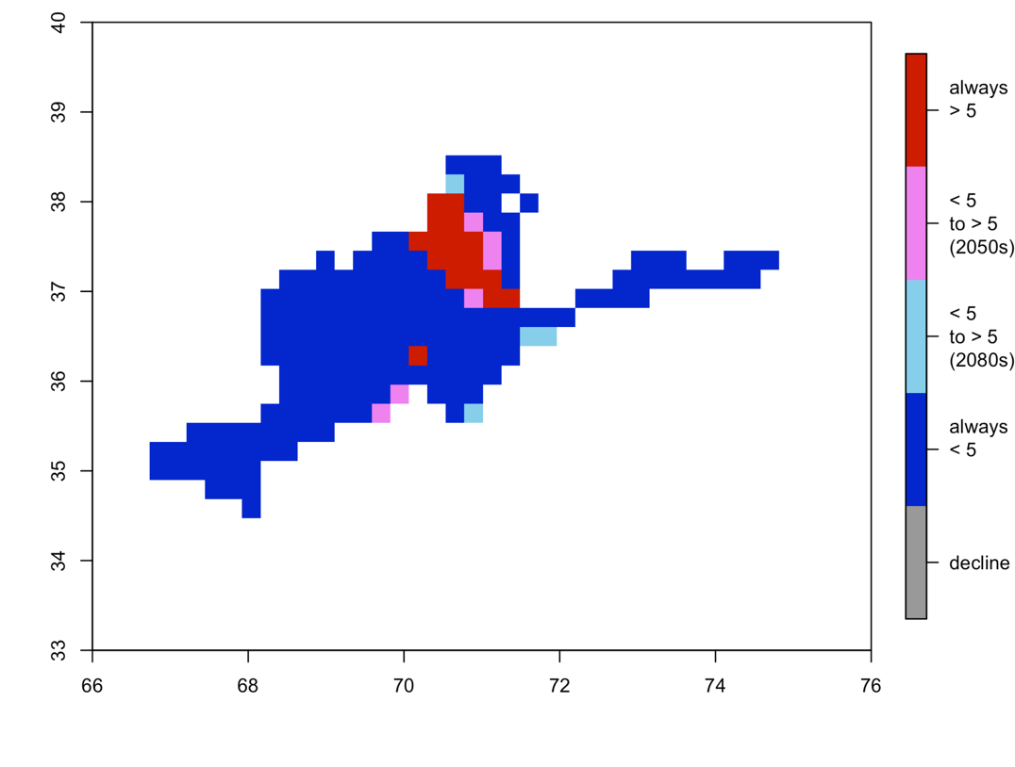
Extreme Precipitation – 30 mm/day
Much of the Panj-Amu River Basin does not see any change in 30 mm events. A higher number of these events (~10/year) is seen in the north
In the northern, eastern, and southeastern regions the ensemble mean number of 30 mm daily precipitation events per year increases slightly by the RCP8.5 mid-century scenario, but only by 1-3 days per year in most areas.
Only a few areas newly surpass 5 days/year of 30 mm events by the 2050s and 2080s in the central northern area of the river basin and to a very small extent in the south.
First decade when 5 days/Year with Precipitation > 30mm
1980-2009 Ensemble Mean
RCPs 8.5 2050s Change in Frequency

Slide 12
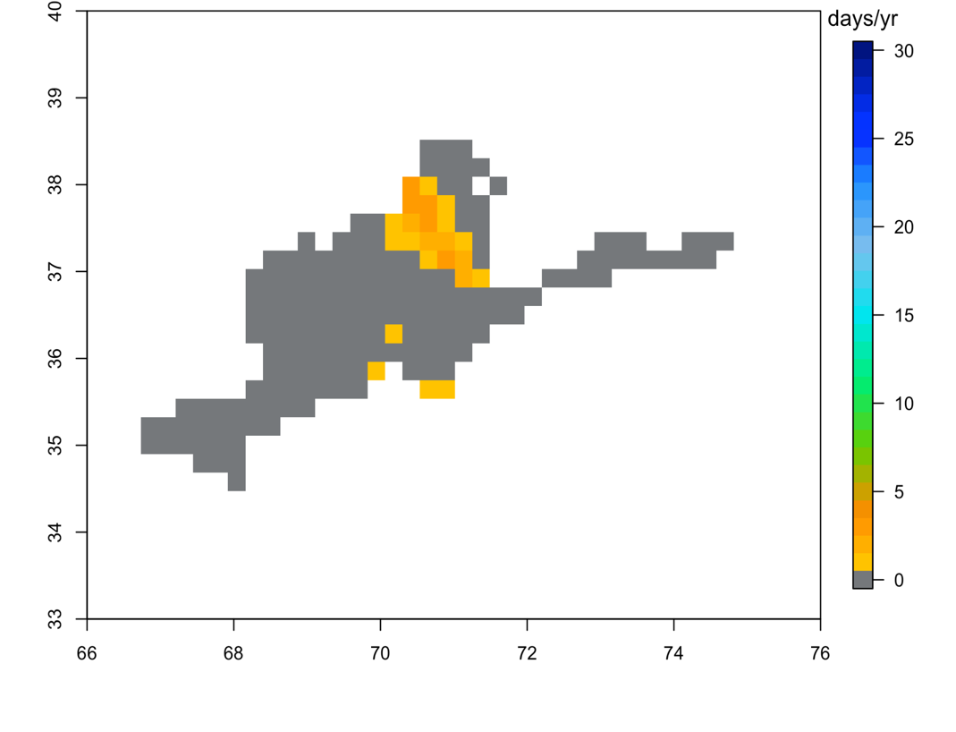
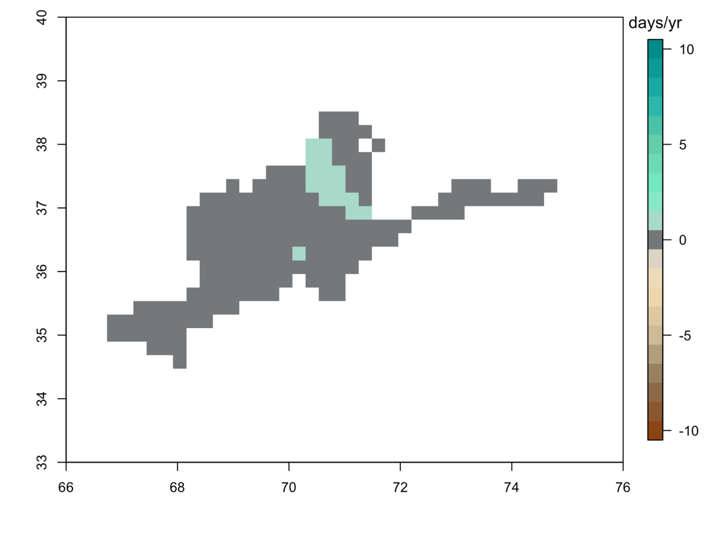
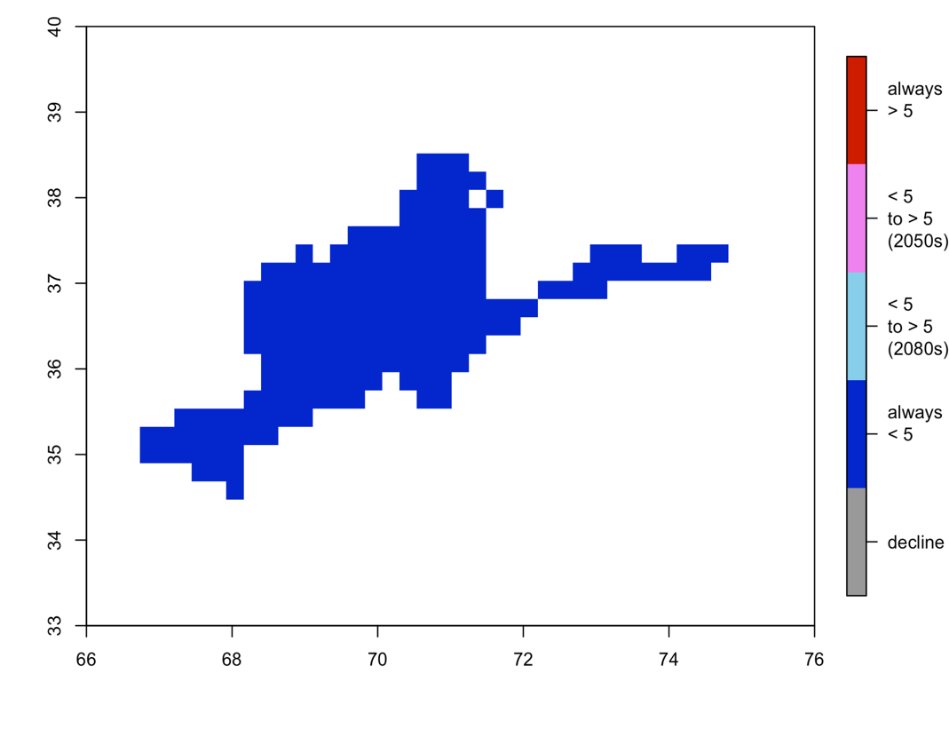
Extreme Precipitation – 50 mm/day
Very few grid cells with these events are seen and these are concentrated in the central north region of the P-ARB, with a few scattered grid cells in the south.
Many of the areas with any daily 50 mm rainfall events see an increase in frequency by ~1 day per year under RCP8.5 by mid-century.
For the ensemble mean across GCM-RCMs, there are no areas in the river basin region that exceed 5 days per year of 50 mm precipitation events at any point in the RCP8.5 projections.
First decade when 5 days/Year with Precipitation > 50mm
1980-2009 Ensemble Mean
RCPs 8.5 2050s Change in Frequency

Slide 13
Soil Moisture Drought
Definition: The soil moisture “1-in-10 year” event is defined for each month in the 30-year baseline as the third-lowest soil moisture value for that month; this value is referred to as the “soil moisture drought” for that month.
Why Soil Moisture Drought matters:
A decline in soil moisture and increased episodic droughts are strongly connected to reduced available water resources and water stress for crops, rangelands and natural ecosystems.
Droughts can drive acute food security and livelihood impacts.
Method
Soil moisture drought showing the “1-in-10-year” (10th percentile) dry soil moisture event. Soil moisture drought metrics are presented for two months:
February, as the month before the peak precipitation month
October, as a month after the dry summer season representing more extreme water limitations

Slide 14
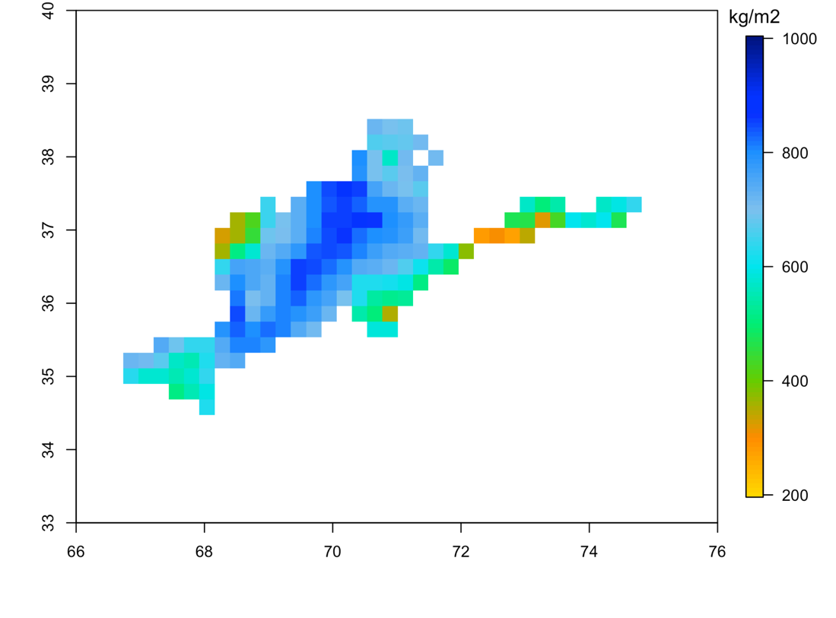
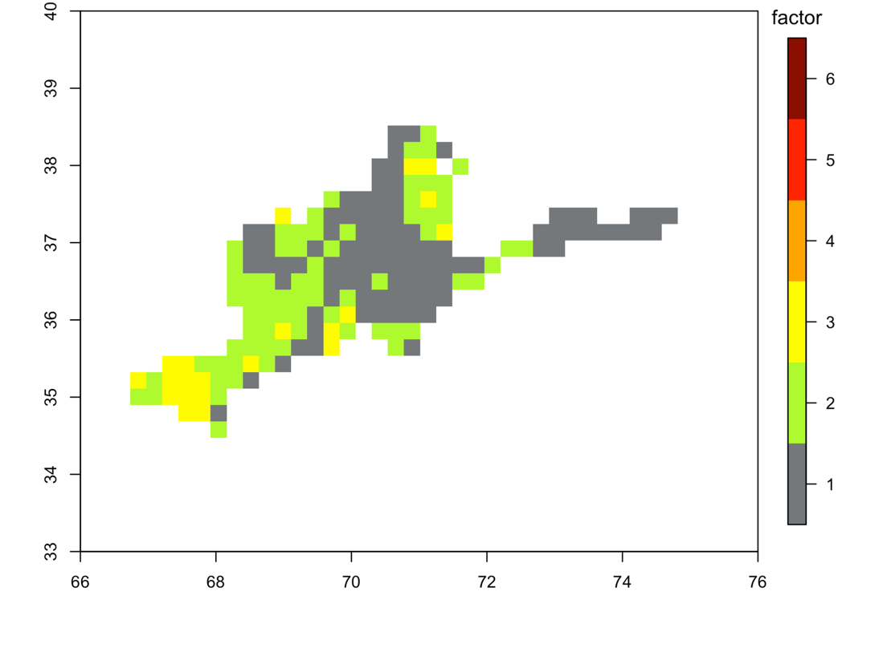
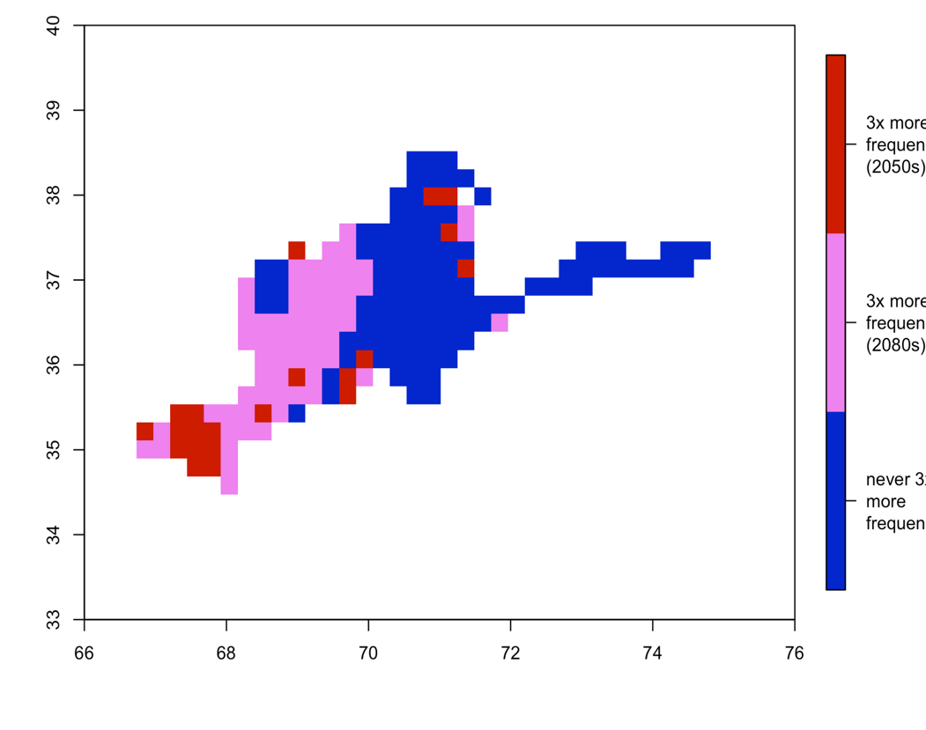
Soil Moisture Drought – February 1-in-10 Year Event
The frequency of rare drought events will increase over much of the Panj-Amu River Basin. Most increases around edges of domain.
Early spring (February) drought events will become 2-3 times more frequent in the southwest and northeast regions.
Broadly wetter patterns throughout the center of the Panj-Amu River Basin and drier events in the northwest and eastern areas similar to overall precipitation pattern in region.
Baseline drought event is twice or three times more frequent for this future scenario across the southwestern region and mountainous north.
1980-2009 Ensemble Mean February Drought Soil Moisture
RCPs 8.5 2050s Change in February Drought Frequency
Decade when February Soil Moisture Drought Becomes 3x More Frequent

Slide 15
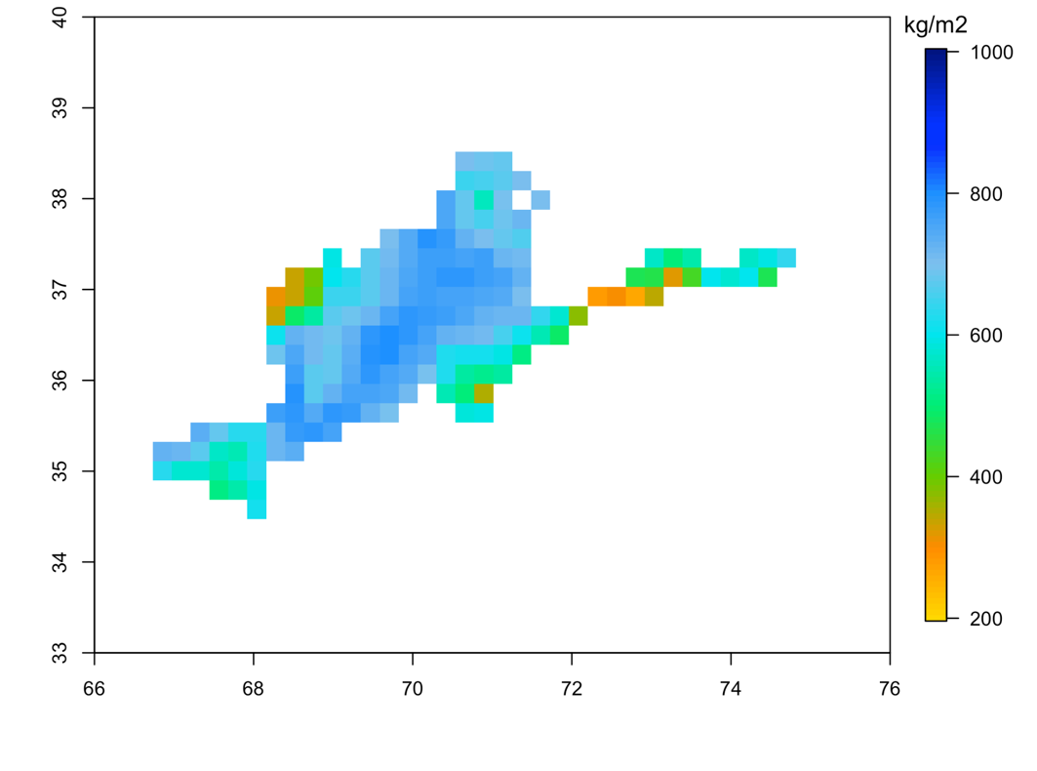
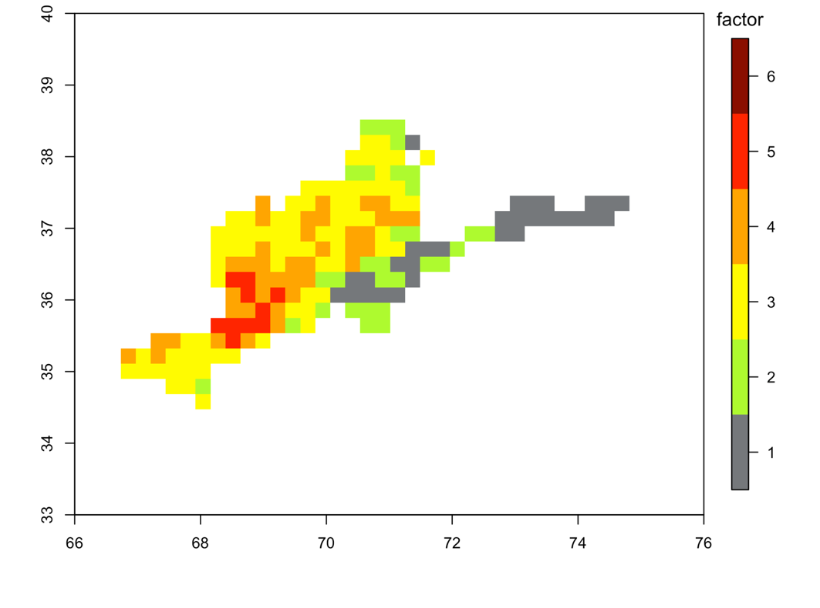
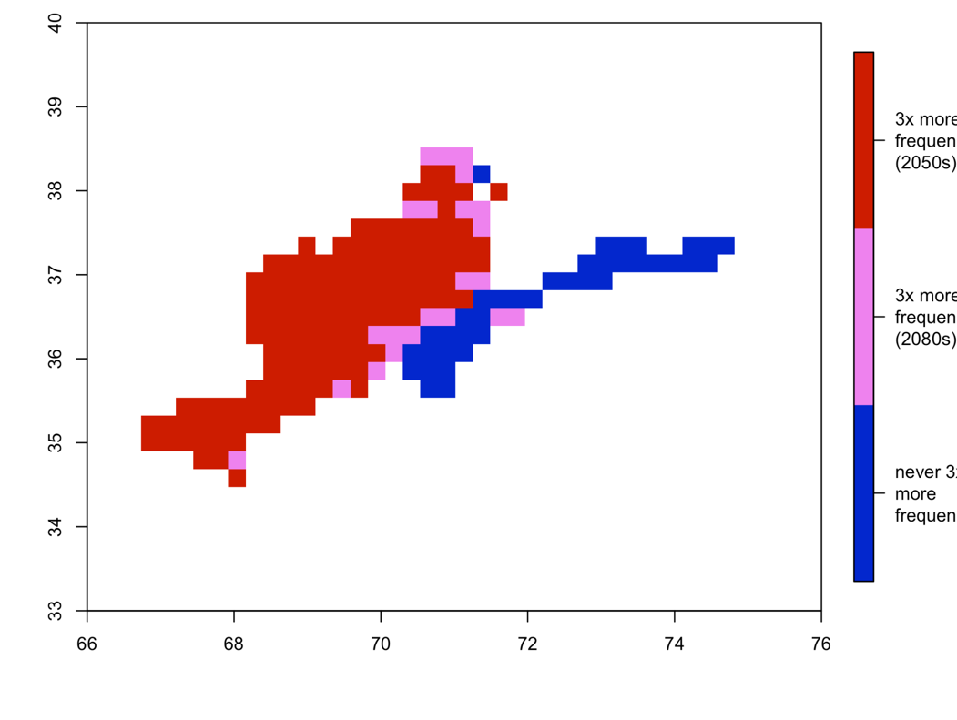
Soil Moisture Drought – October 1-in-10 Year Event
Late autumn (October) drought events will become 3-5 times more frequent in the central, west, and southwest regions. More of a focus in center of domain.
Large parts of the Panj-Amu River Basin are two to three times more likely to experience drought.
The baseline drought event is four or five times more frequent for this future scenario across the central and southwestern regions.
Baseline drought event occurs at about the same frequency in the future (roughly once every ten years) in the high mountain regions in and around Wakhan.
1980-2009 Ensemble Mean October Drought Soil Moisture
RCPs 8.5 2050s Change in October Drought Frequency
Decade when October Soil Moisture Drought Becomes 3x More Frequent

Slide 16
Conclusions
Hazard oriented approach allows us to focus on climate conditions exceeding tolerance thresholds that result from local vulnerabilities.
Extreme heat: The number of extreme heat days is projected to increase by mid-century in the western and central portions of the Panj-Amu River Basin. Higher thresholds follow lower thresholds up mountains.
Extreme precipitation: The frequency of extreme precipitation events is projected to increase by mid-century in the eastern half of the Panj-Amu River Basin. Patterns are similar across thresholds, with more conclusive findings for less rare events.
Soil moisture drought: The frequency of rare, “1-in-10-year” drought events will increase over much of the P-ARB. Different seasons of drought have different patterns.
Other hazards analyzed that are detailed in the vulnerability assessment:
Near-surface permafrost boundary line
Growing season length
Snow water equivalent
Disruptive pressures on society and natural ecosystems are important to recognize in current and future planning for the Panj-Amu River Basin.

