Slide 1
Climate Science 101
Background Material for Project on
Climate Projections for the Panj-Amu River Basin
Presented by: Manishka De Mel
Alex Ruane, Meridel Phillips and Jennifer Evans
NASA GISS and Columbia University
June 2022

Slide 2
1. WEATHER AND CLIMATE ARE NOT THE SAME THING
Weather refers to atmospheric conditions that occur locally over short periods of time—from minutes to hours, days to weeks. Familiar examples include rain, snow, clouds, winds, or thunderstorms.
Climate, on the other hand, refers to the long-term regional or global average of temperature, humidity, and rainfall patterns over a period of time, often 30+ years.
“Weather is what you get; climate is what you expect.”

Slide 3
2. CLIMATE CHANGE IS HAPPENING
Global warming is the long-term heating of Earth's climate system observed since the pre-industrial period (between 1850 and 1900) due to human activities, primarily fossil fuel burning, which increases heat-trapping greenhouse gas levels in Earth's atmosphere.
Climate change is a long-term change (30+ years) in the average weather patterns that have come to define Earth's local, regional, and global climates. It includes global warming, but refers to the broader range of changes including shrinking mountain glaciers and extreme weather.
.

Slide 4
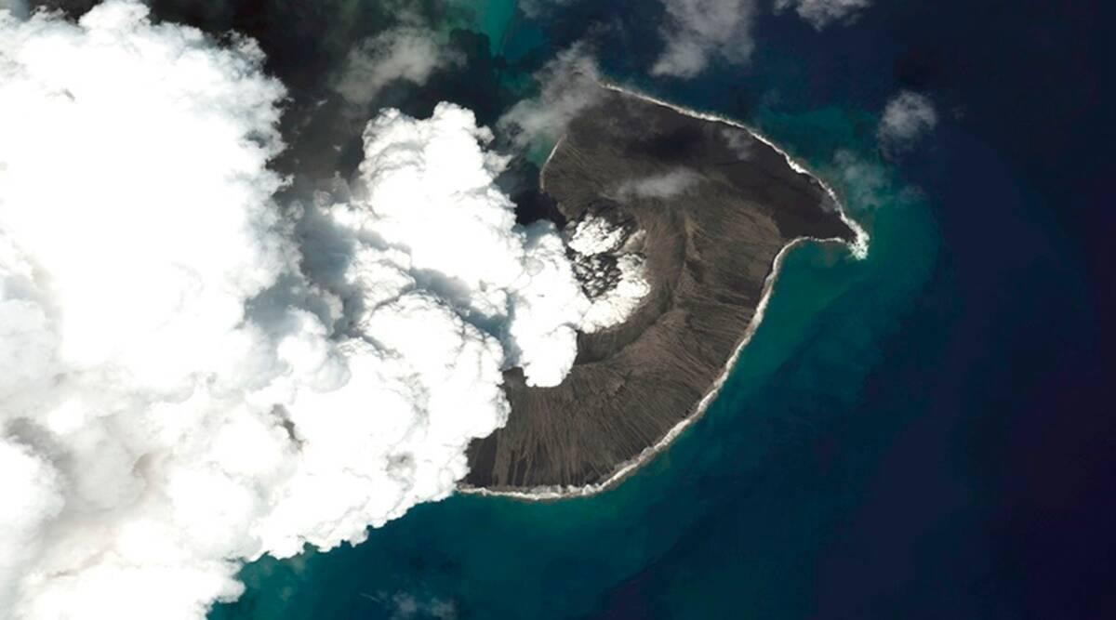
Factors Causing Climate Change
Natural processes can contribute to climate change, including internal variability (e.g., cyclical ocean patterns like El Nino and La Nina) and external forcings (e.g., volcanic activity, changes in the Sun's energy output, variations in Earth's orbit).
Changes observed in Earth's climate since the early 20th century are partly driven by human activities, particularly fossil fuel burning and deforestation, which increases heat-trapping greenhouse gas levels in Earth's atmosphere, raising Earth's average surface temperature.
Satellite image provided by Maxar Technologies, Indian Express. Tonga Eruption

Slide 5
Evidence of Rapid Climate Change
Rising Global Temperatures
Warming Oceans
Increase in Sea Level Rise
Shrinking Ice Sheets
Increase in Extreme Weather Events

Slide 6
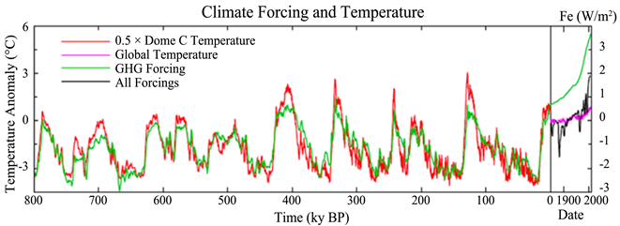
3. CURRENT WARMING IS ACCELERATED BY HUMAN ACTIVITY
Earth's climate has changed continuously throughout its history.
The current warming trend is of particular significance because it has been accelerated by human activity since the mid-20th century.
https://climate.nasa.gov/evidence/

Slide 7
Greenhouse Gases
The planet's average surface temperature has risen about 1.18 degrees Celsius since the late 19th century, a change driven largely by increased greenhouse gas emissions into the atmosphere.
Observed increases in well-mixed greenhouse gas concentrations since around 1750 are without doubt (unequivocally) caused by human activities (IPCC, 2021).
NASA Global Climate Change - https://climate.nasa.gov/evidence
NASA Goddard Institute for Space Studies: https://data.giss.nasa.gov/gistemp

Slide 8
4. CLIMATE CHANGE MEANS MORE EXTREMES

Slide 9
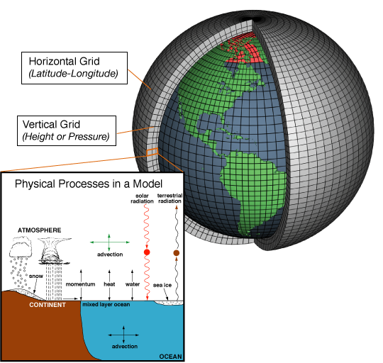
Simulated for every day into the future
5. CLIMATE MODELS ARE USEFUL TOOLS FOR PLANNING
Climate models are computer simulations of Earth’s climate
Shared Socioeconomic Pathway (SSP)/Representative Concentration Pathways (RCPs)
Temperature
Rainfall
Extreme heat
Climate Model
Future

Slide 10
Mitigation and Adaptation
As we are already committed to some level of climate change, responding to climate change involves a two-pronged approach:
MITIGATION: Reducing emissions of and stabilizing the levels of heat-trapping greenhouse gases in the atmosphere
ADAPTATION: Adapting to the climate change already in the pipeline
Credit: Tony Webster
Credit: Dr. Denielle Kreeger

Slide 11
6. WE NEED TO ADAPT NOW
There are limits to adaptation.
Even effective adaptation cannot prevent all losses and damages
Above 1.5°C some natural solutions may no longer work.
Above 1.5°C, lack of fresh water could mean that people living on small islands and those dependent on glaciers and snowmelt can no longer adapt.
By 2°C it will be challenging to farm multiple staple crops in many current growing areas.

Slide 12
CONCLUSIONS
Weather and climate change are not the same thing
Climate change is happening
Current warming is accelerated by human activity
Climate change means more extremes
Climate models are useful tools to plan for climate change
We need to adapt now

