Slide 1
Bioclimatic Variables
Project on Climate Projections
for the Panj-Amu River Basin
Presented by: Meridel Phillips (SciSpace, LLC)
Alex Ruane, Manishka De Mel and Jennifer Evans
NASA GISS and Columbia University
June 2022

Slide 2
Introduction
Bioclimatic variables are derived variables from the monthly mean, maximum, and minimum temperature as well as monthly precipitation totals
Developed for species distribution modeling and related ecological applications as they represent key aspects of the long-term climate, climate seasonality, and extreme or limiting environmental factors
BIO1 = Annual Mean Temperature
BIO2 = Mean Diurnal Range
BIO3 = Isothermality
BIO4 = Temperature Seasonality
BIO5 = Max Temperature of Warmest Month
BIO6 = Min Temperature of Coldest Month
BIO7 = Annual Temperature Range
BIO8 = Mean Temperature of Wettest Quarter
BIO9 = Mean Temperature of Driest Quarter
BIO10 = Mean Temperature of Warmest Quarter
BIO11 = Mean Temperature of Coldest Quarter
BIO12 = Total Annual Precipitation
BIO13 = Precipitation of Wettest Month
BIO14 = Precipitation of Driest Month
BIO15 = Precipitation Seasonality
BIO16 = Precipitation of Wettest Quarter
BIO17 = Precipitation of Driest Quarter
BIO18 = Precipitation of Warmest Quarter
BIO19 = Precipitation of Coldest Quarter

Slide 3
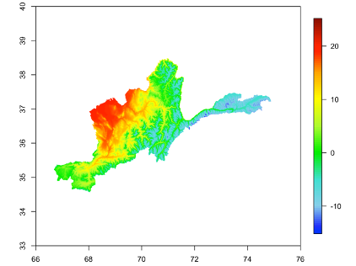
BIO1: Annual Mean Temperature
Mean annual temperature is calculated as the average across 12 monthly mean temperatures for each year
Bias-adjusted CORDEX-Core Ensemble Mean Annual Temperature (ºC) for Baseline (1980-2009)
Overall Patterns
High annual temperatures in the western desert regions with lower temperatures in the mountainous east and Wakhan corridor
Annual mean temperatures range between 12ºC and 20ºC in the west and can fall below -10ºC in the eastern region

Slide 4
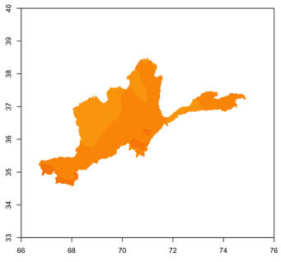
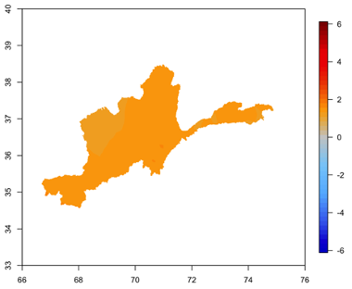
BIO1: Annual Mean Temperature under RCP2.6
Mean annual temperature increases under RCP2.6 by the 2050s with similar pattern and magnitude of warming visible by the 2080s
1-2ºC of warming projected in southern, northern, and northeastern areas of the P-ARB
Magnitude of change is very slightly higher in the 2050s than the 2080s
Bias-adjusted CORDEX-Core Ensemble Annual Temperature Change (ºC) under RCP2.6 by 2050s (2040-2069)
Bias-adjusted CORDEX-Core Ensemble Annual Temperature Change (ºC) under RCP2.6 by 2080s (2070-2099)

Slide 5
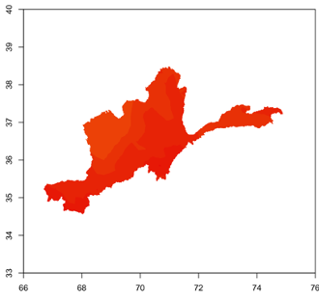
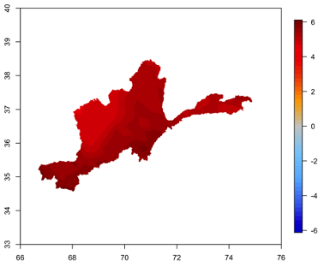
BIO1: Annual Mean Temperature under RCP8.5
Mean annual temperature increases more rapidly under RCP8.5
About 3-6ºC of warming projected by the 2050s with higher levels by 2080s
Warming covers all regions, with higher increases in the same regions as RCP2.6
Pattern of greater warming at higher elevations
Bias-adjusted CORDEX-Core Ensemble Annual Temperature Change (ºC) under RCP8.5 by 2050s (2040-2069)
Bias-adjusted CORDEX-Core Ensemble Annual Temperature Change (ºC) under RCP8.5 by 2080s (2070-2099)

Slide 6
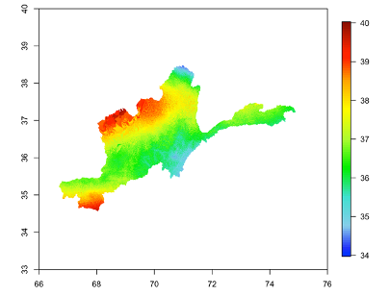
BIO7: Annual Temperature Range
Annual temperature range is calculated as the difference between minimum temperature of the coldest month and maximum temperature of the warmest month for each year
Bias-adjusted CORDEX-Core Ensemble Annual Temperature Range (ºC) for Baseline (1980-2009)
Overall Patterns
Larger annual temperatures ranges in the western desert regions and southern corner of the P-ARB with smaller annual ranges in the Gissaro-Alai open woodlands and Hindu Kush alpine meadow
Highest annual temperature ranges are nearly 40ºC between annual high and low temperatures; lower ranges fall around 35ºC

Slide 7
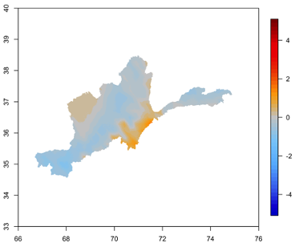
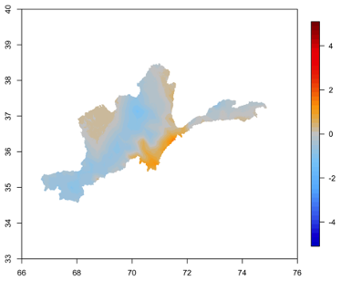
BIO7: Annual Temperature Range under RCP2.6
Changes in annual temperature range are small under RCP2.6 with increases in south and west and decreases across much of central woodlands
The pattern and magnitude of change is similar between 2050s and 2080s with slightly higher magnitude declines in 2080s
Bias-adjusted CORDEX-Core Ensemble Annual Temperature Range Change (ºC) under RCP2.6 by 2050s (2040-2069)
Bias-adjusted CORDEX-Core Ensemble Annual Temperature Range Change (ºC) under RCP2.6 by 2080s (2070-2099)

Slide 8
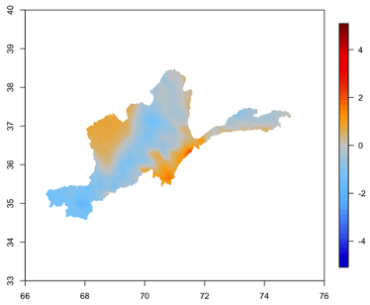
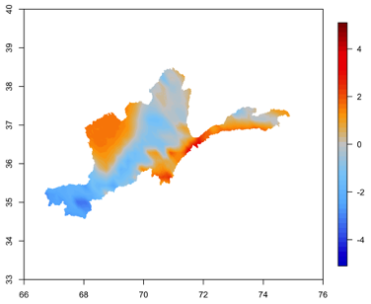
BIO7: Annual Temperature Range under RCP8.5
Similar but intensified pattern of change in annual temperature range to RCP2.6 with increases in the south and west and decreases across central and southwestern areas
Further intensification in magnitude by 2080s under RCP8.5
Bias-adjusted CORDEX-Core Ensemble Annual Temperature Range Change (ºC) under RCP8.5 by 2050s (2040-2069)
Bias-adjusted CORDEX-Core Ensemble Annual Temperature Range Change (ºC) under RCP8.5 by 2080s (2070-2099)

Slide 9
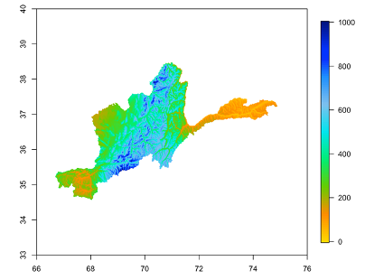
BIO12: Total Annual Precipitation
Total annual precipitation range is calculated by taking the sum over 12 monthly precipitation totals in each year
Bias-adjusted CORDEX-Core Ensemble Total Annual Precipitation (mm/year) for Baseline (1980-2009)
Overall Patterns
Precipitation is highest along the central region of the P-ARB with low precipitation totals in the eastern areas and southwest corner
Future scenario precipitation changes are shown in percent change relative to baseline
Low baseline levels such as those in the east and south may not necessarily translate to large increases in absolute numbers in the future

Slide 10
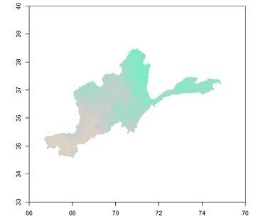
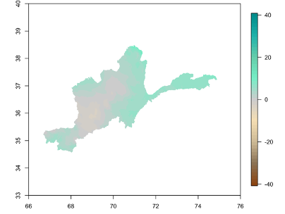
BIO12: Total Annual Precipitation under RCP2.6
Precipitation changes are more complex than temperature changes
Largest relative increases in northern, northeastern, eastern and southern regions under RCP2.6
Small decreases in central and western regions with some increases in southwest in 2080s
Bias-adjusted CORDEX-Core Ensemble Annual Precipitation Change (%) under RCP2.6 by 2050s (2040-2069)
Bias-adjusted CORDEX-Core Ensemble Annual Precipitation Change (%) under RCP2.6 by 2080s (2070-2099)

Slide 11
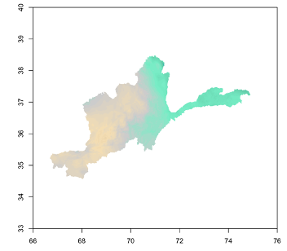
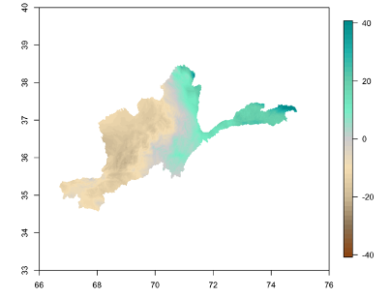
BIO12: Total Annual Precipitation under RCP8.5
Similar pattern of change to RCP2.6 but with higher magnitude changes
Larger precipitation increases in northern and eastern regions although eastern mountains have very low baseline levels
Decreases in central and western regions with larger magnitude decreases in 2080s
Bias-adjusted CORDEX-Core Ensemble Annual Precipitation Change (%) under RCP8.5 by 2050s (2040-2069)
Bias-adjusted CORDEX-Core Ensemble Annual Precipitation Change (%) under RCP8.5 by 2080s (2070-2099)

Slide 12
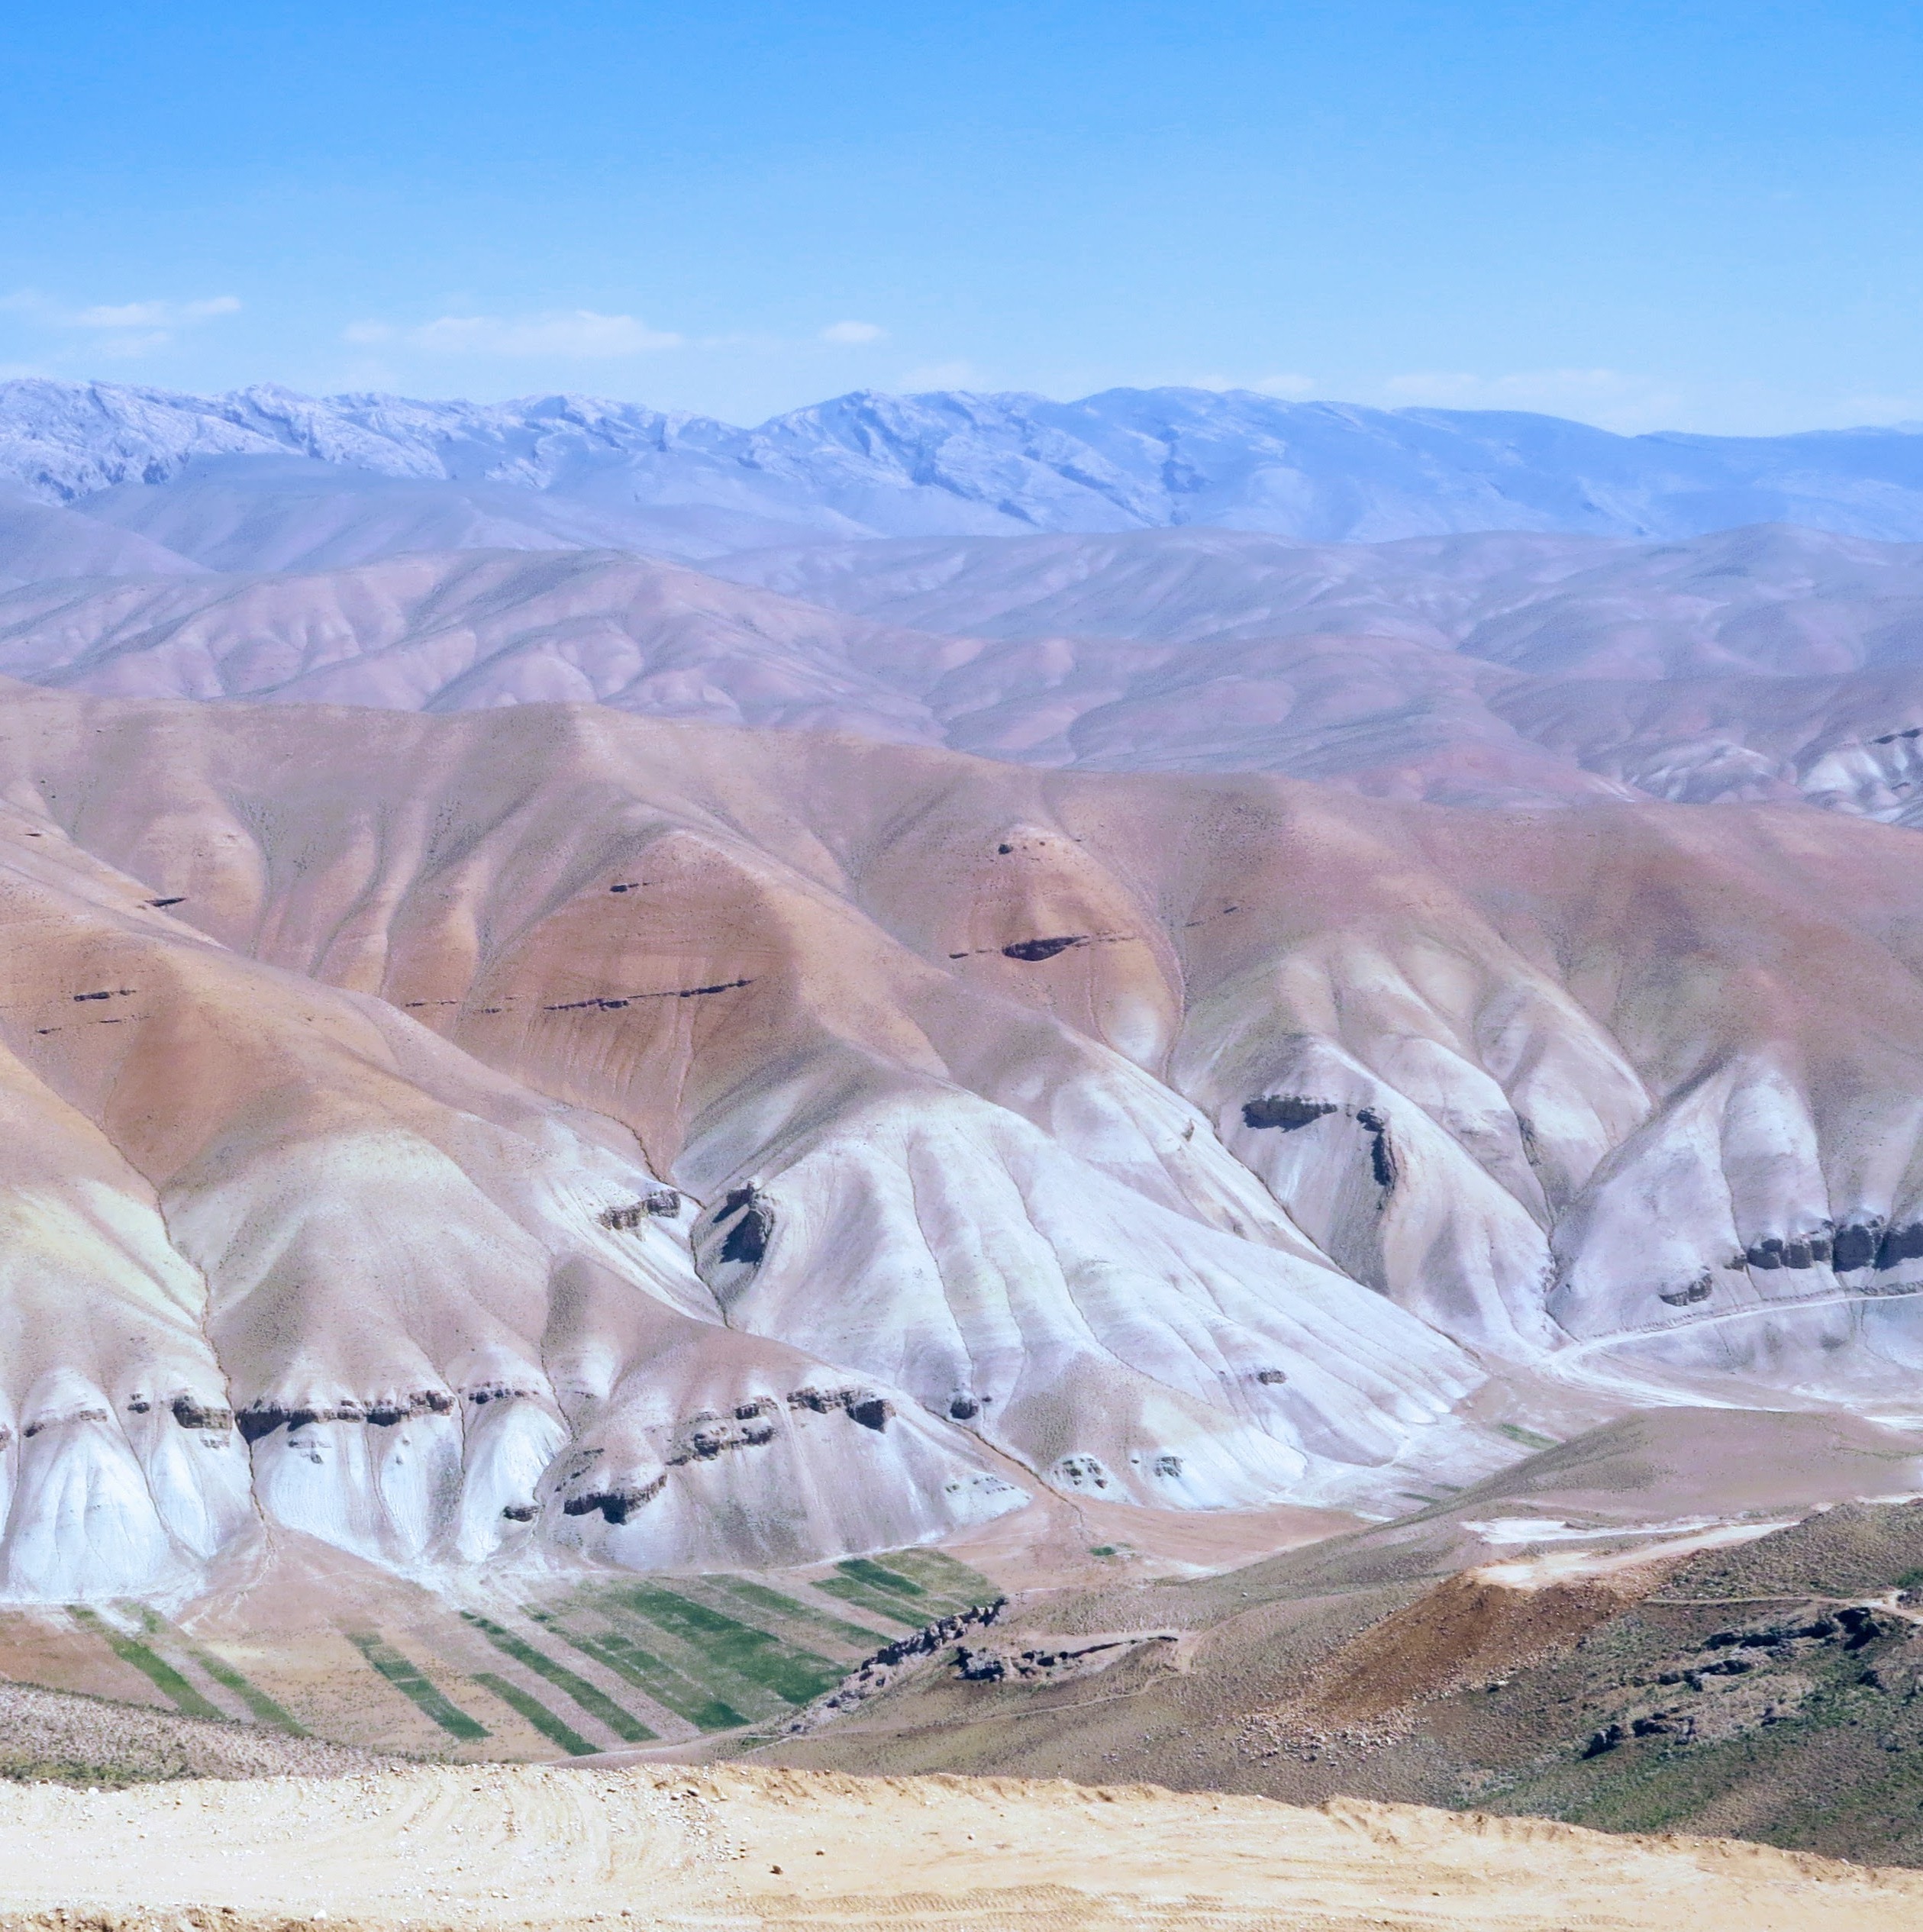
Conclusions
Bioclimatic variables show how changes in ecosystem-relevant metrics will change under future climate scenarios
Projections from downscaled, bias-adjusted climate data show broad increases in temperature across the region
Changes in annual temperature range and annual precipitation vary by region
Species and ecosystem models use ensemble bioclimatic results to show the species-specific limits of acceptable or optimal conditions for habitats
Credit: Paul Elsen, WCS

