Slide 2
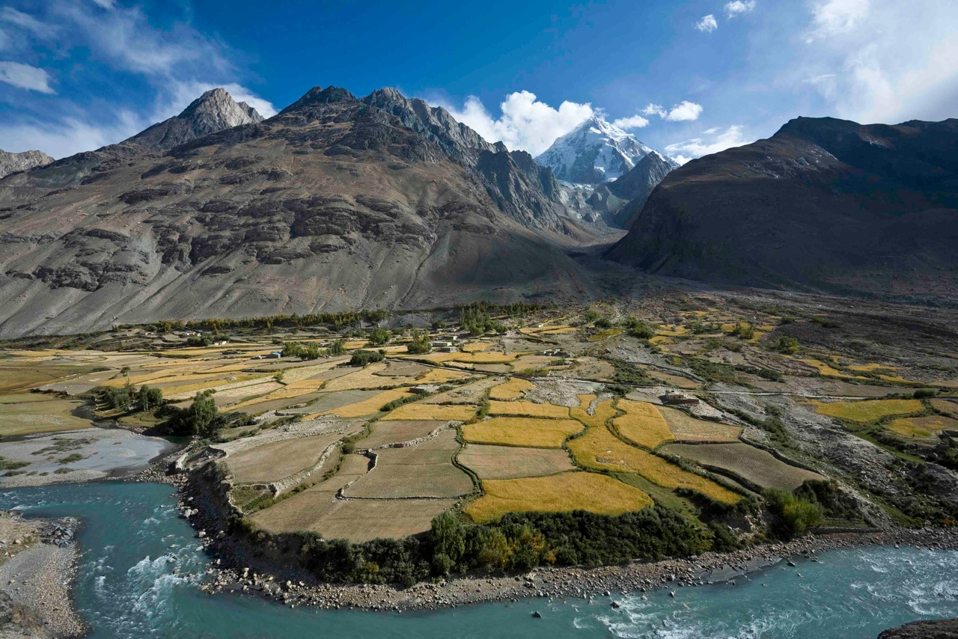
Confronting climate vulnerability in Northeastern Afghanistan

Slide 3
Solution: Improving resilience to climate change of communities and the ecosystems in the Panj-Amu River Basin and the sustainability of their use for the benefit of rural communities
Problem 1: Lack of knowledge on climate change
Problem 2: Unsustainable use and poor management of natural resources
Problem 3: Inefficient use of energy and poor supply of renewable energy in rural areas

Slide 4
OVERALL OBJECTIVE: To improve resilience to climate change and the sustainability use of ecosystems
SPECIFIC OBJECTIVE 1: Improved natural resources management and climate change adaptation measures
SPECIFIC OBJECTIVE 2: Increased renewable energy generation and distribution
Improved knowledge and adaptive capacity
Effective and holistic adaptation strategies available for the Panj-Amu River Basin and are implemented

Slide 5
Exposure
Sensitivity
Potential Impact
Adaptive Capacity
Vulnerability

Slide 6
Components of regional climate vulnerability
Climate
Natural hazards
Ecosystems
Wildlife
Hydrology
Socioeconomic

Slide 7
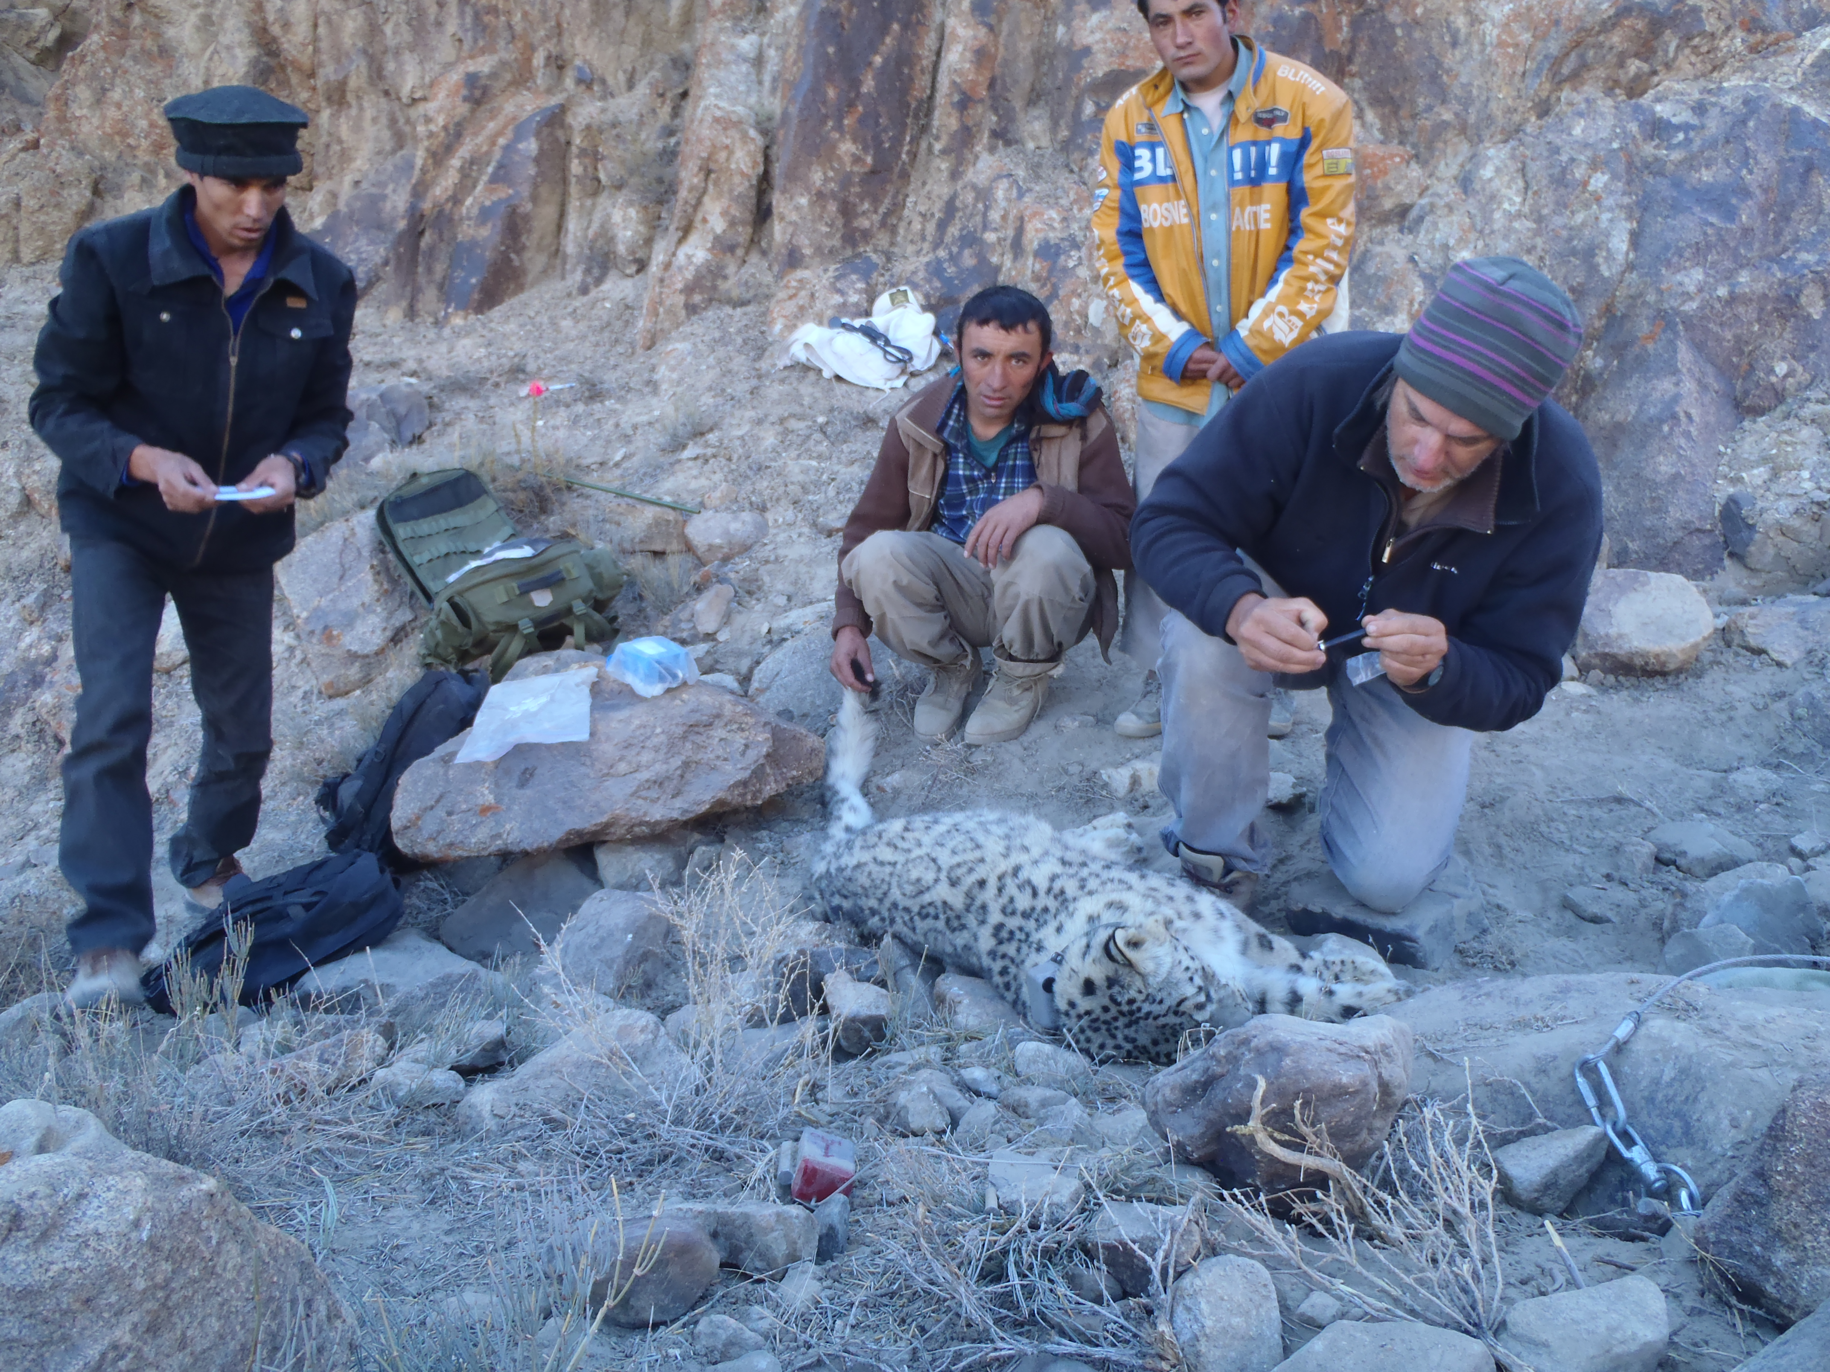
Wildlife species (exposure + sensitivity)
Trait-based estimates of climate sensitivity
103 mammals, 273 birds
Additionally - do we have good occurrence data?
Camera trapping
Targeted surveys
Telemetry
If yes: Species distribution models
19 mammals, 60 birds

Slide 8
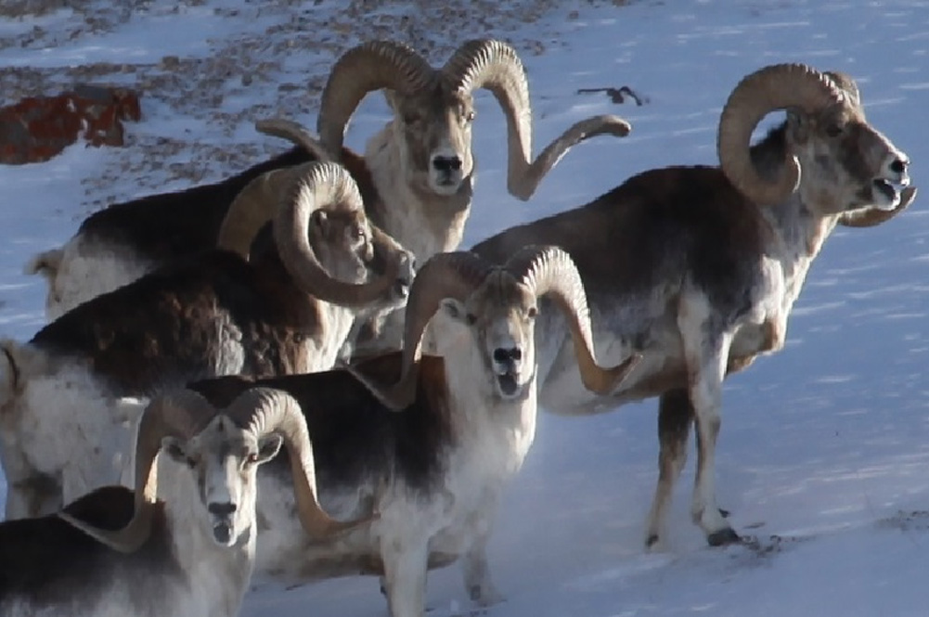
Wildlife traits
Use ecological traits to estimate species sensitivity
Body of literature indicating that certain traits correlate with increased sensivity
List of traits: number of ecoregions occupied, geographic range size, median elevation, elevational range, median temperature, temperature range, median precipitation, precipitation range, age of sexual maturity, litter size, body mass, diet breadth, generation length, habitat breadth, trophic level (mammals only)
IUCN range maps, CHELSA data, and published estimates used
Each trait rescaled by quintile, sensitivity scores summed across traits

Slide 9
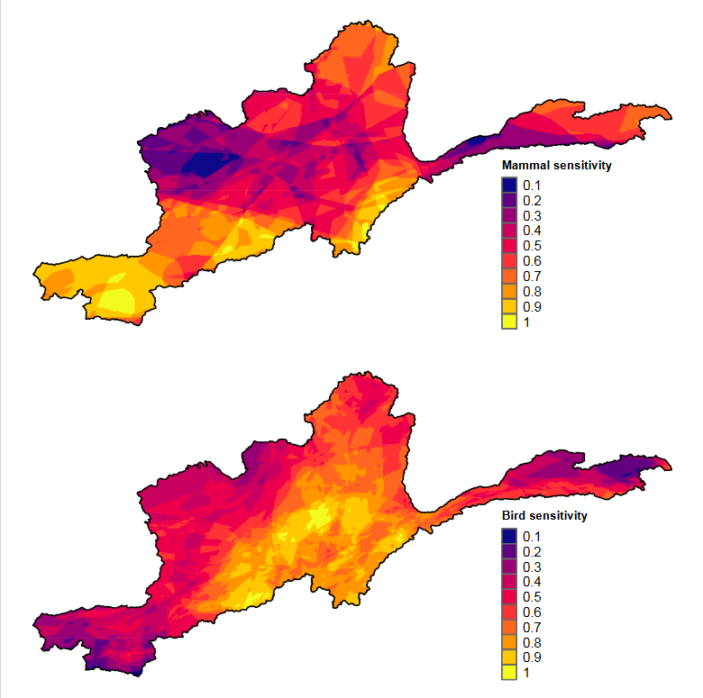

Slide 10
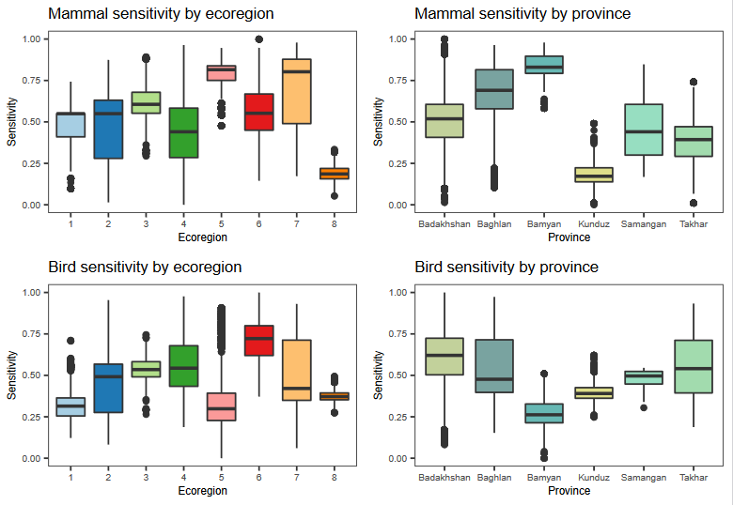

Slide 11
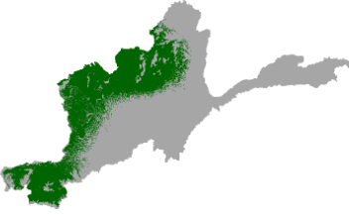
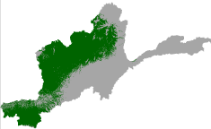
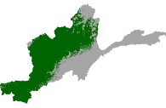
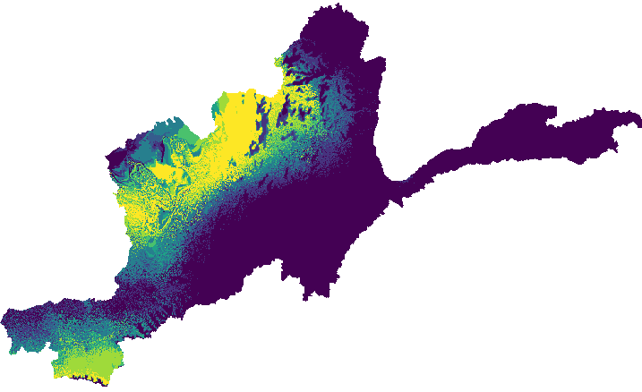
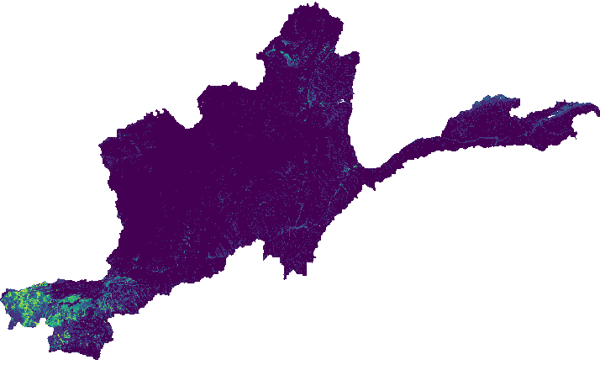
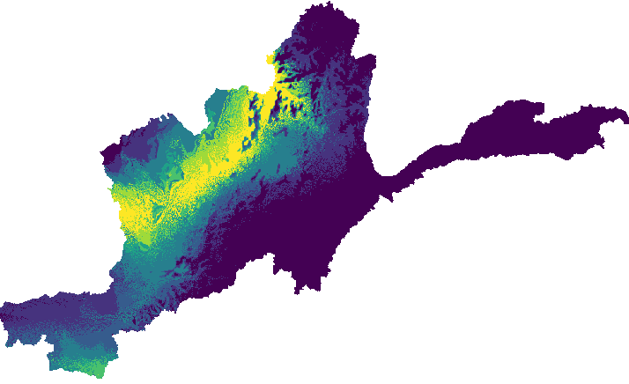
Regional model
Climate predictors
Climate envelop
Present, midcentury and endcentury models
Averaged
Species data
Local predictors
Final local model
Five algorithms
Local model
Repeat 256 times

Slide 12
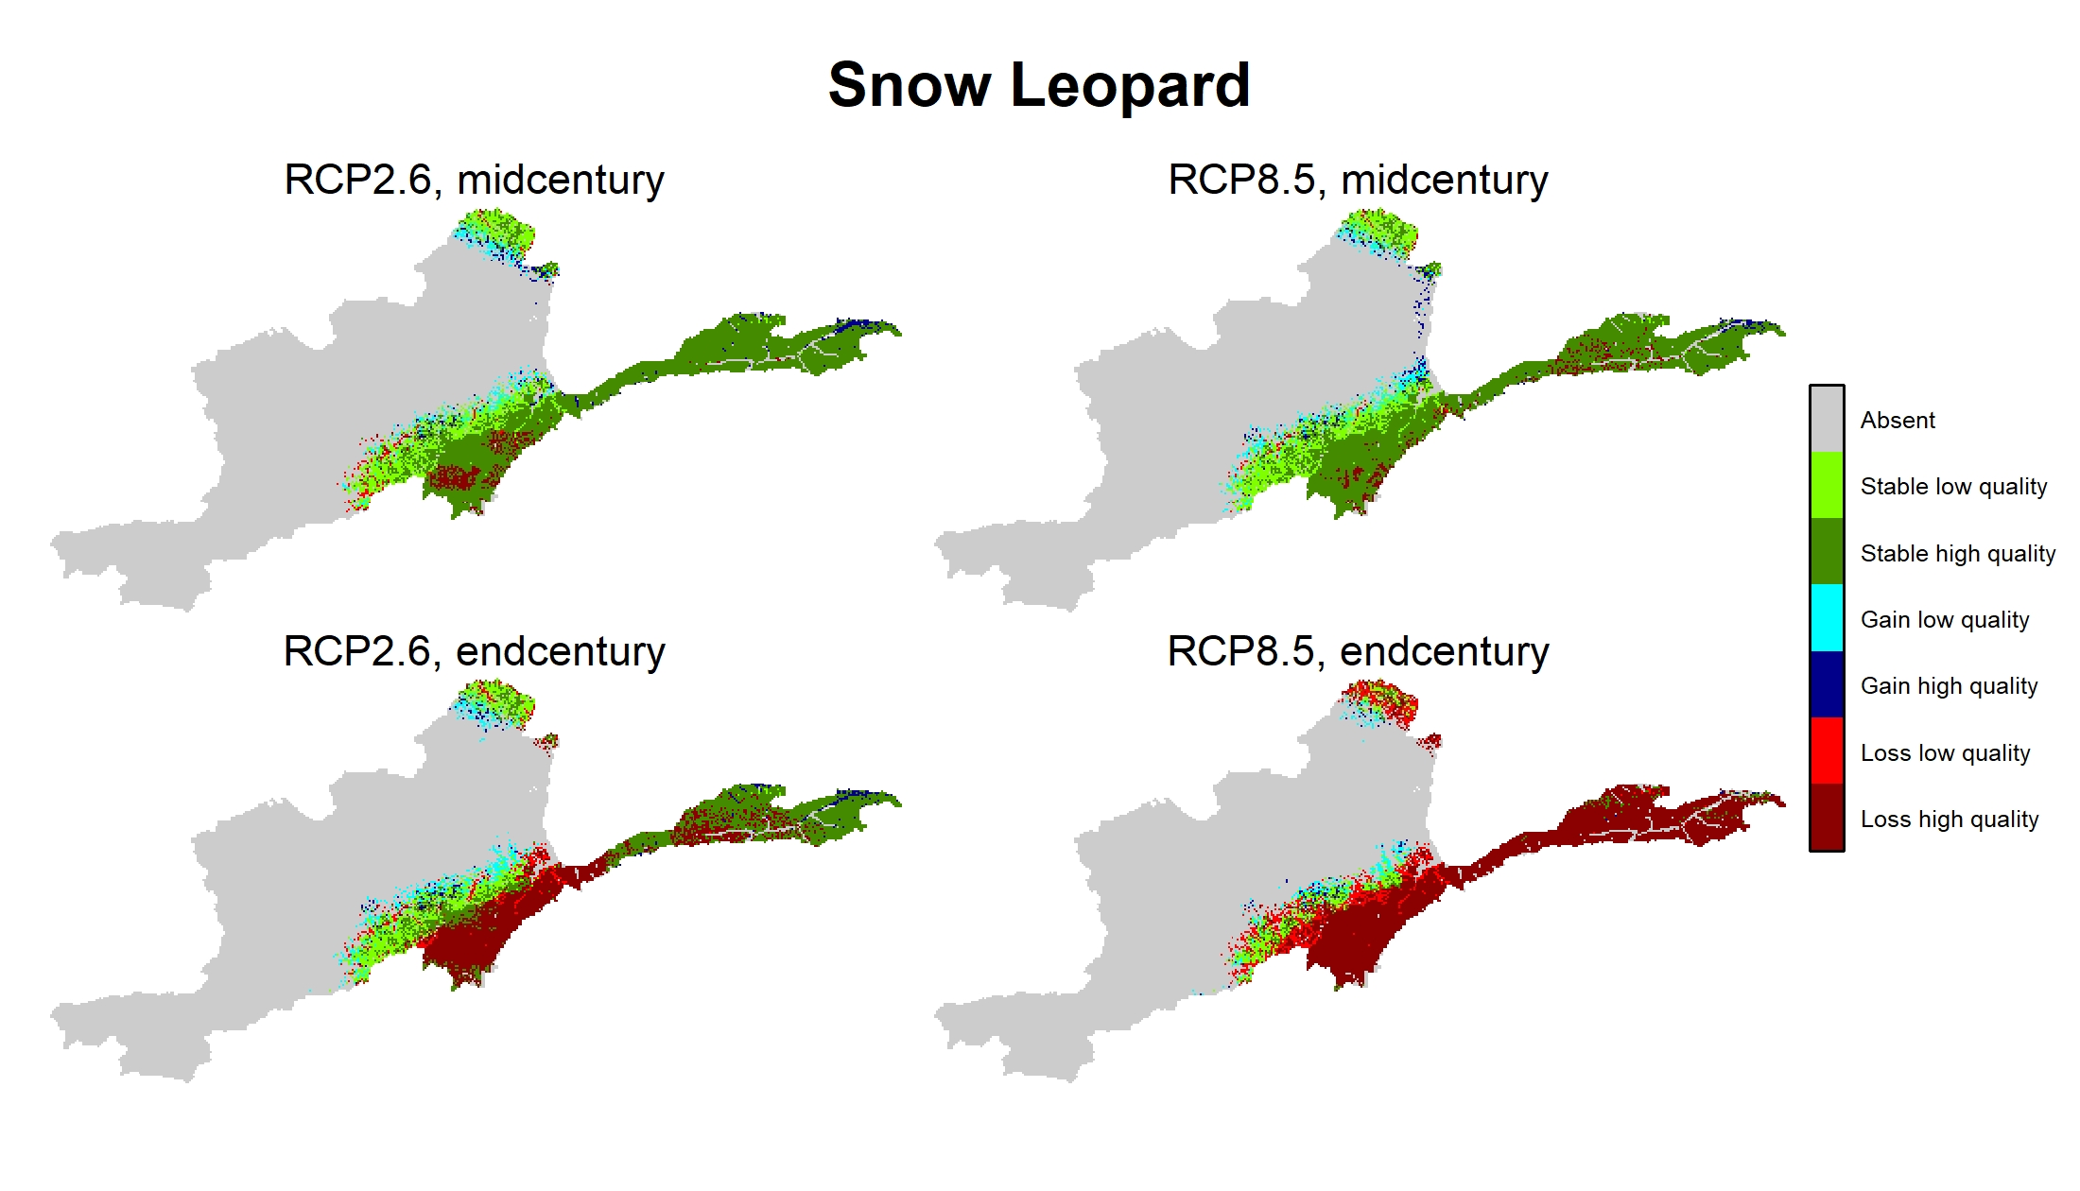

Slide 13
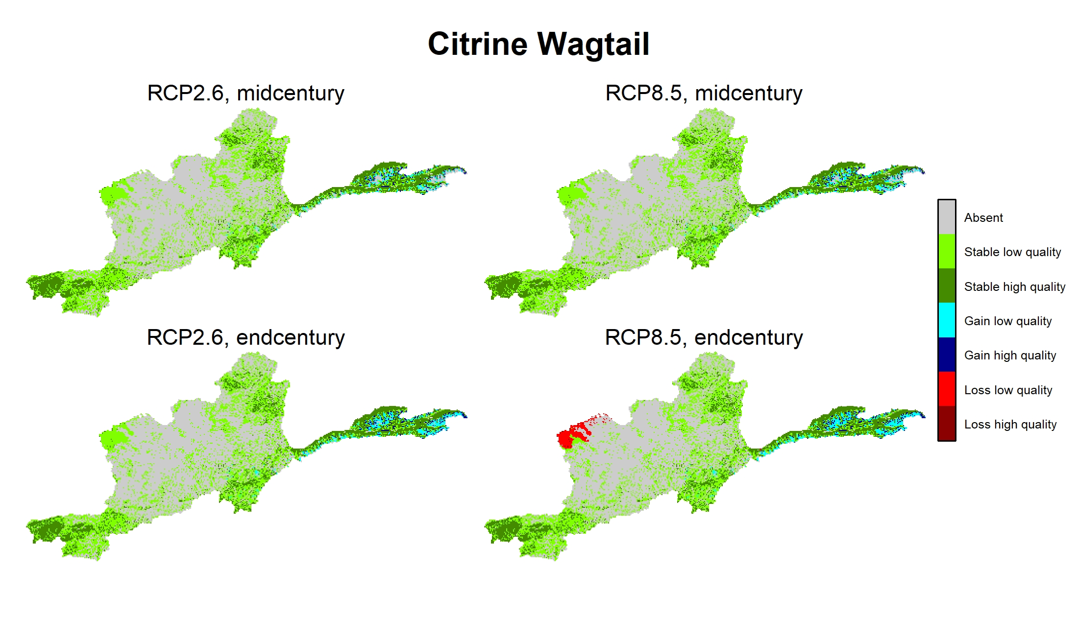

Slide 14
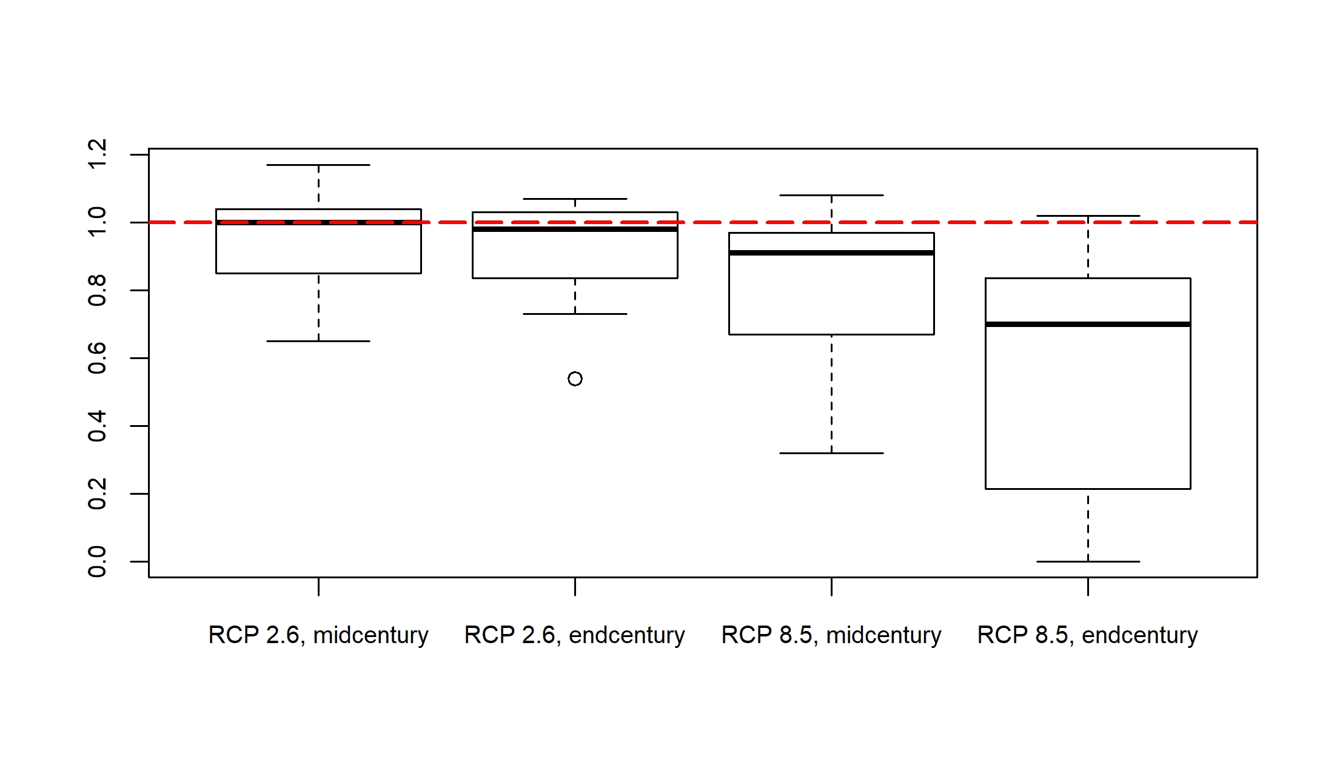

Slide 15
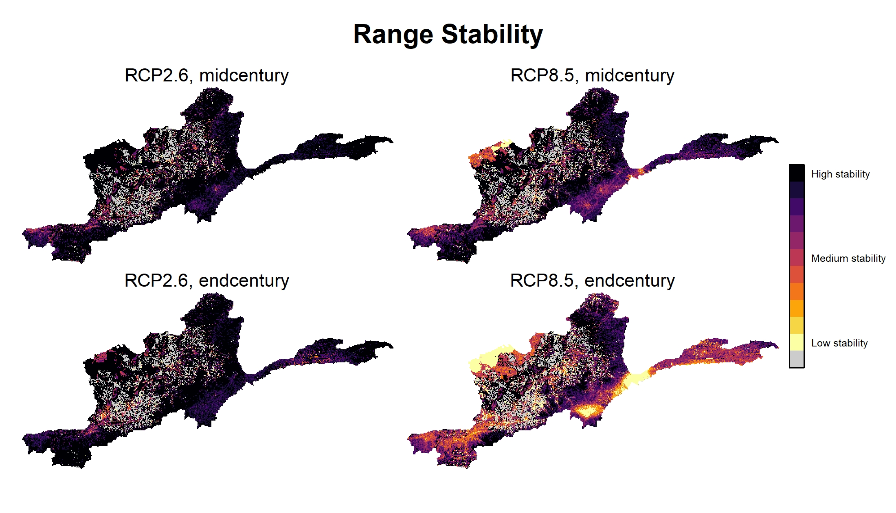

Slide 16
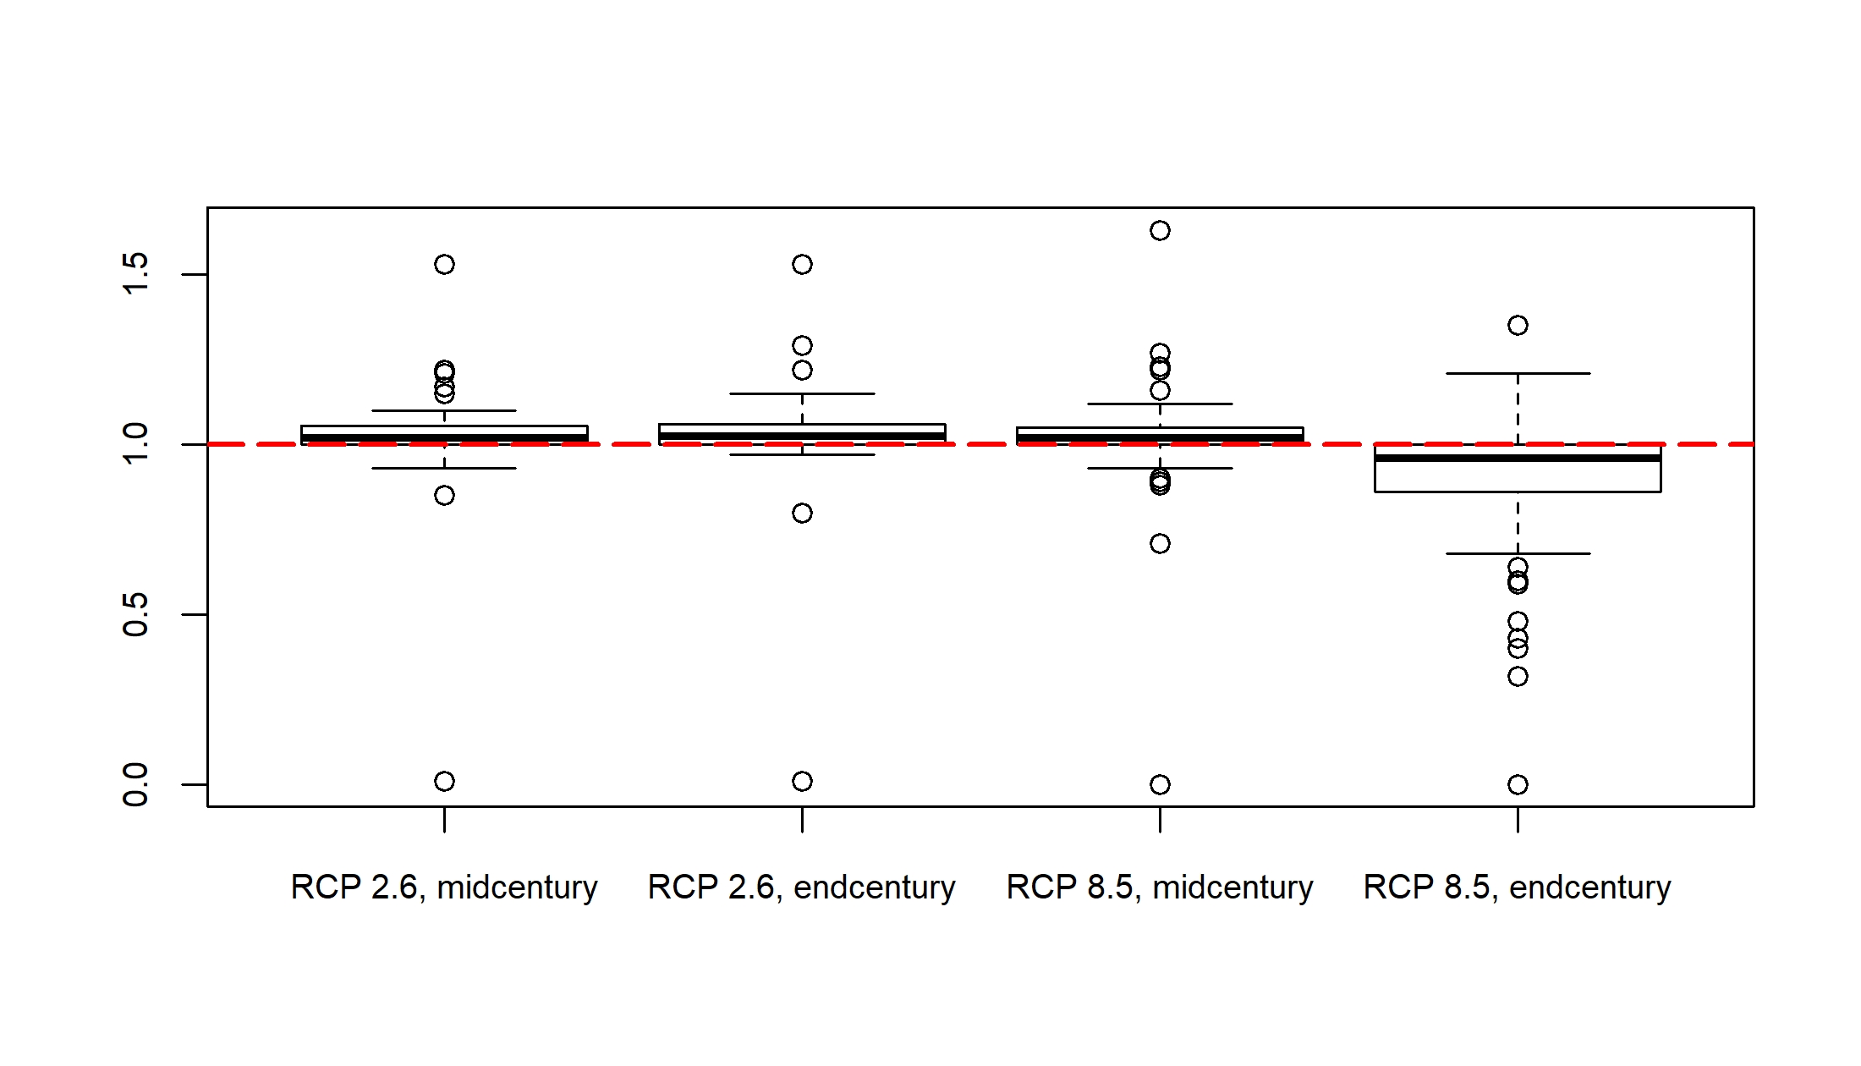

Slide 17
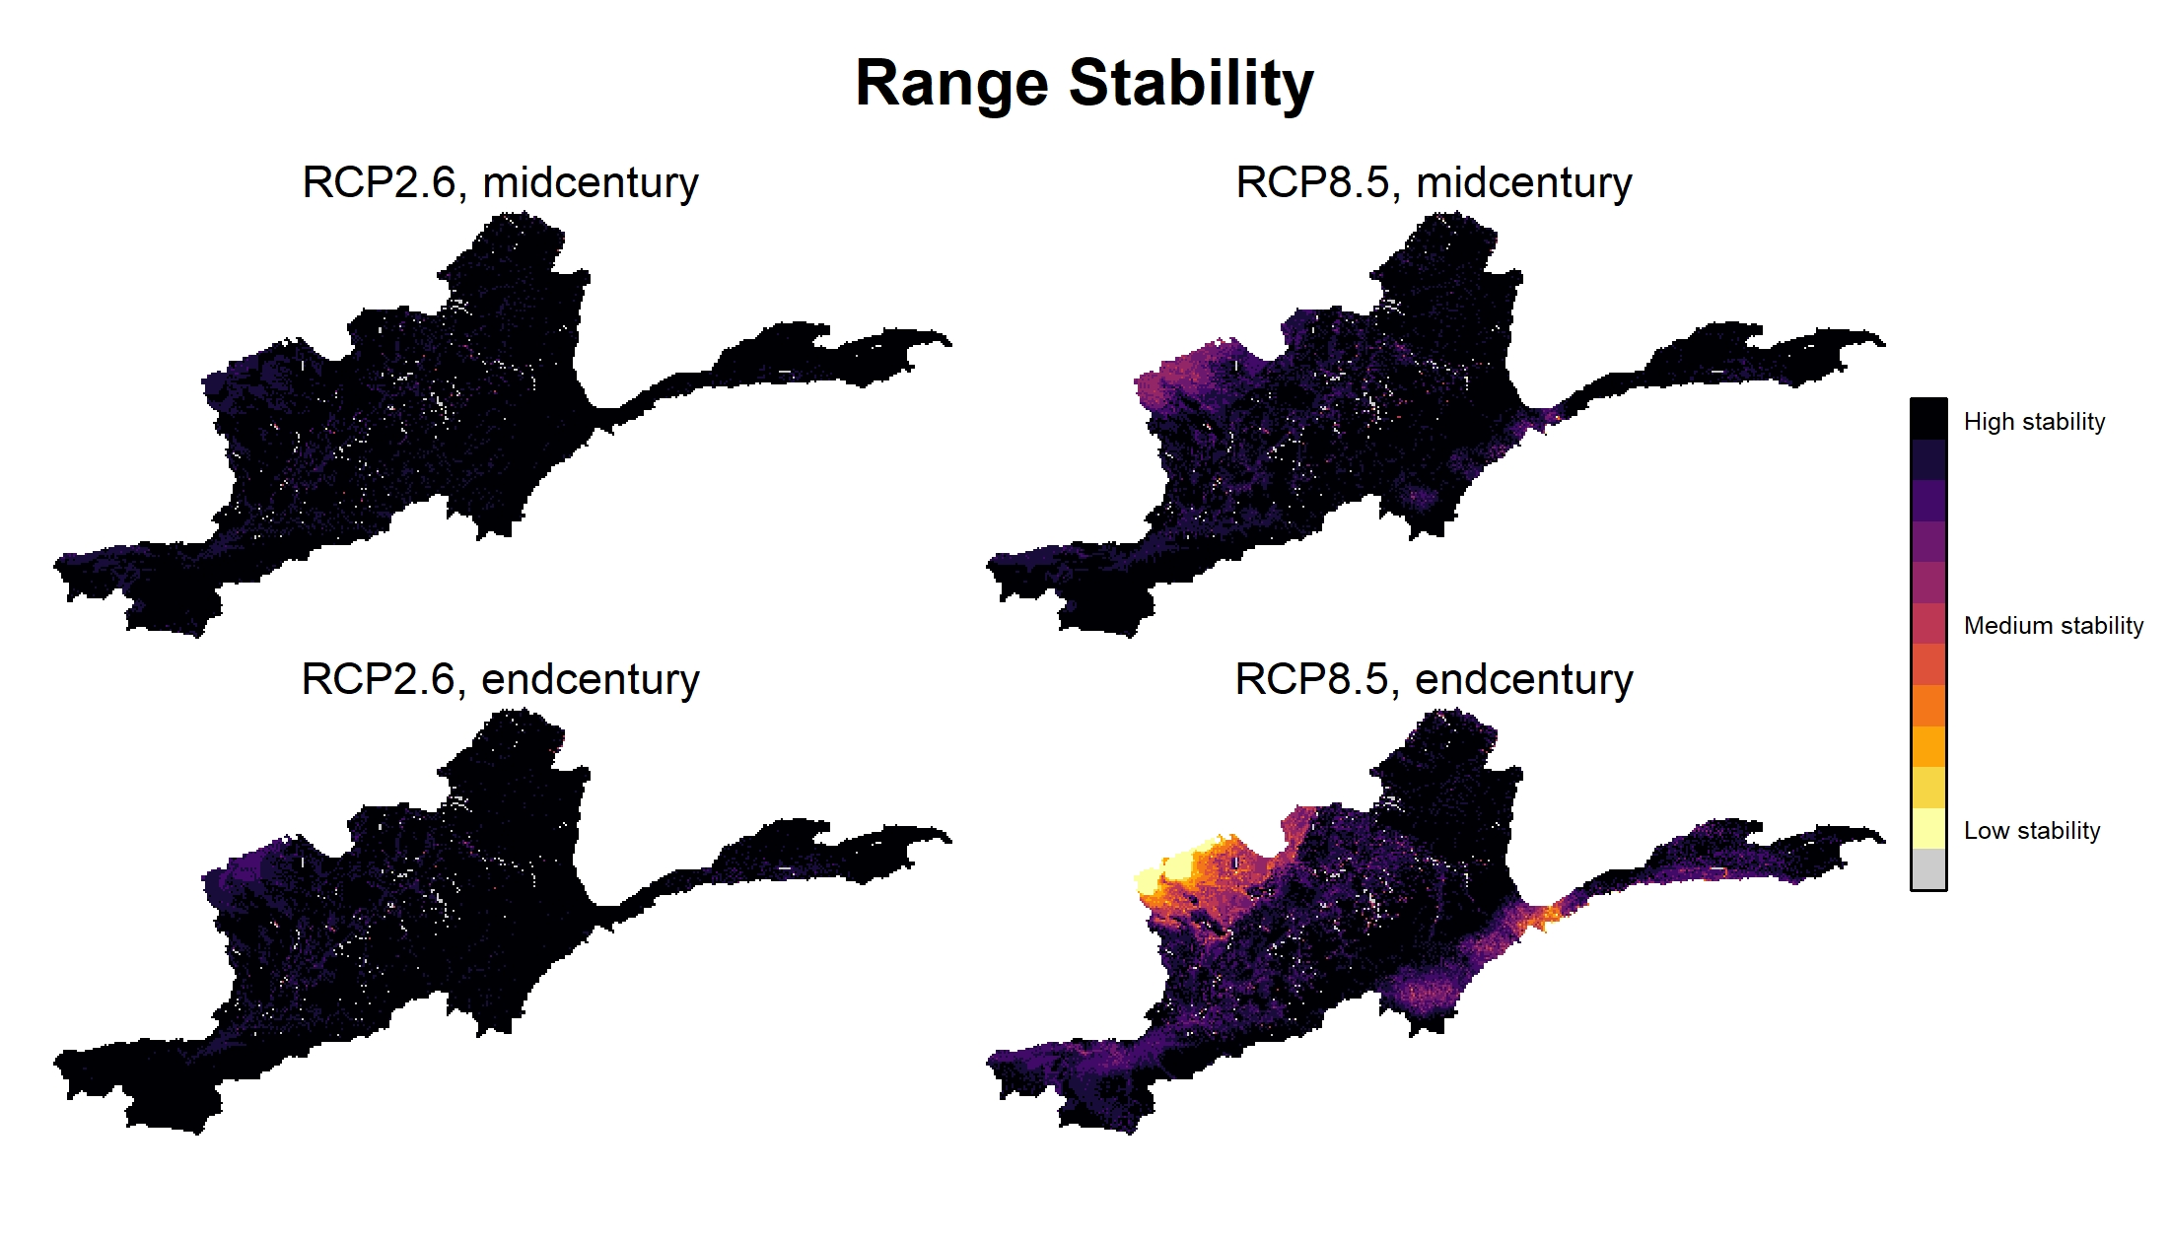

Slide 18
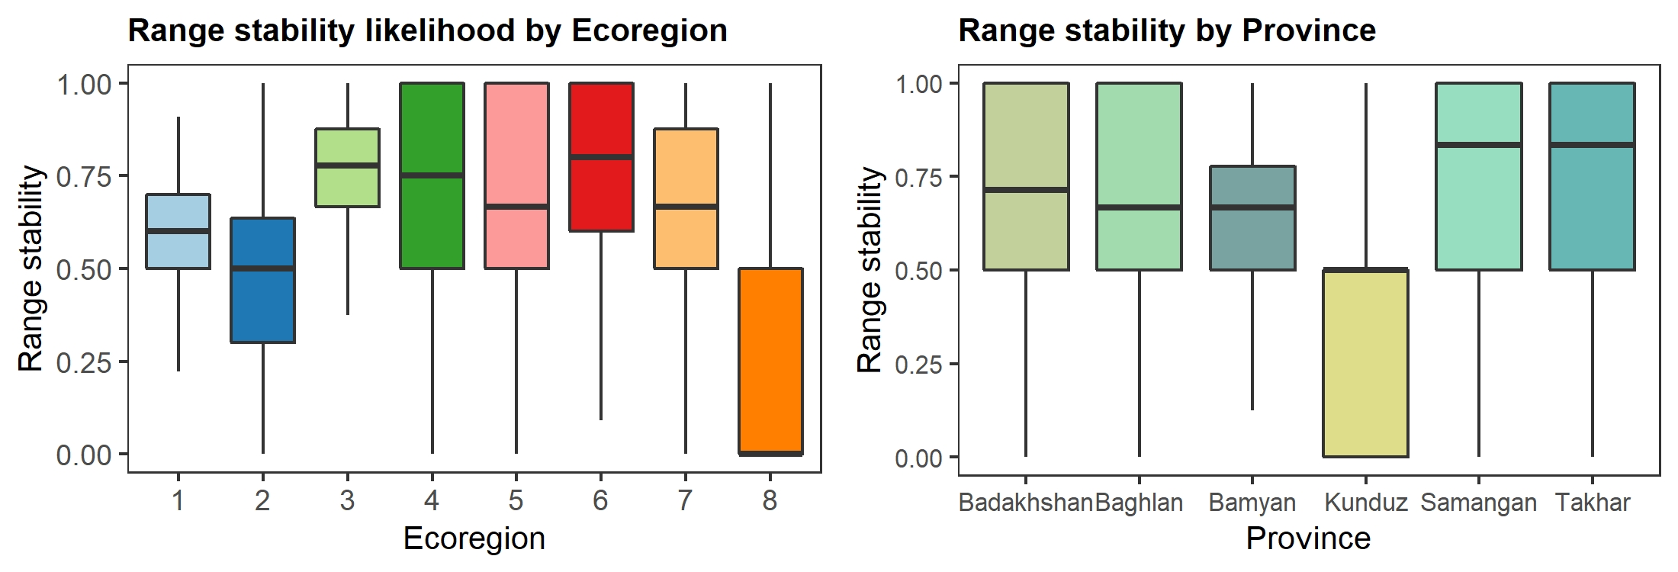

Slide 19
