Slide 2
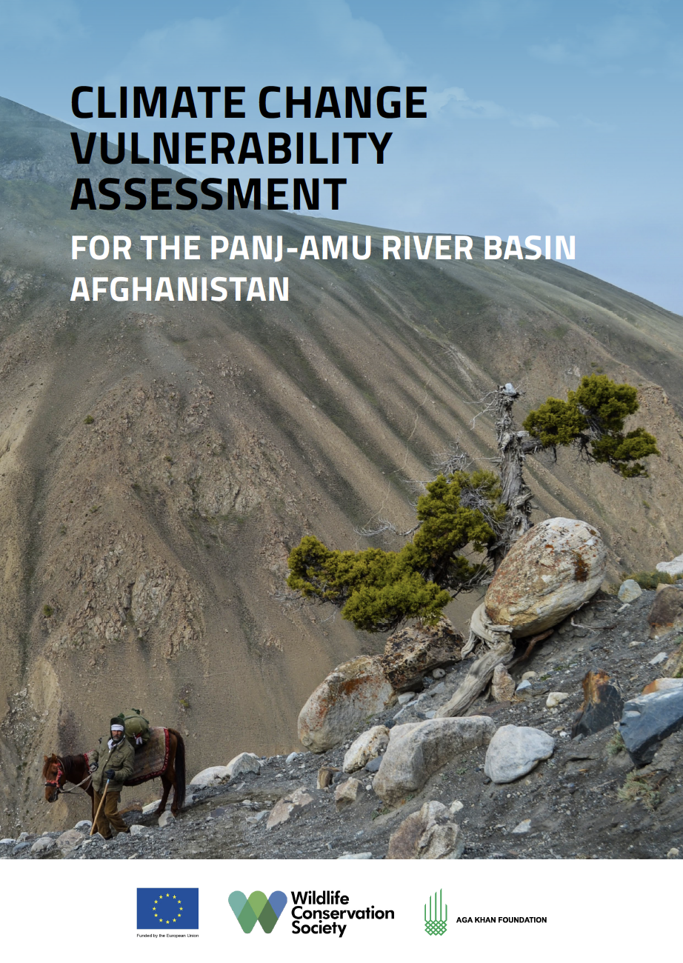


Slide 3
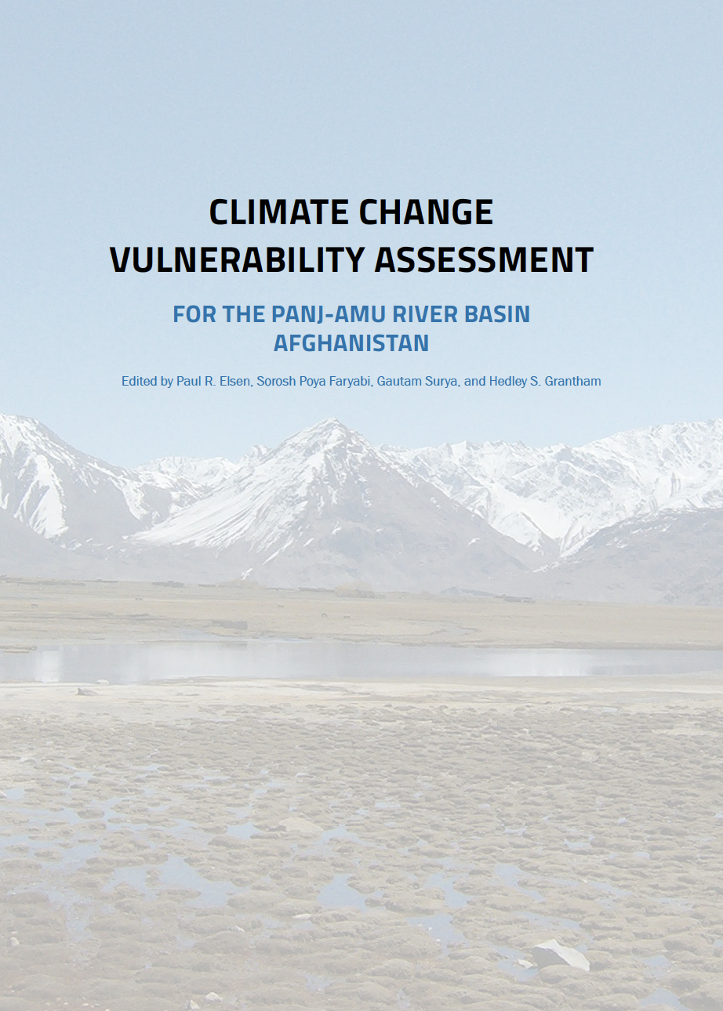
Major Aims
To describe future changes in climatic conditions and natural hazards in the Panj–Amu River Basin and associated vulnerabilities to ecosystems, hydrology, wildlife, natural resources, and local communities
To provide recommendations for policy and management for each sector
To inform long-term monitoring decisions and priorities

Slide 4
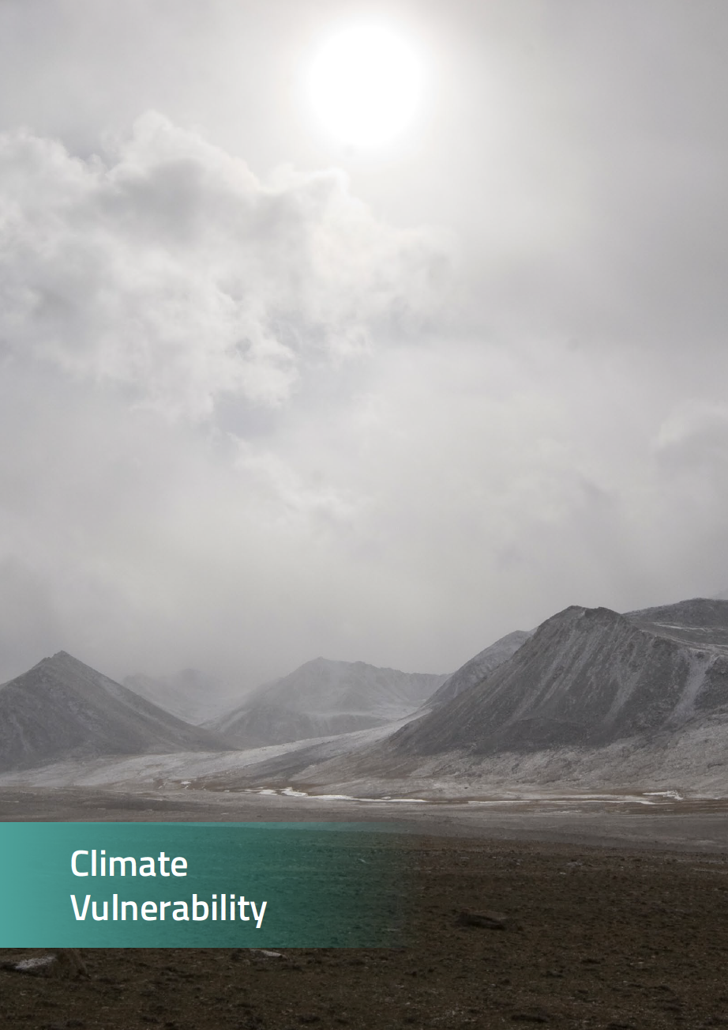
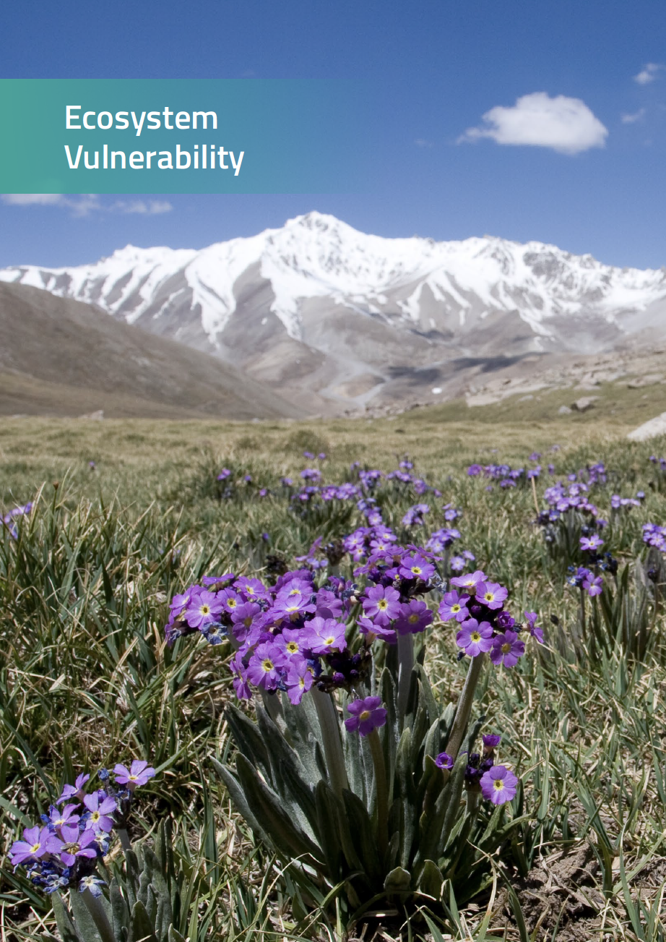
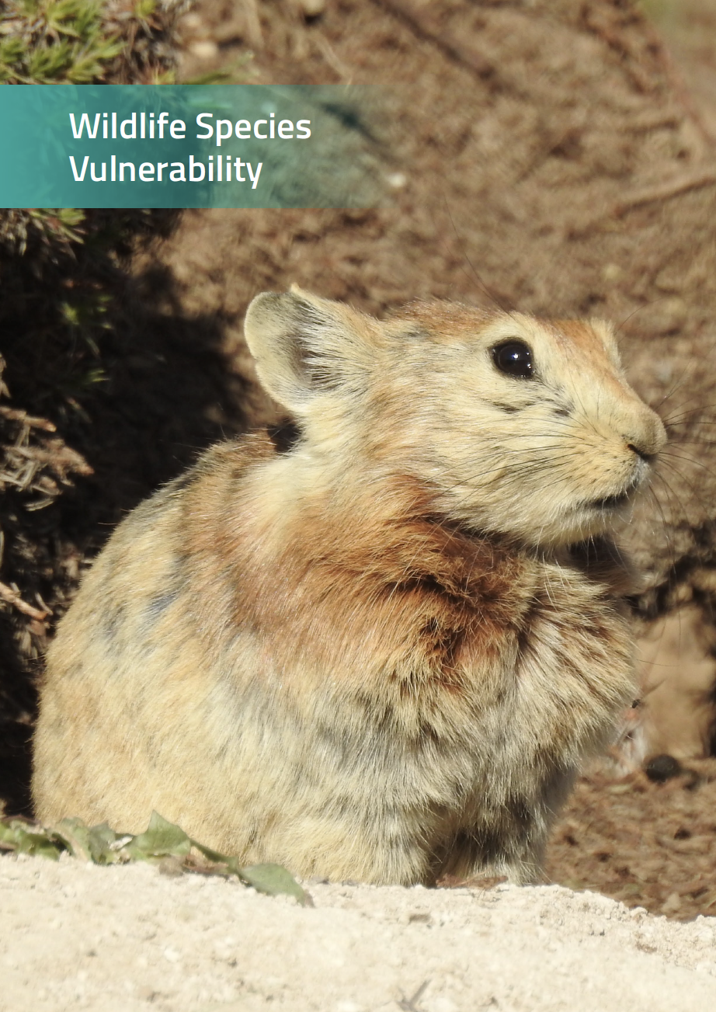
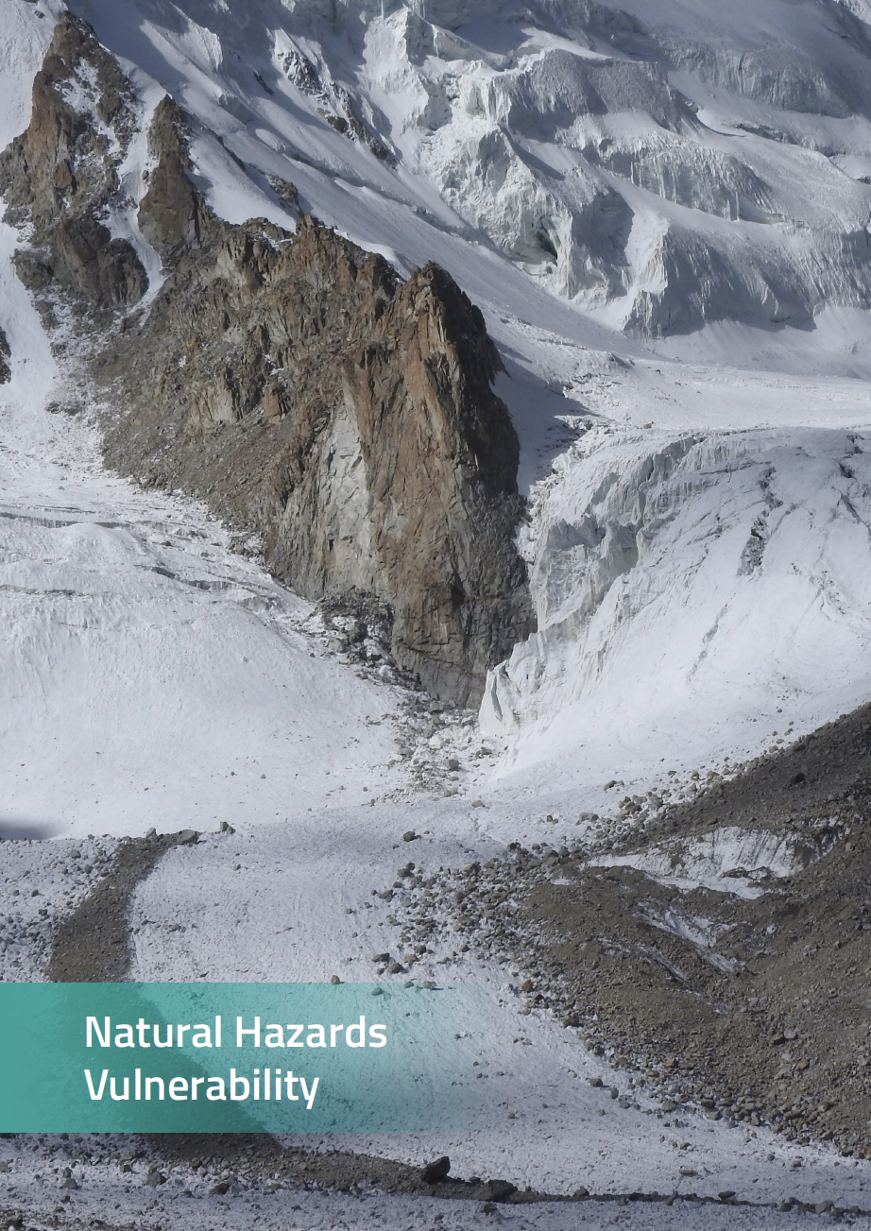
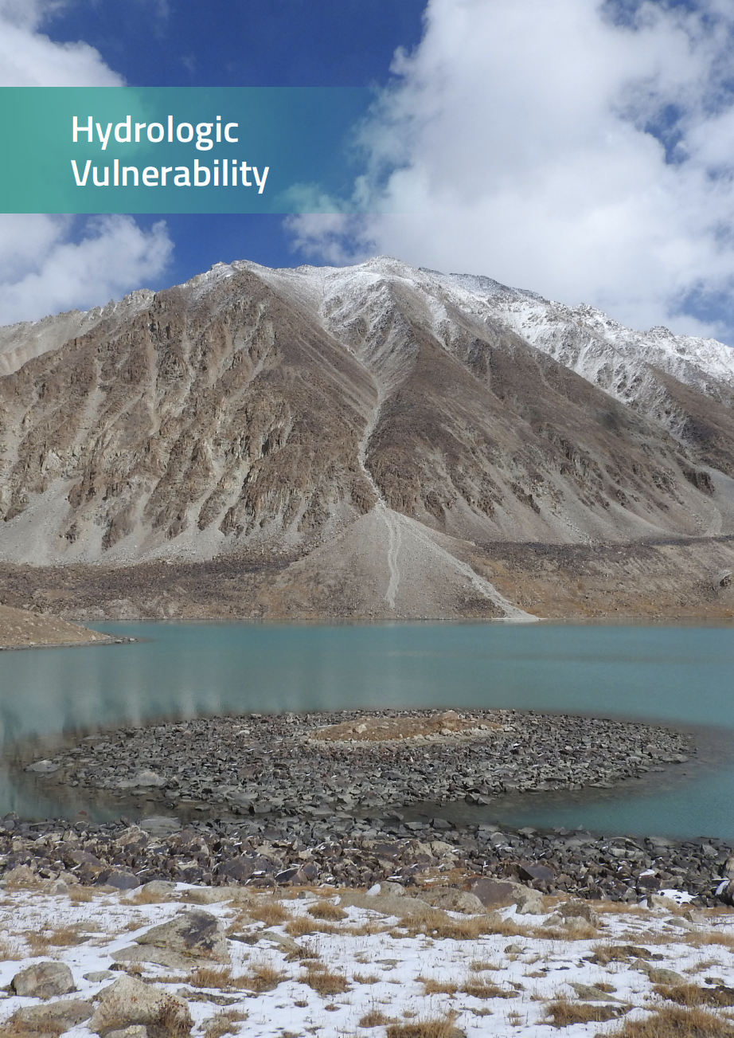
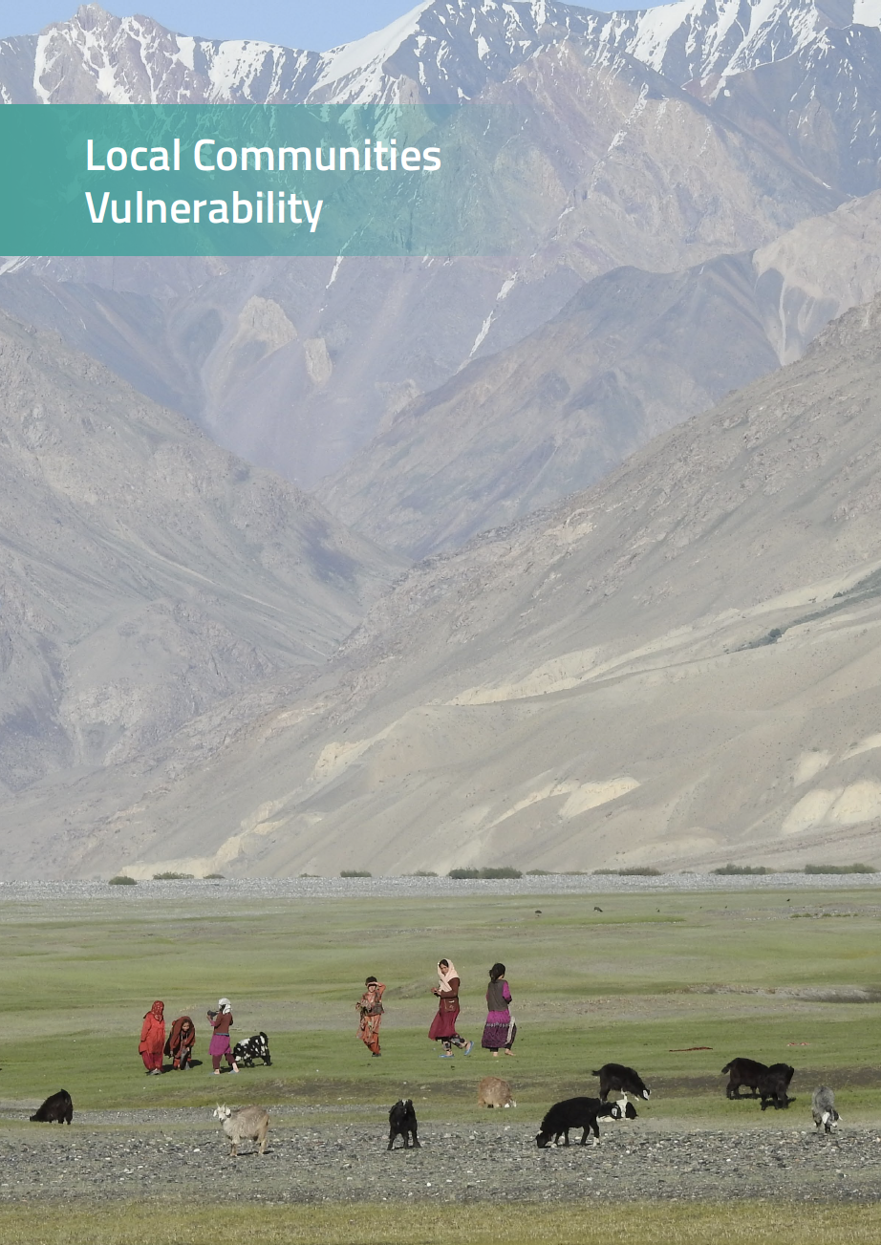
Vulnerability assessment covers six sectors

Slide 5
Ecosystem vulnerability

Slide 6
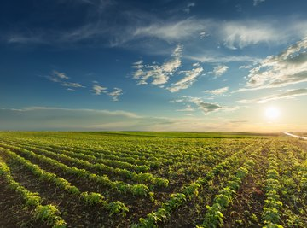
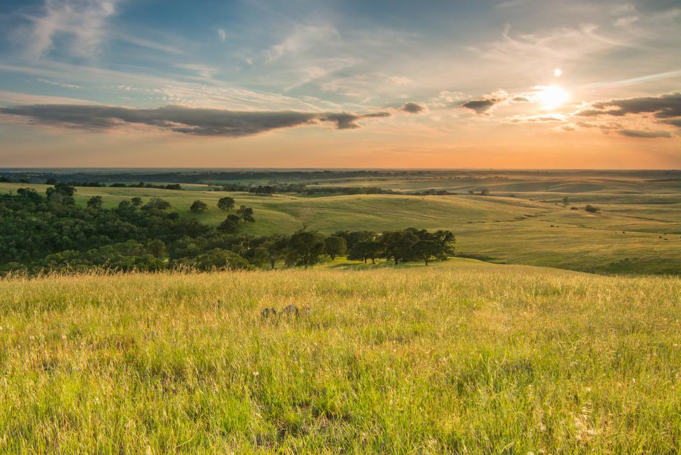
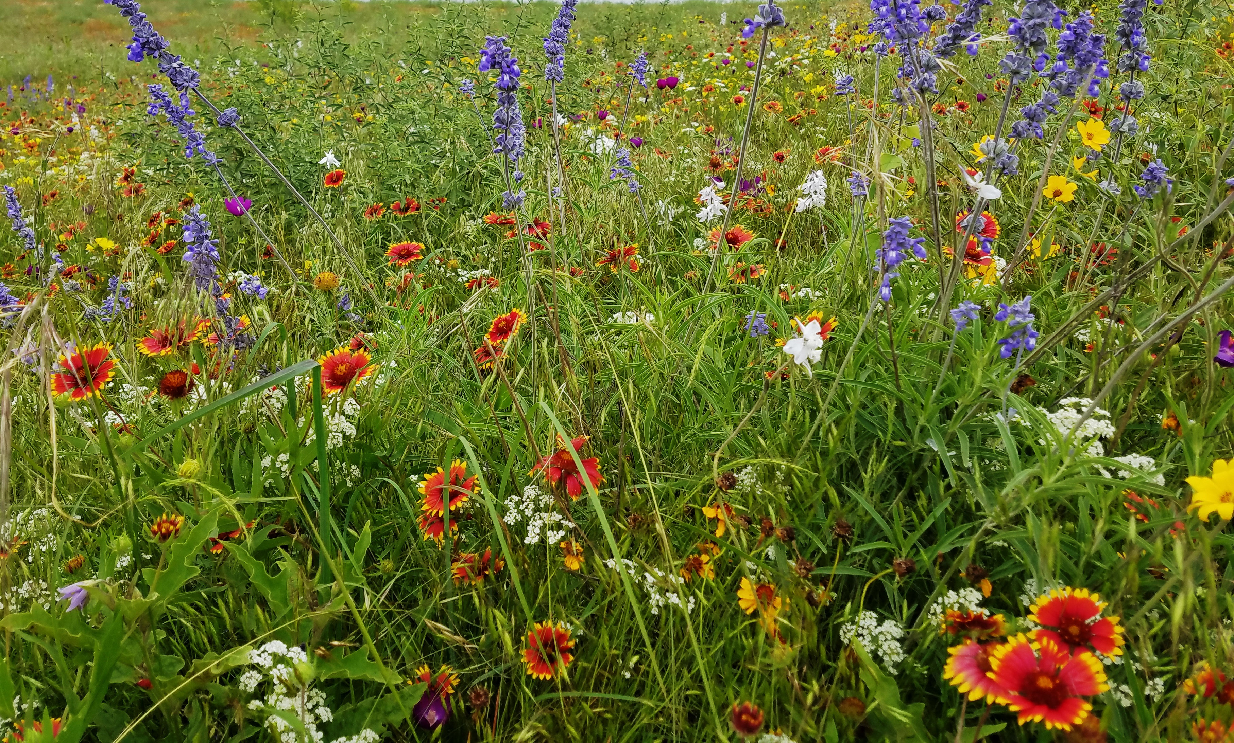
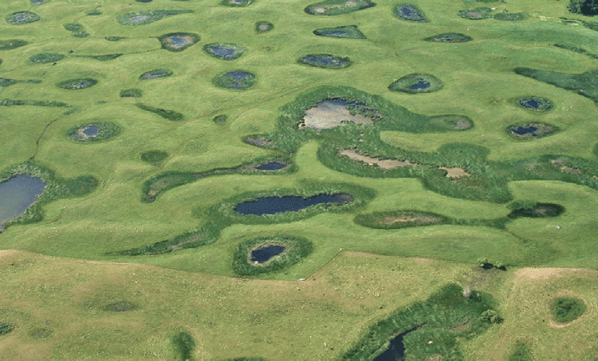
Healthy ecosystems provide important services for people and biodiversity
FOOD PRODUCTION
CARBON STORAGE
POLLINATION
WATER SUPPLY

Slide 7
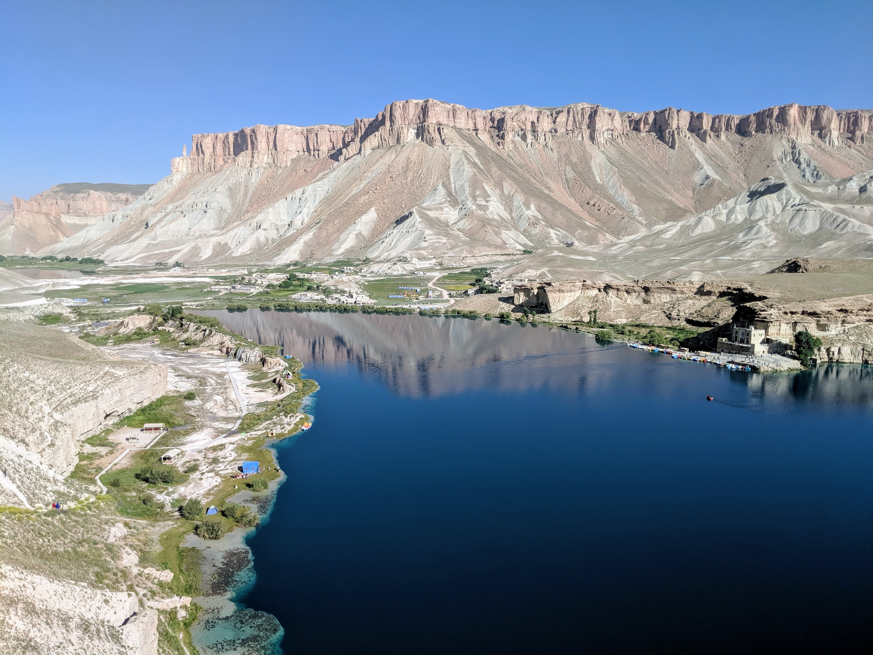
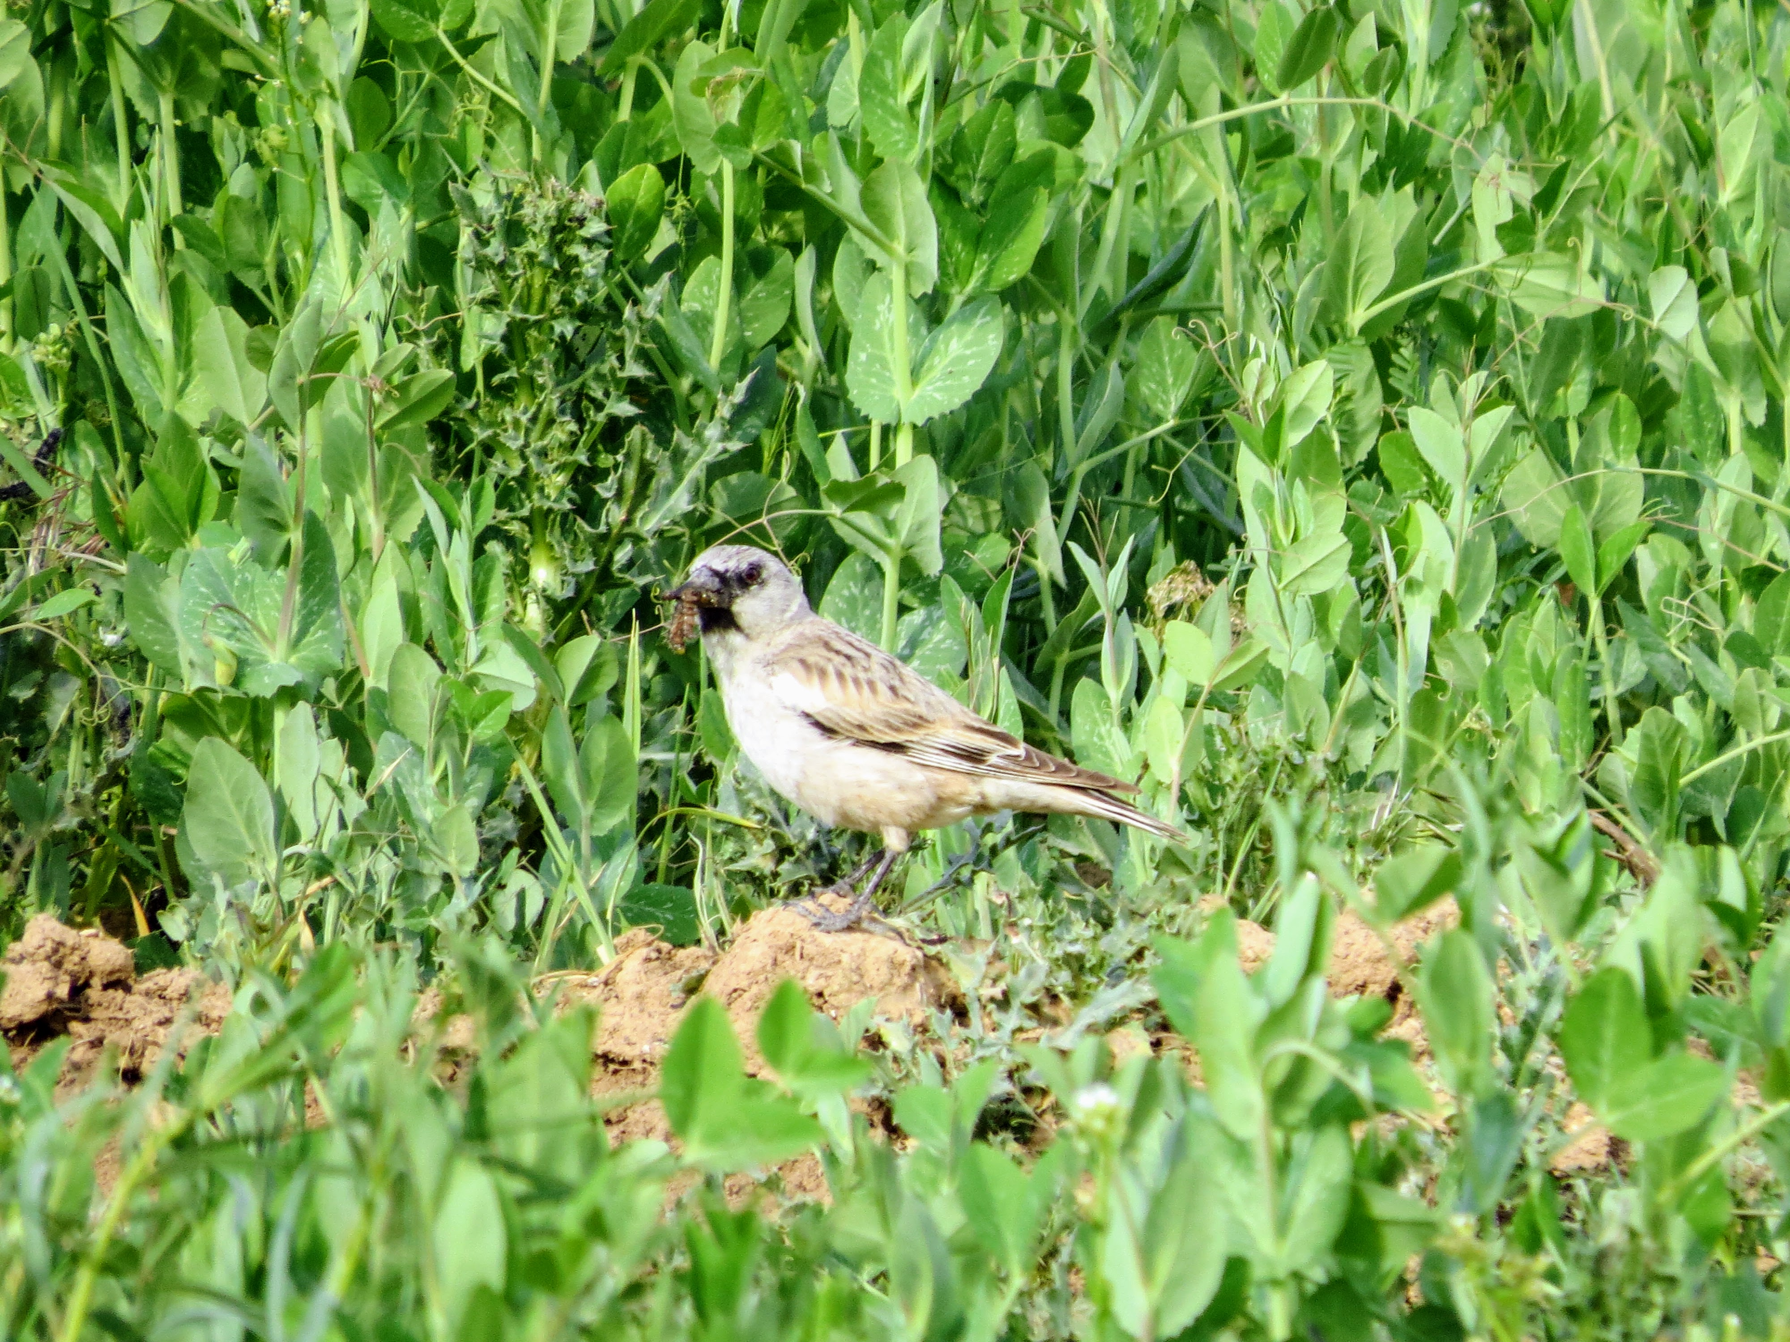
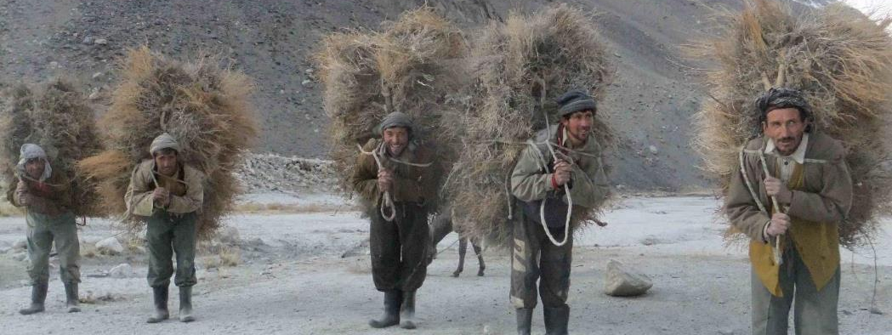
Cultural value
Biodiversity value
Value to local communities

Slide 8
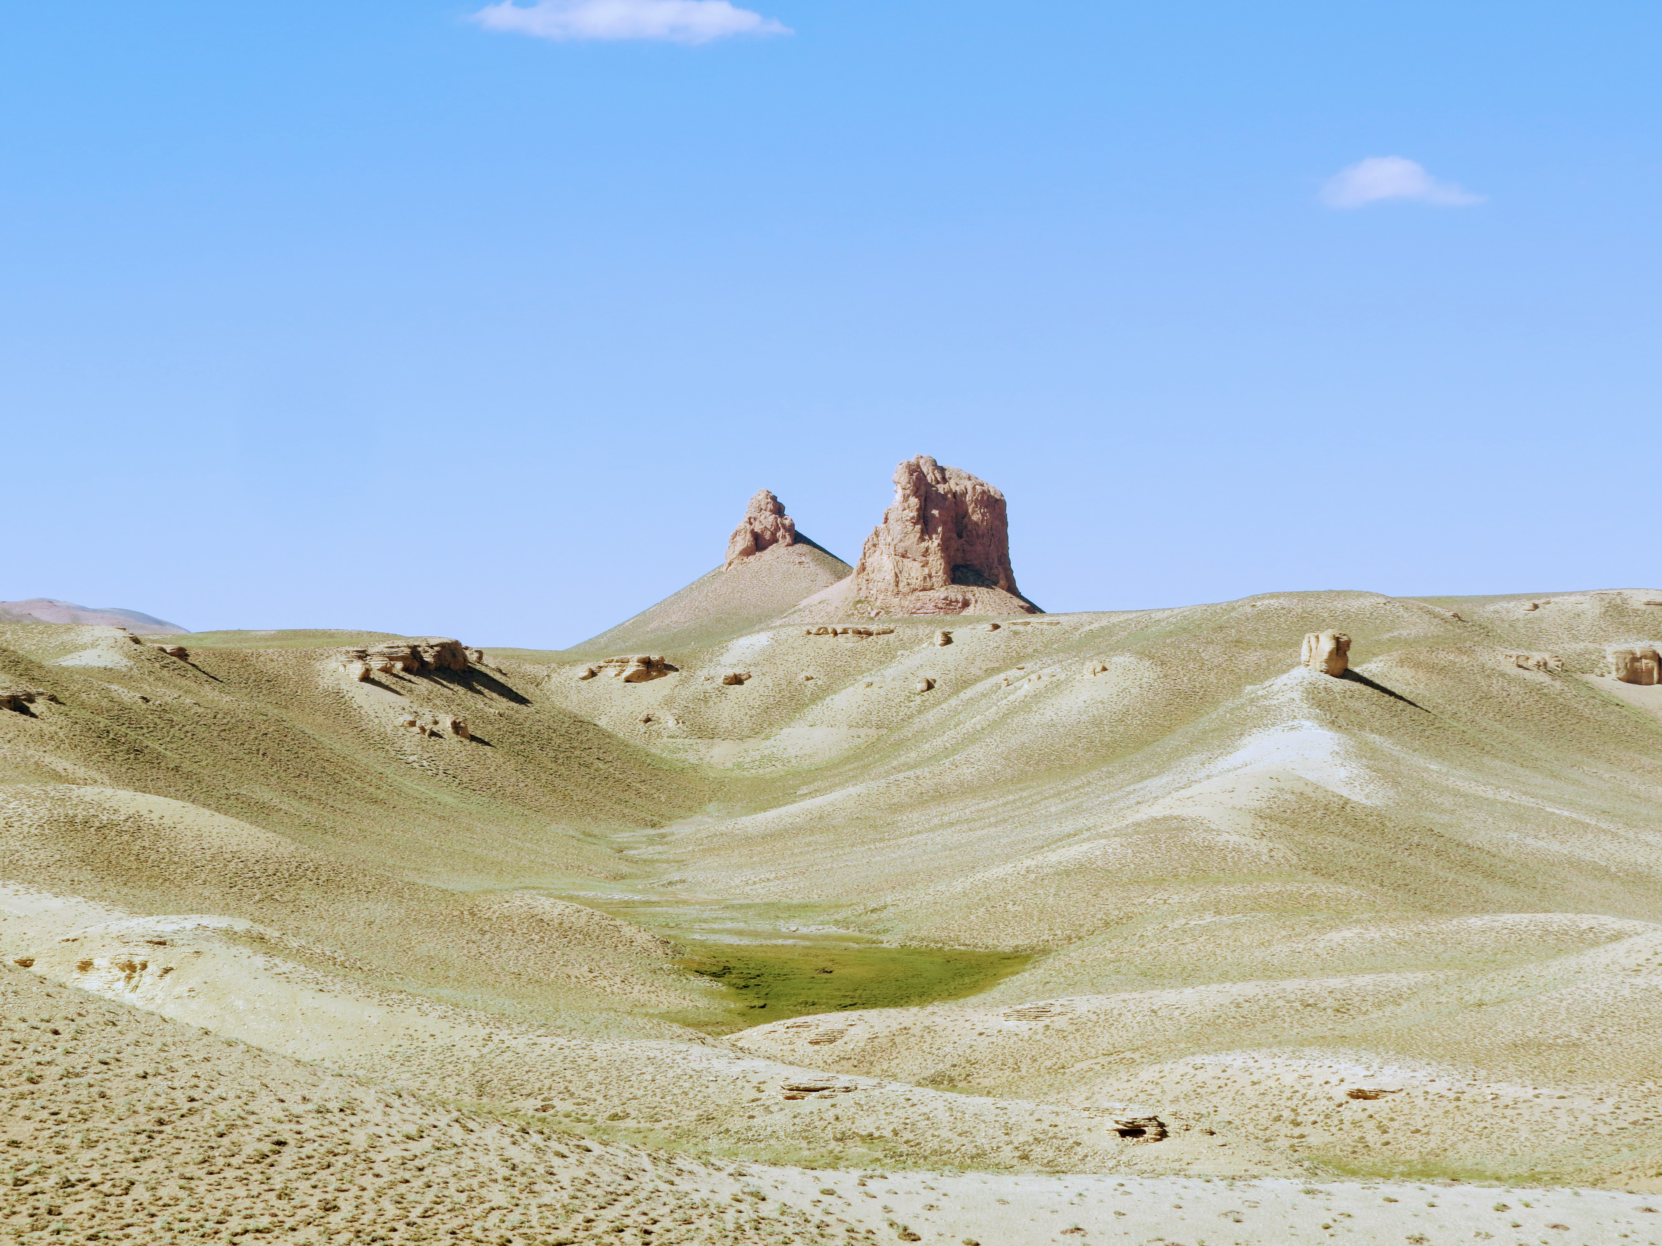
Rangeland degradation in Afghanistan

Slide 9
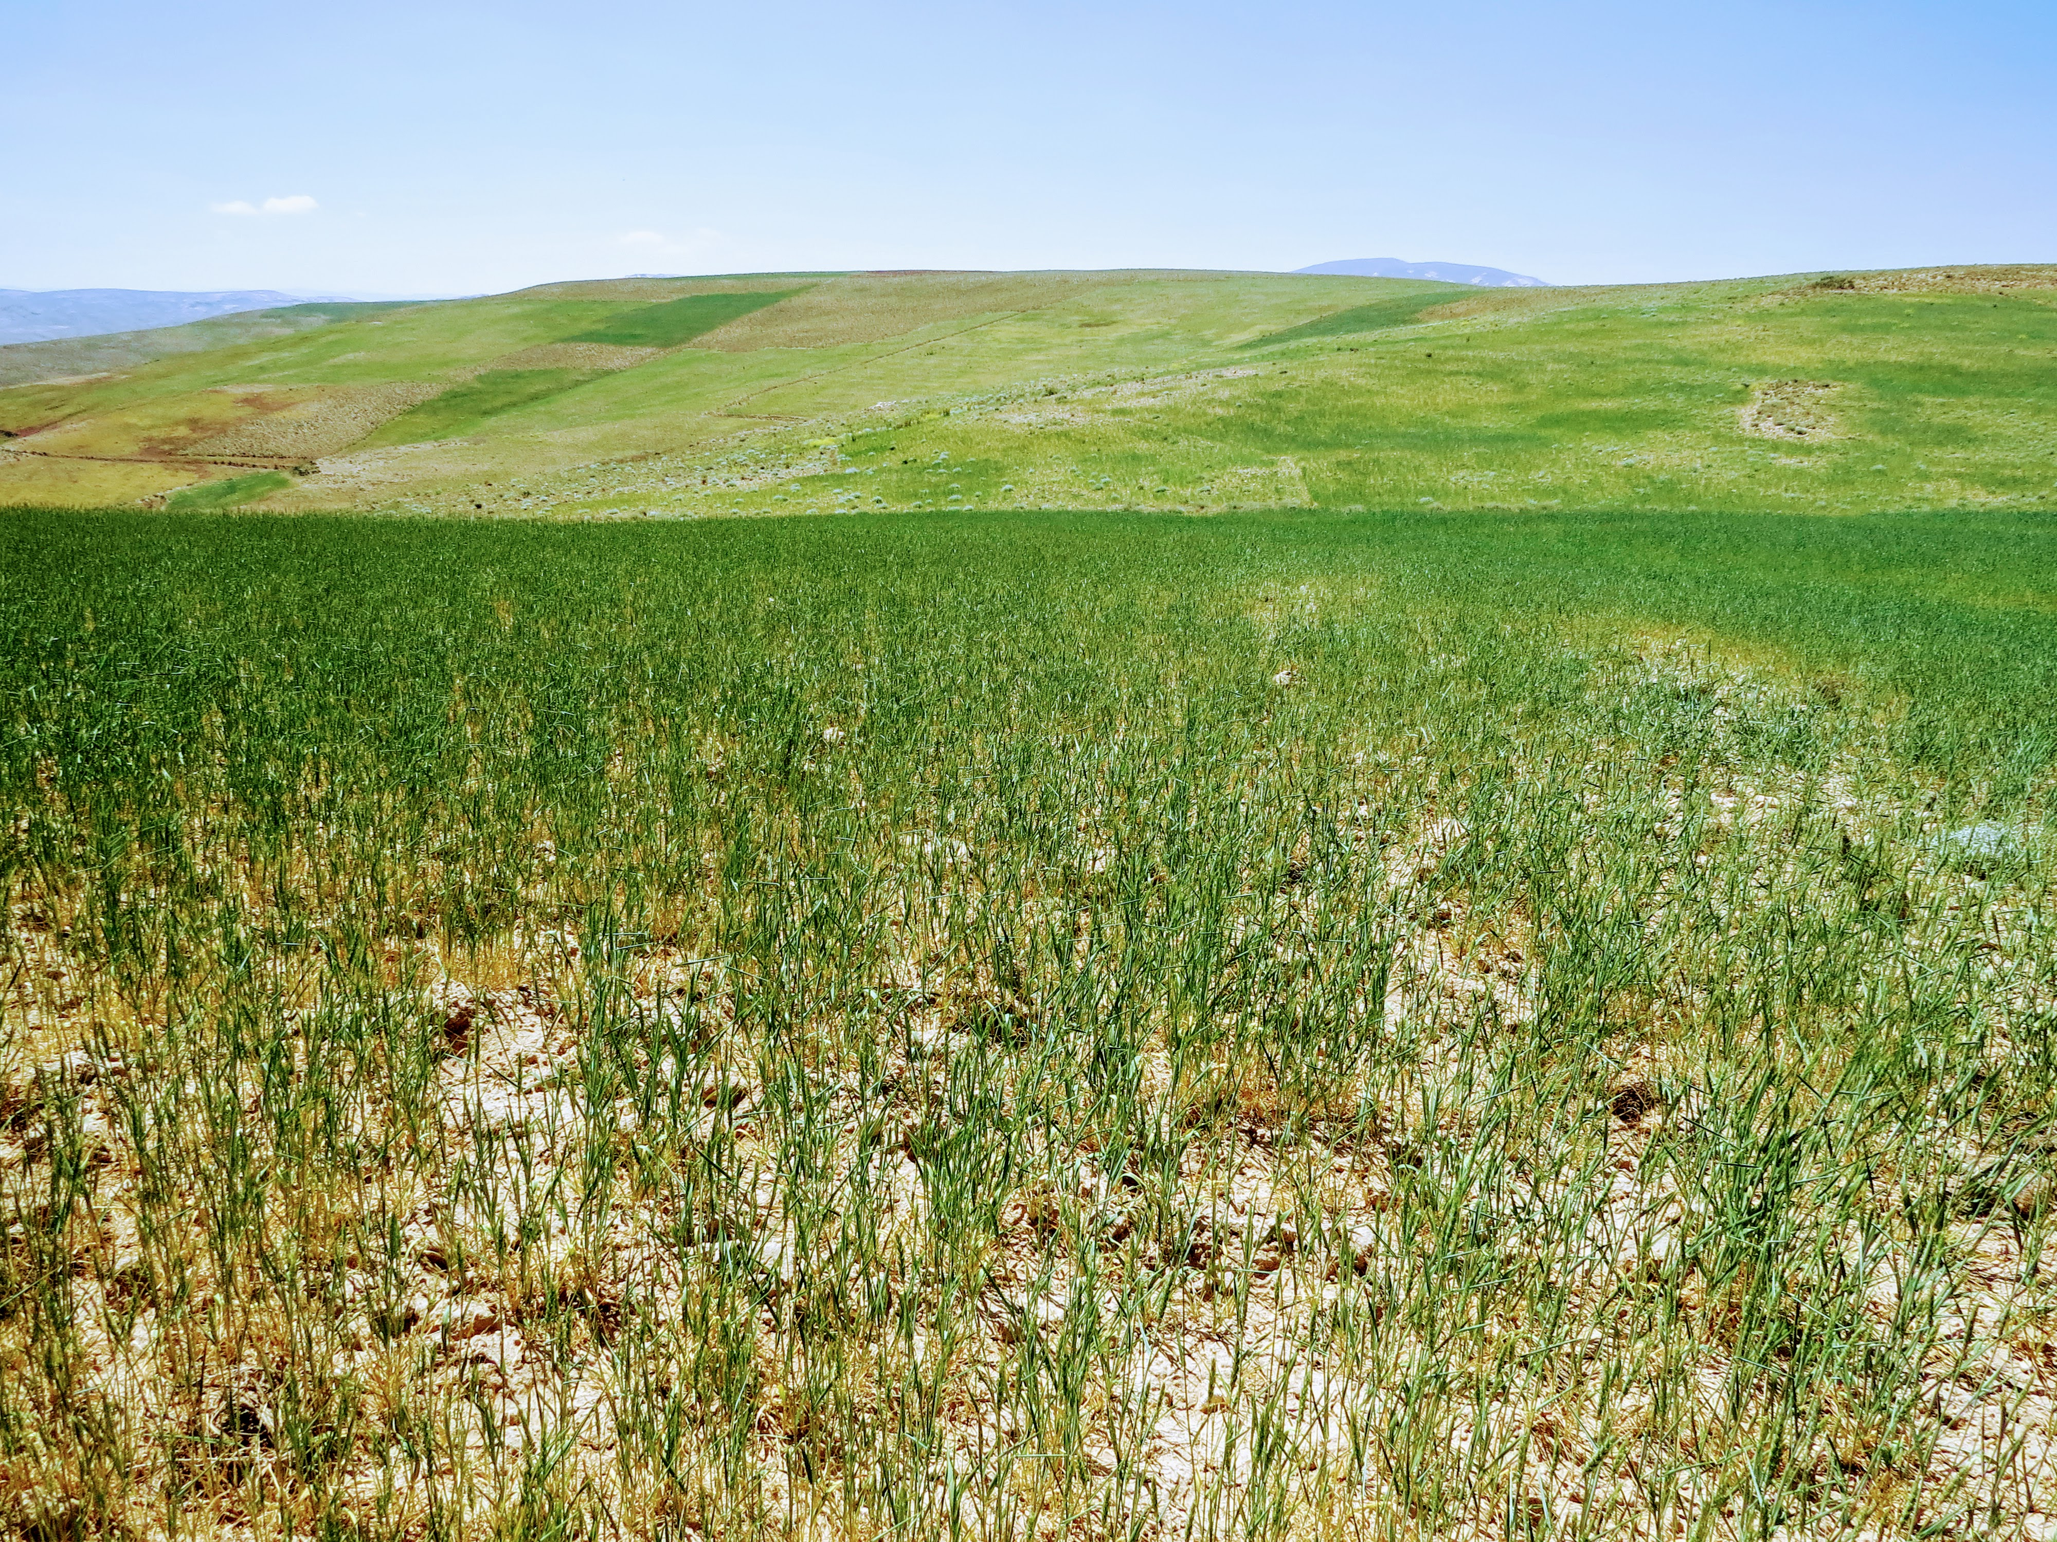
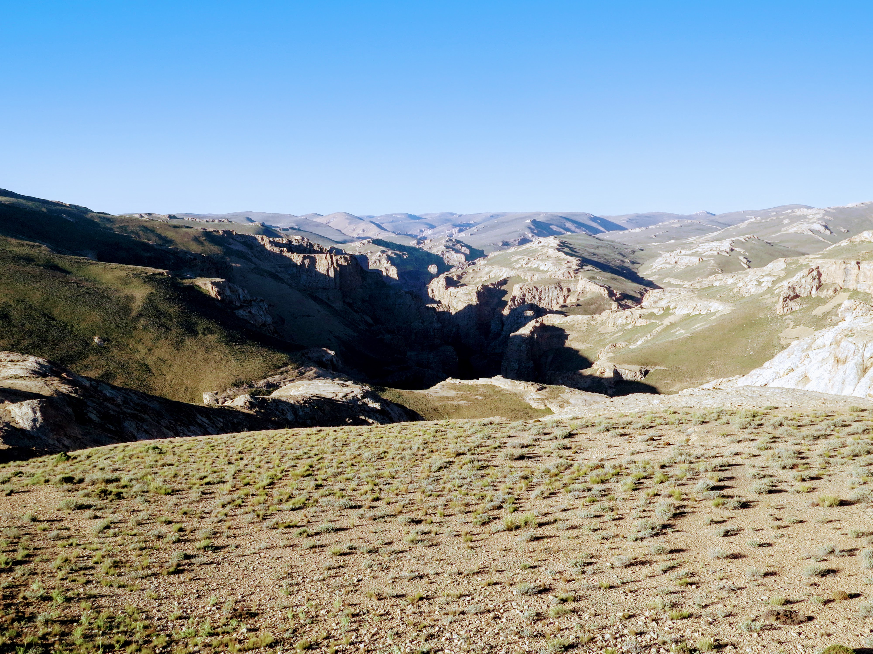
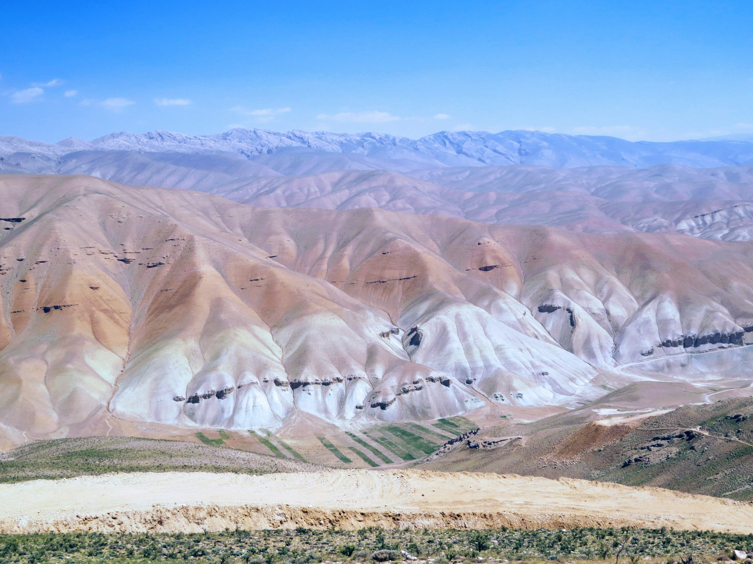
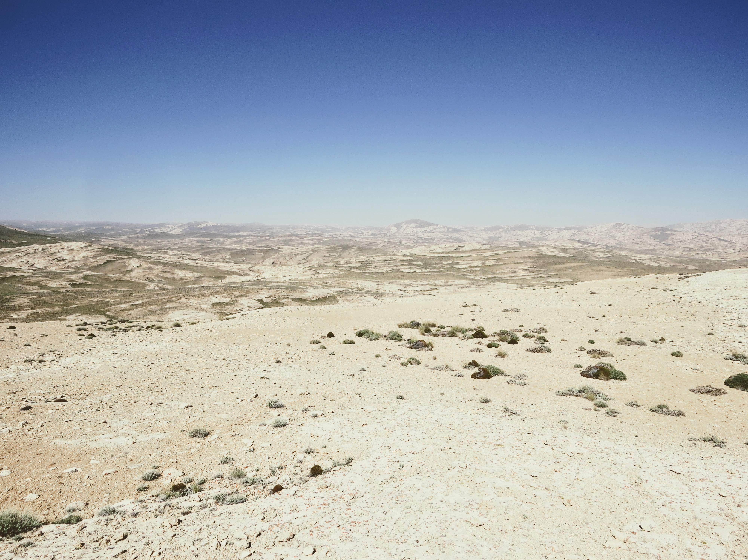
Conversion to rainfed agriculture
Overgrazing by livestock
Development of
new road networks
Reduced rainfall and drought

Slide 10
Geographic scope

Slide 11
Provinces and ecoregions
Ecoregions
Provinces

Slide 12
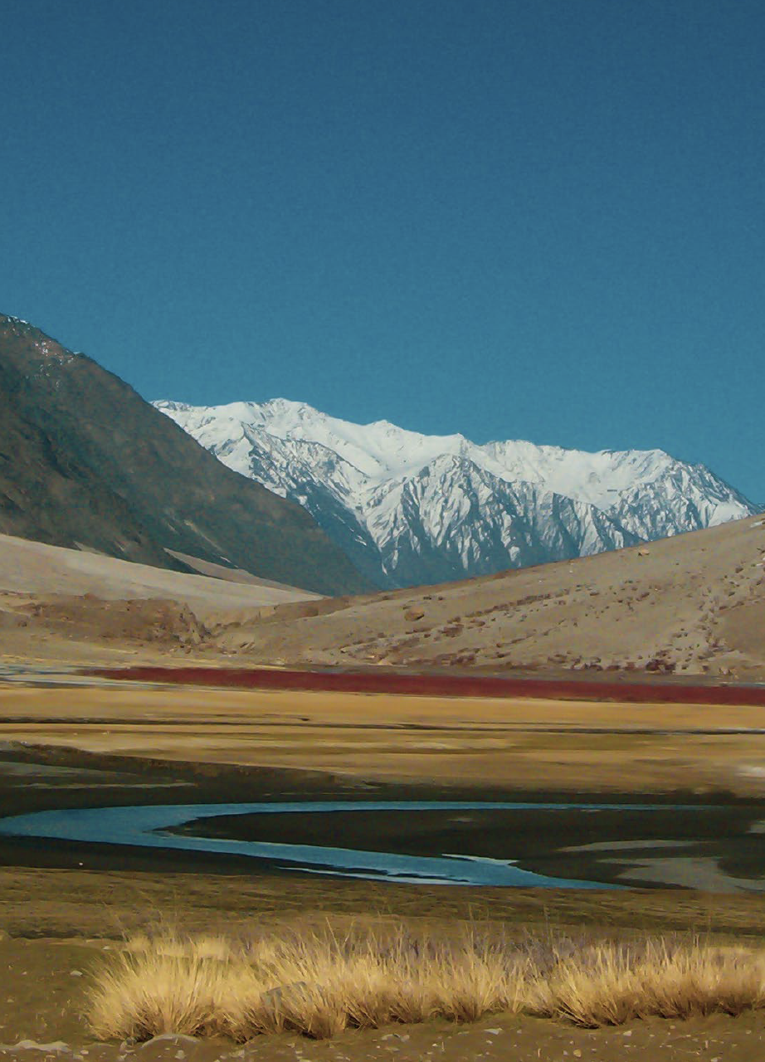
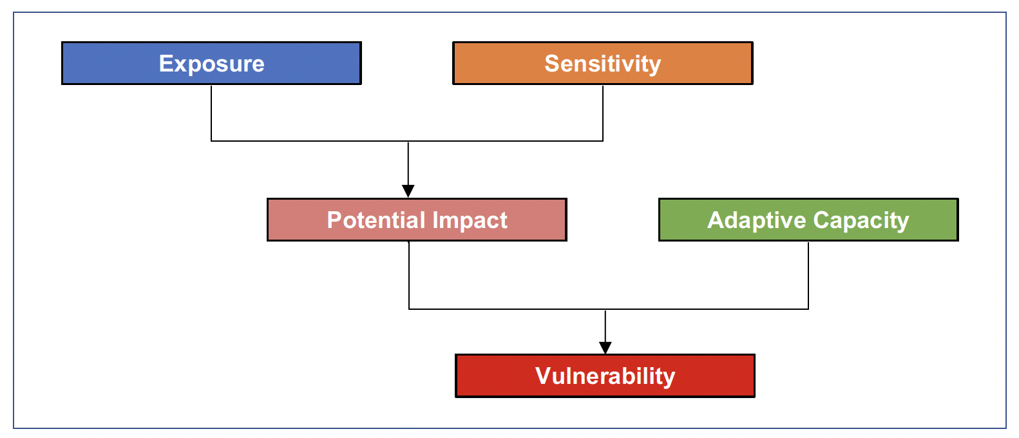
Components of Vulnerability
Exposure refers to the amount of climate change likely to be experienced by an ecosystem
Sensitivity refers to the amount of impact that an ecosystem suffers given amount of exposure
Adaptive capacity refers to the capacity of an ecosystem to cope with or withstand the change or impact

Slide 13
Category | Indicator | Vulnerability Component Assessed
Ecosystem | Changes in land cover | Exposure
Ecosystem | Ecosystem carbon | Adaptive capacity
Ecosystem | Changes in NDVI | Exposure
Ecosystem | Changes in rangeland condition | Exposure
Ecosystem | Ecosystem protection status | Adaptive capacity
Ecosystem | Shifts in ecoregions | Exposure
Ecosystem | Thermal heterogeneity | Adaptive capacity
Ecosystem | Topographic heterogeneity | Adaptive capacity

Slide 14
Changes in land cover
Assessed changes in natural land cover from 1992-2020 using ESA CCI land cover maps at 300 m spatial resolution

Slide 16
Ecosystem carbon
Belowground biomass carbon
Aboveground biomass carbon
Soil carbon
Notes:
Maps of ecosystem carbon

Slide 17
Notes:
Maps of ecosystem carbon

Slide 18
Changes in the Normalized Difference Vegetation Index
Annual NDVI trend

Slide 20
Changes in rangeland condition
Green vegetation trend

Slide 22
Ecosystem protection status

Slide 24
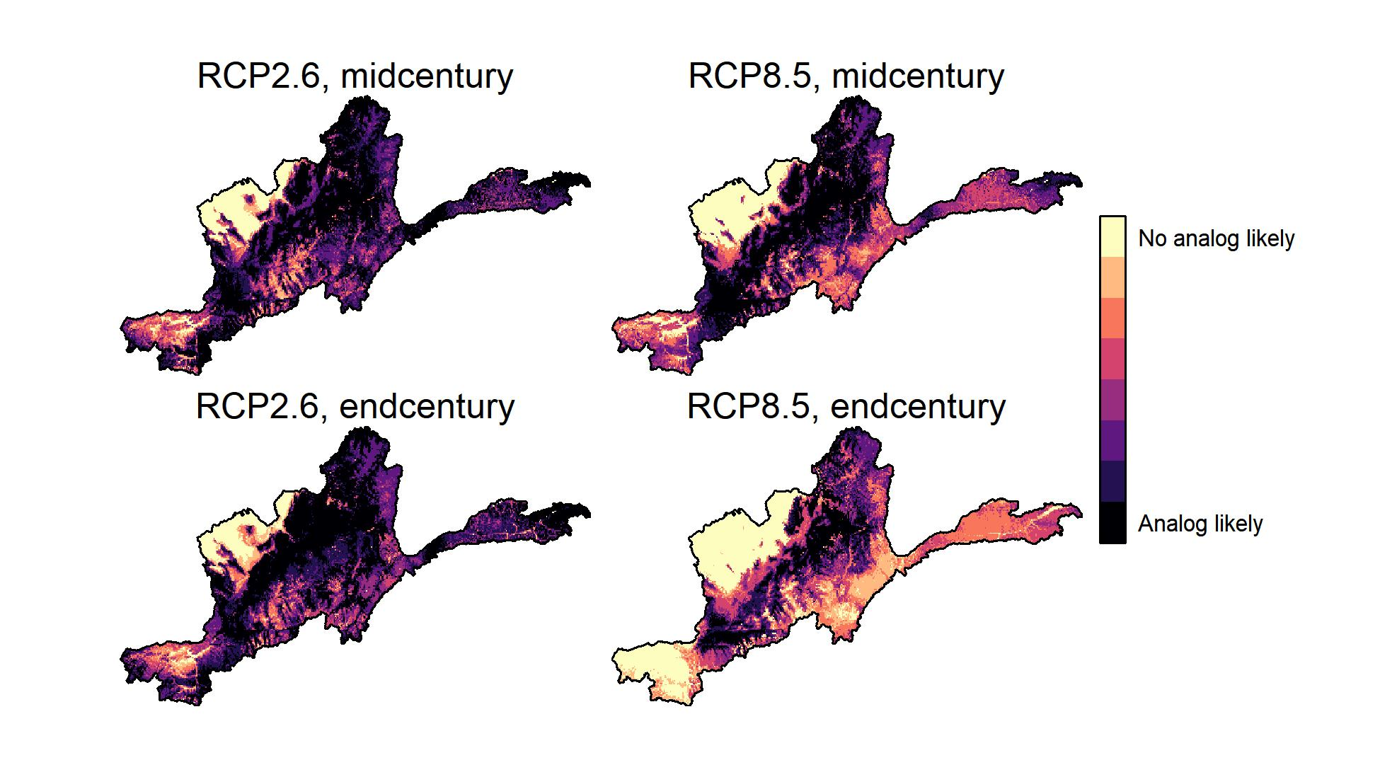
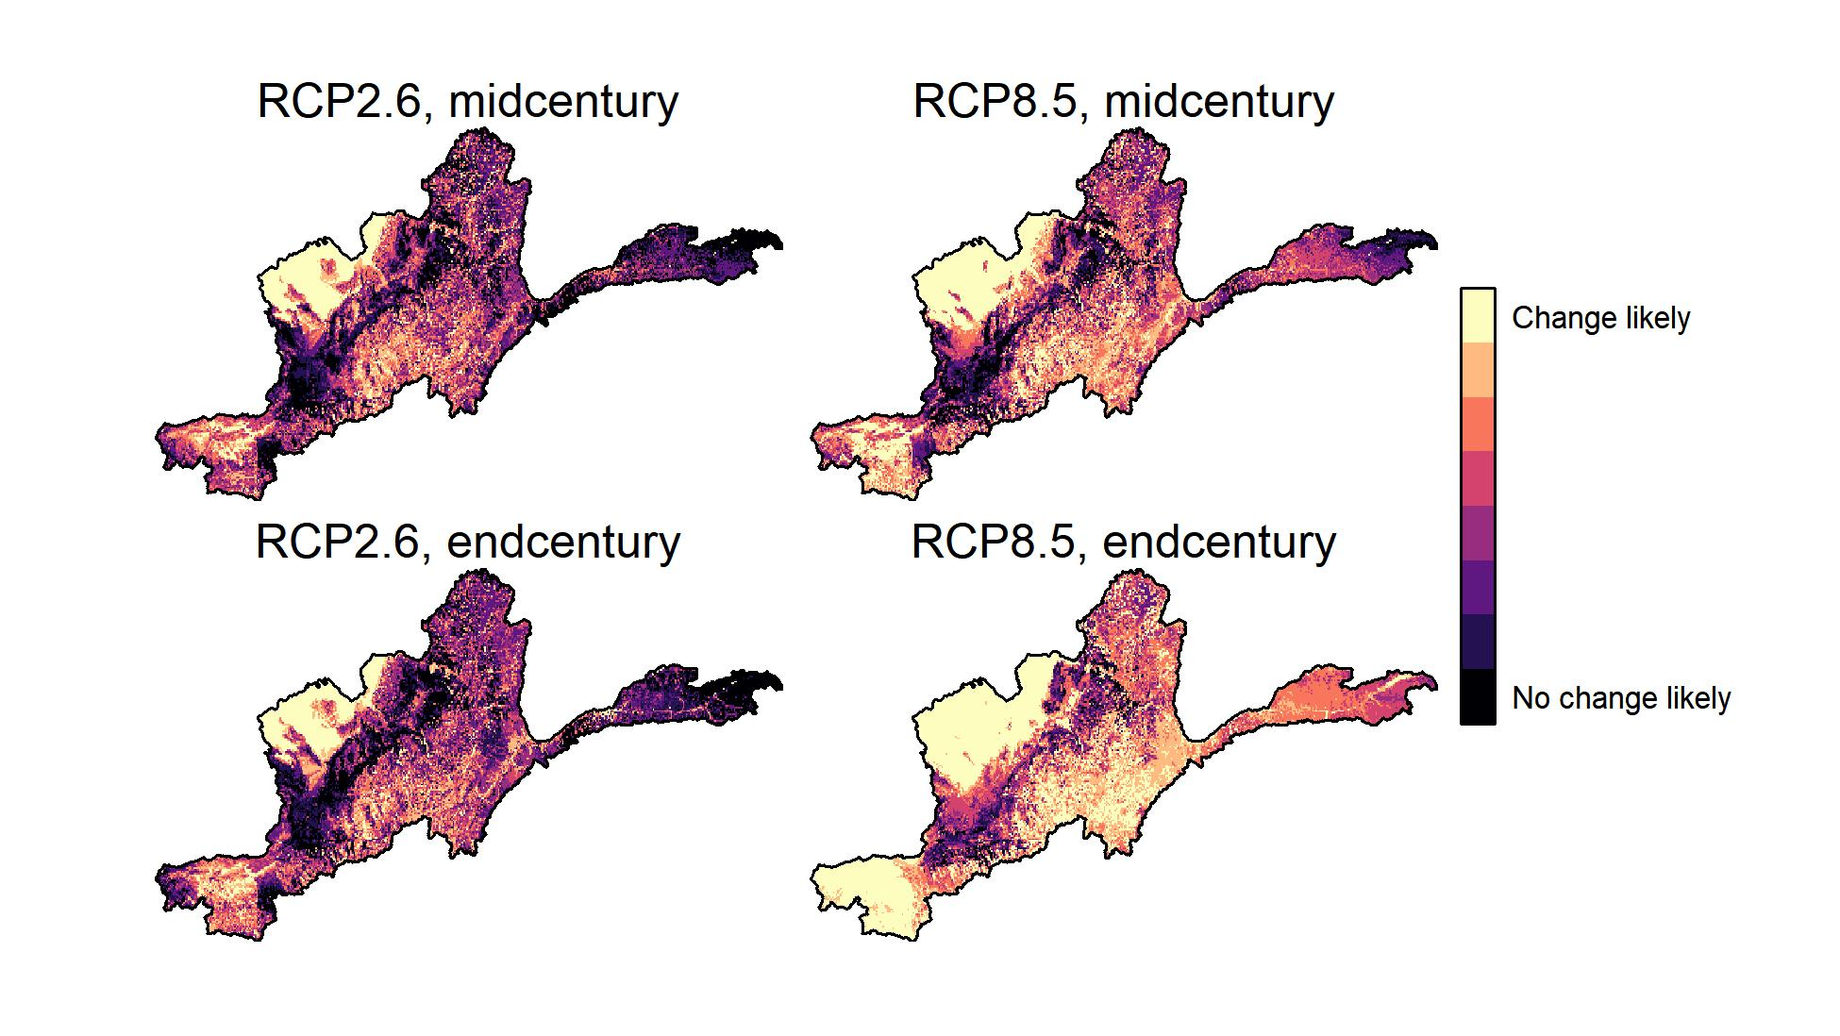
Shifts in ecoregions
Climate analogs
Biome change

Slide 25
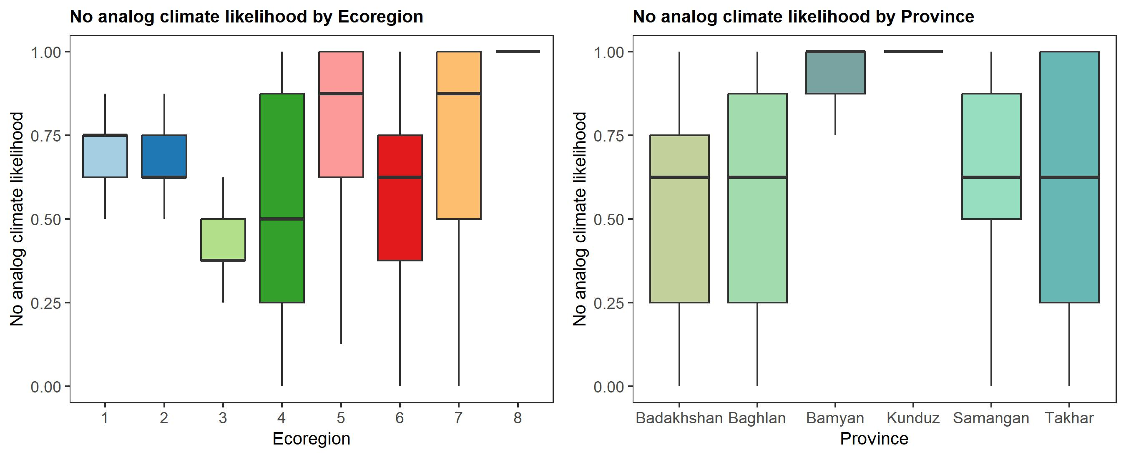
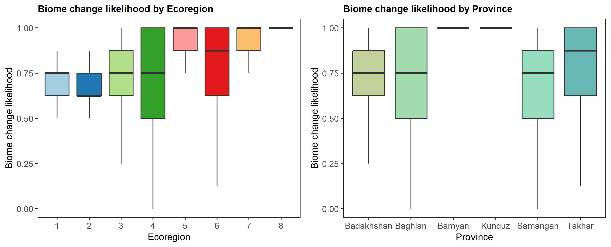
Climate analogs
Biome change

Slide 26
Thermal heterogeneity

Slide 28
Topographic heterogeneity

Slide 30
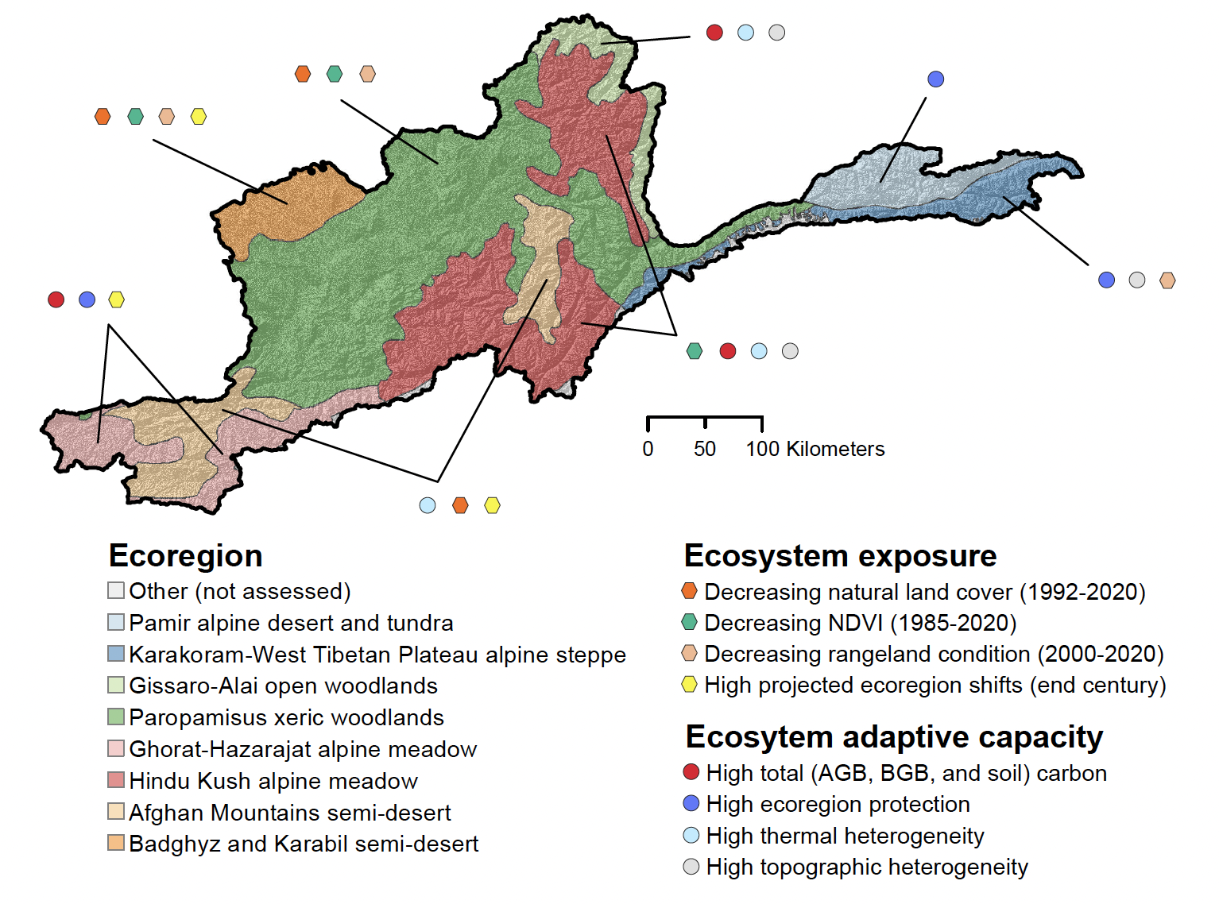
Ecosystem Vulnerability

Slide 31
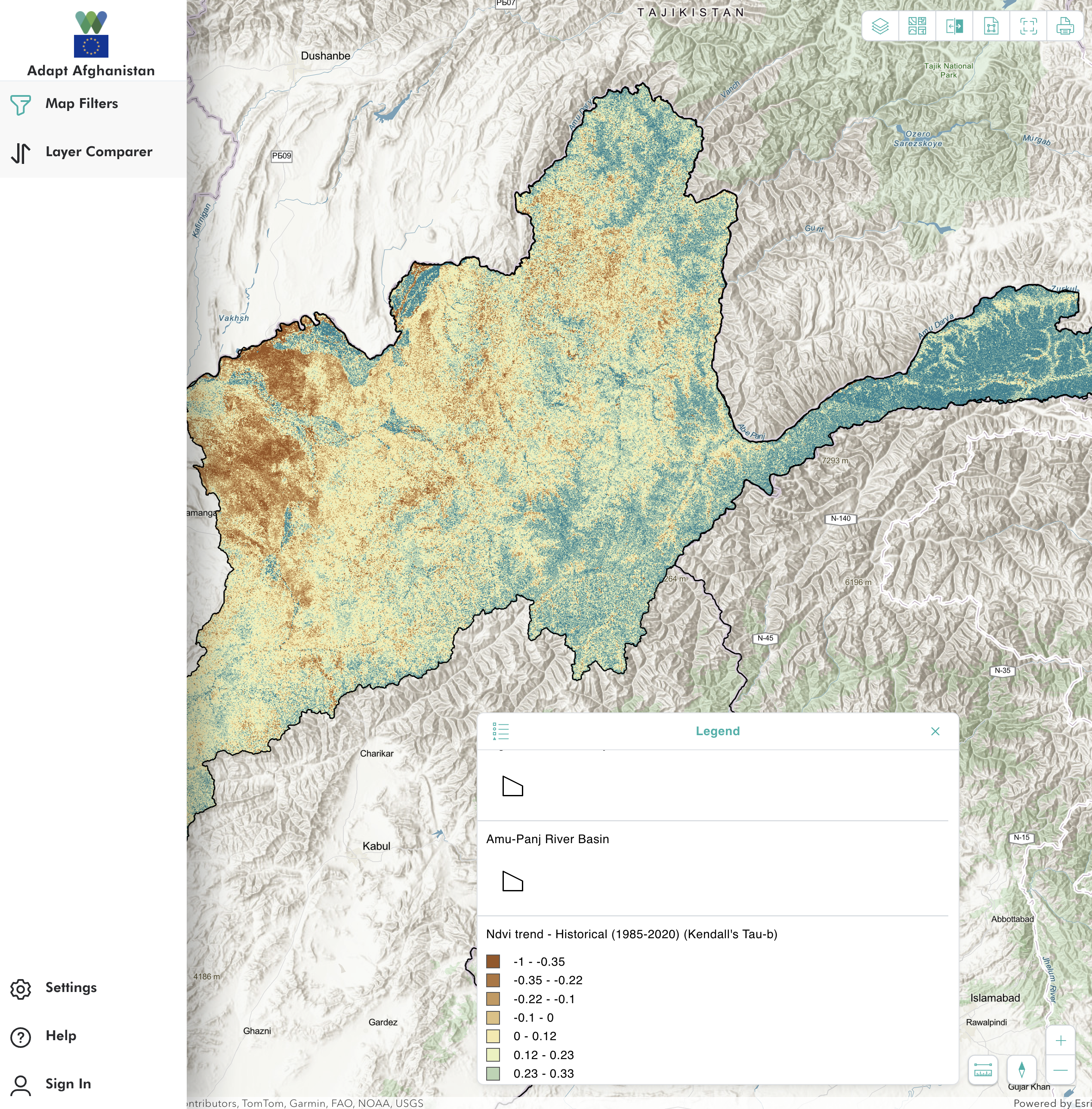
www.adaptafghanistan.com

